Slide 1

D-Day and the Battle of Normandy 80 Years On – A Brief Introduction
Royal Engineers Historical Society Battlefield Tour 2024
Mungo Melvin
Thursday, 26 September 2024

Slide 2
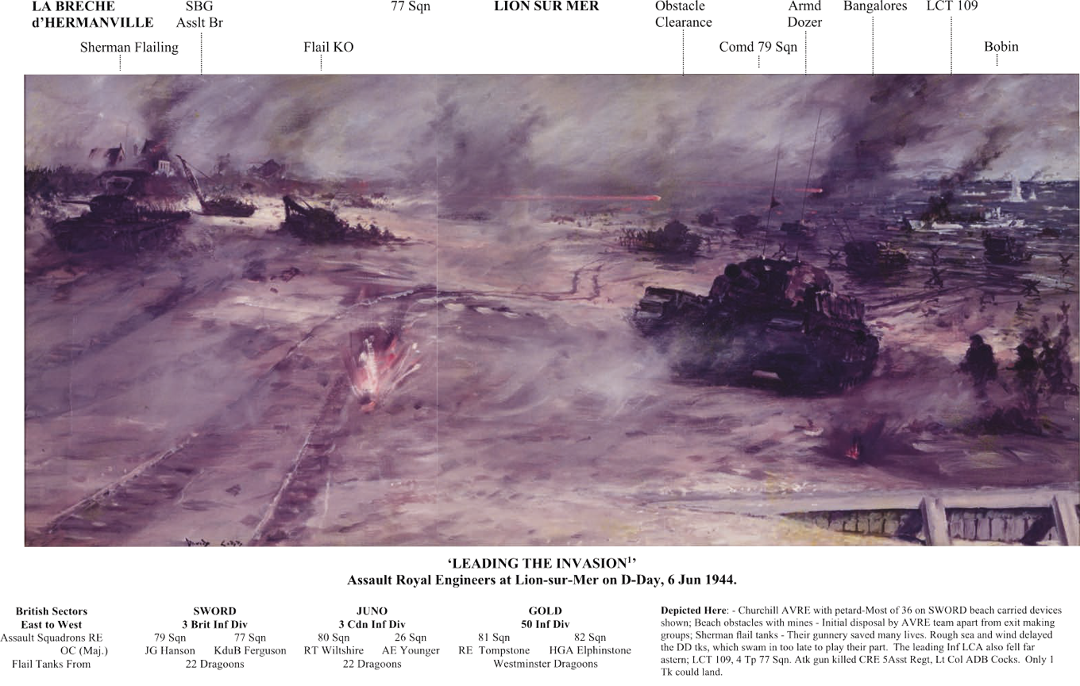
The Sapper Story

Slide 3
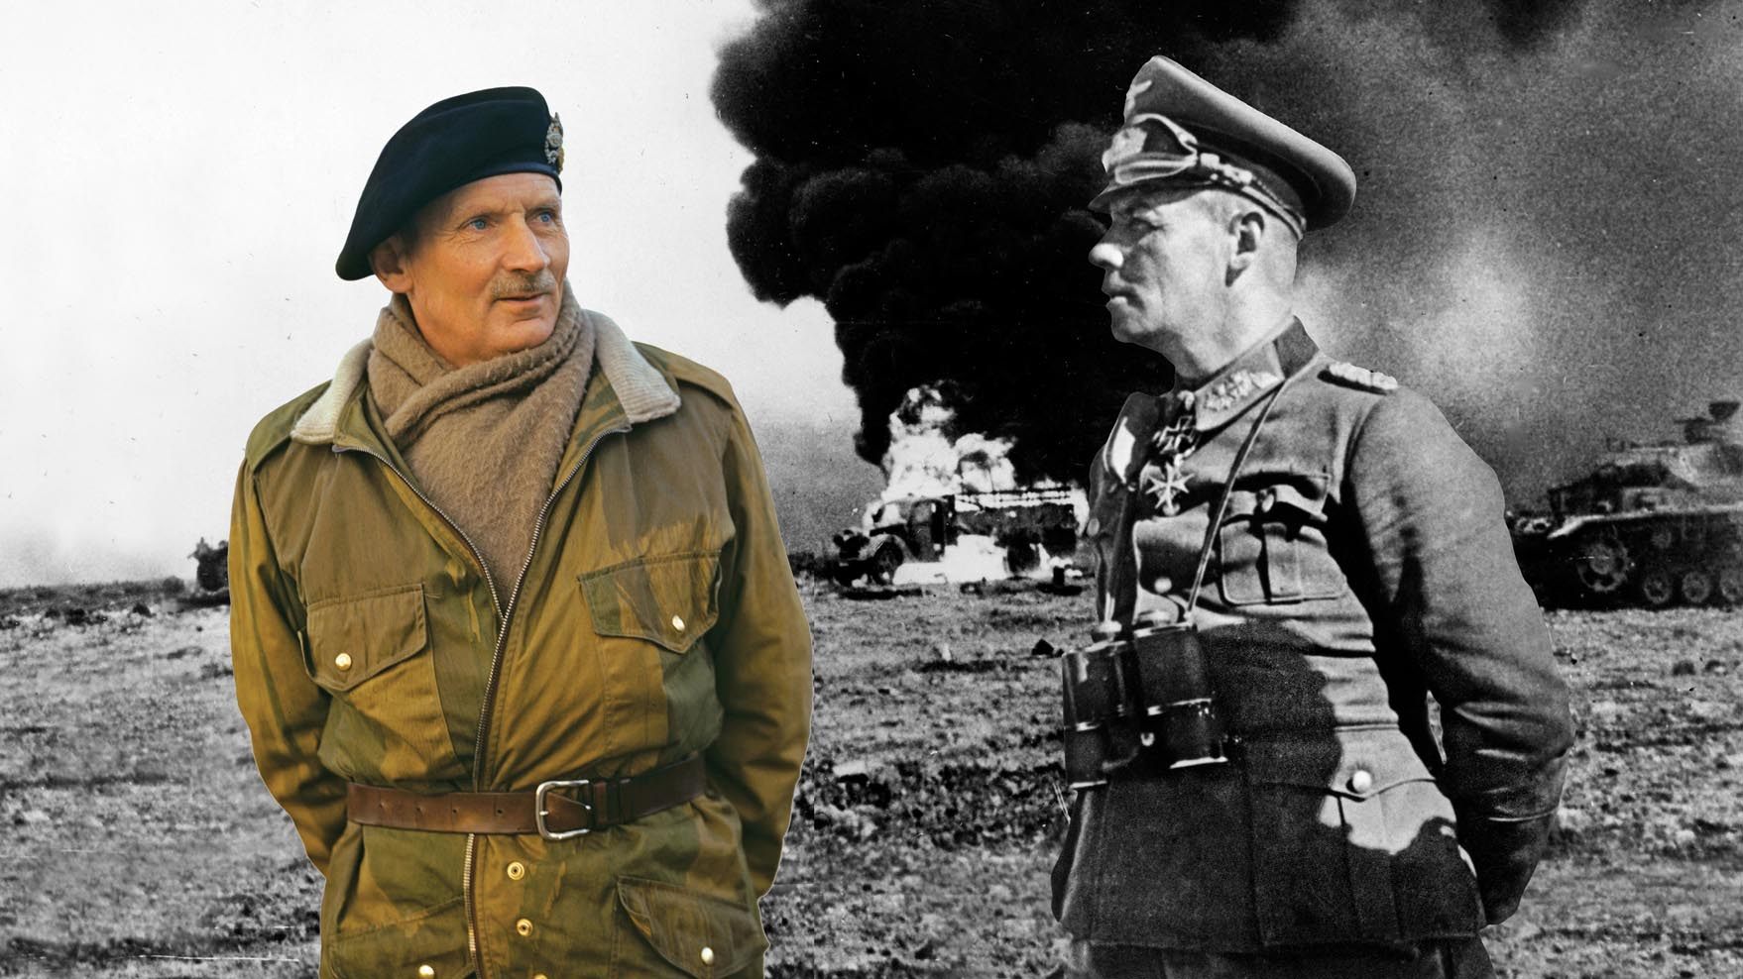


From the Western Desert to Normandy

Slide 4
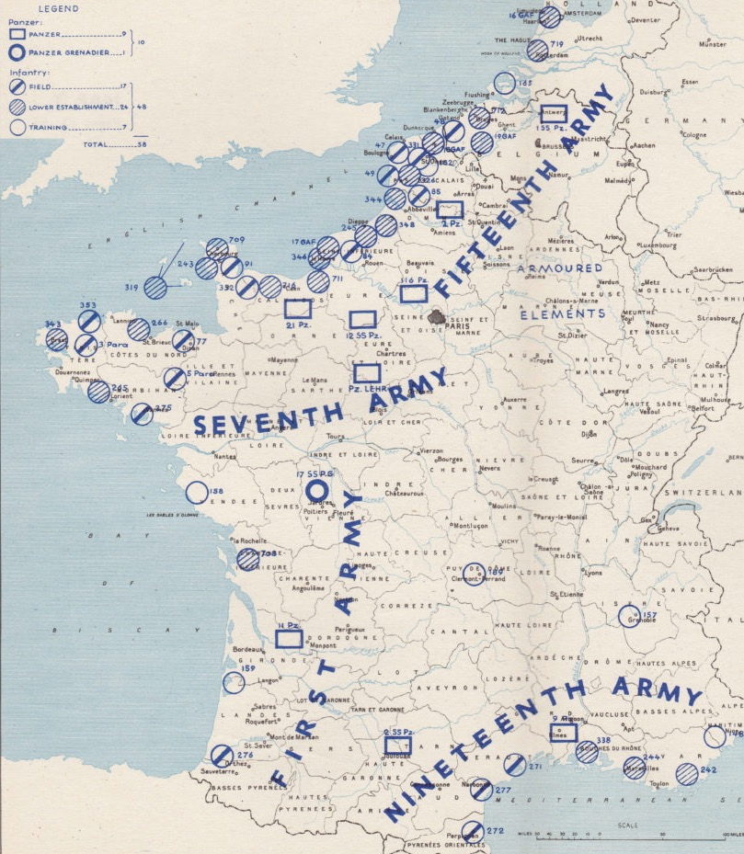
The German Army in the West

Slide 5
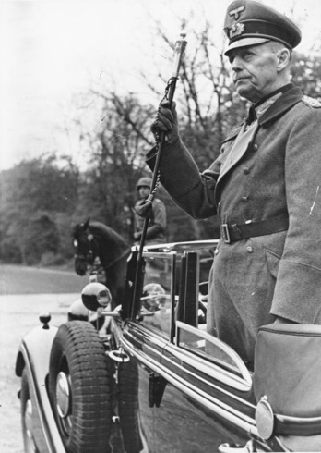
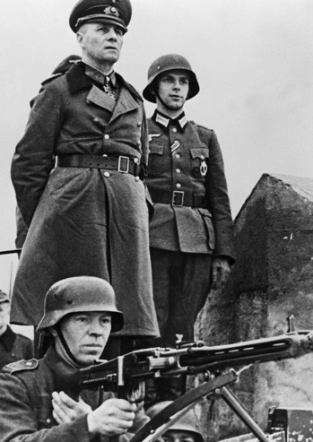
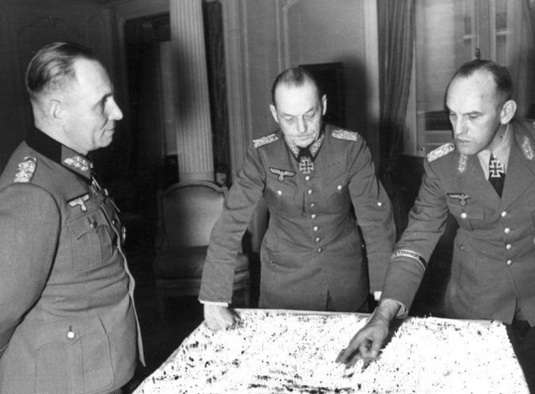
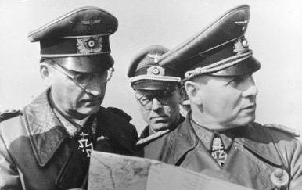
German High Command
Field Marshal
Gerd von Rundstedt
C-in-C West
Field Marshal
Erwin Rommel
C-in-C Army Gp B
Rundstedt (centre) with Rommel (left) and Lt Gen Alfred Grause (right) – Rommel’s Chief of Staff in April 1944, who was replaced by Hans Speidel (below left)

Slide 6
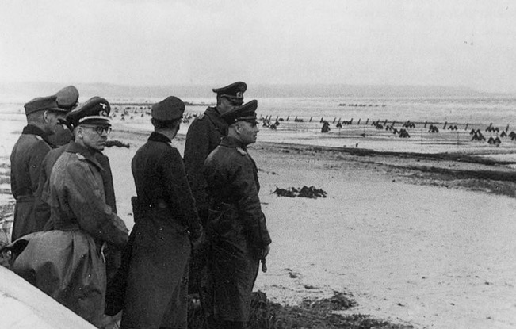
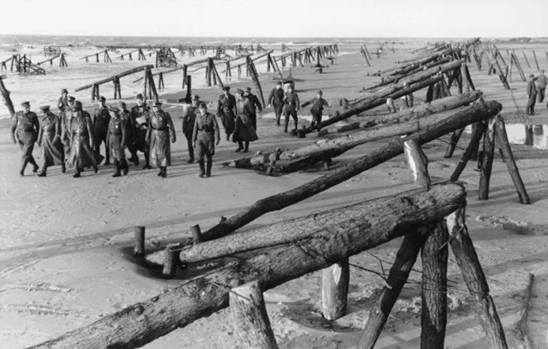
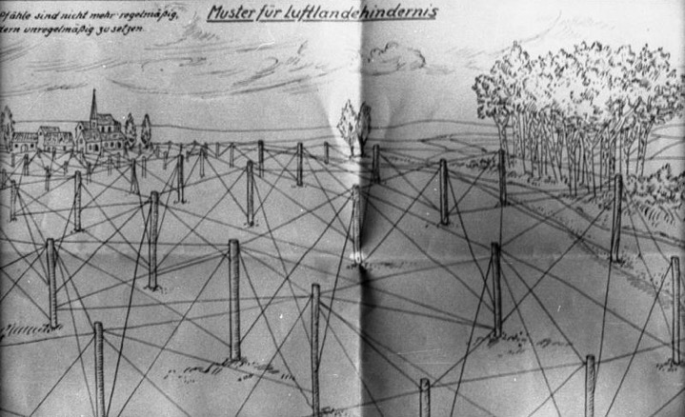
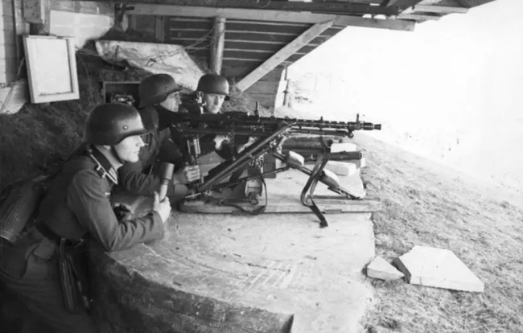
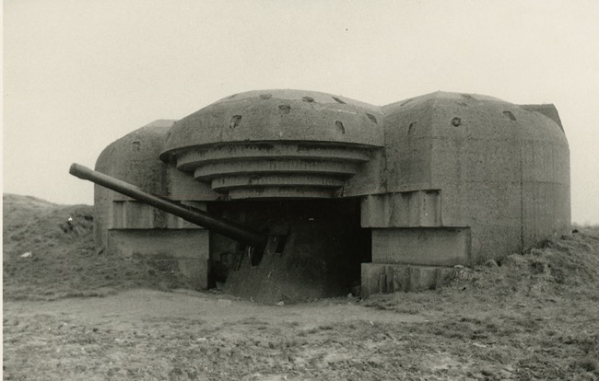
The Atlantic Wall

Slide 7
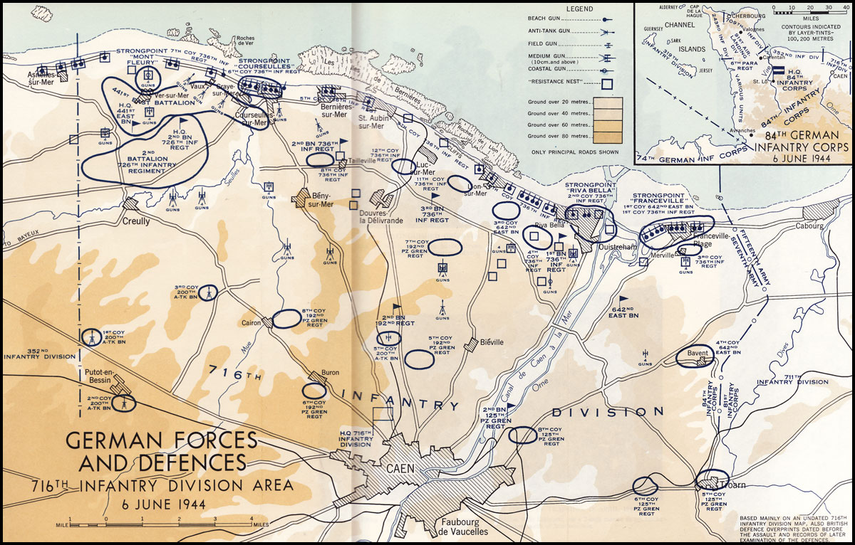
Defending Forces & Defences

Slide 8
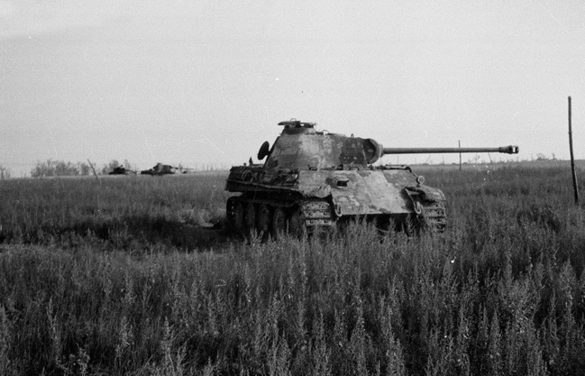
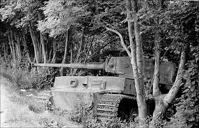
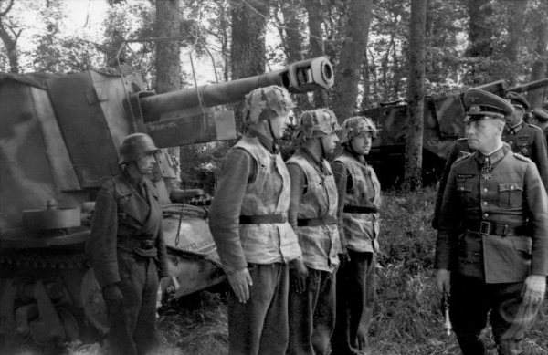
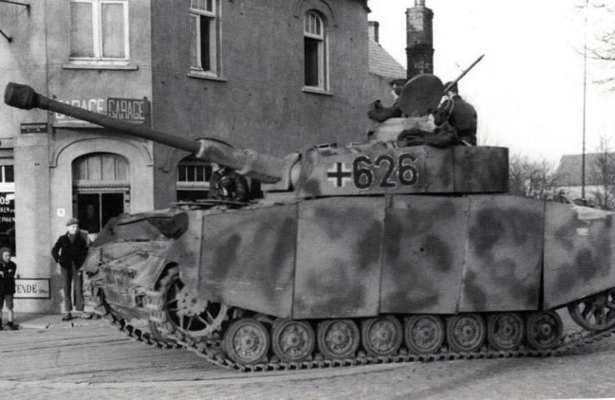
The Panzer Threat

Slide 9
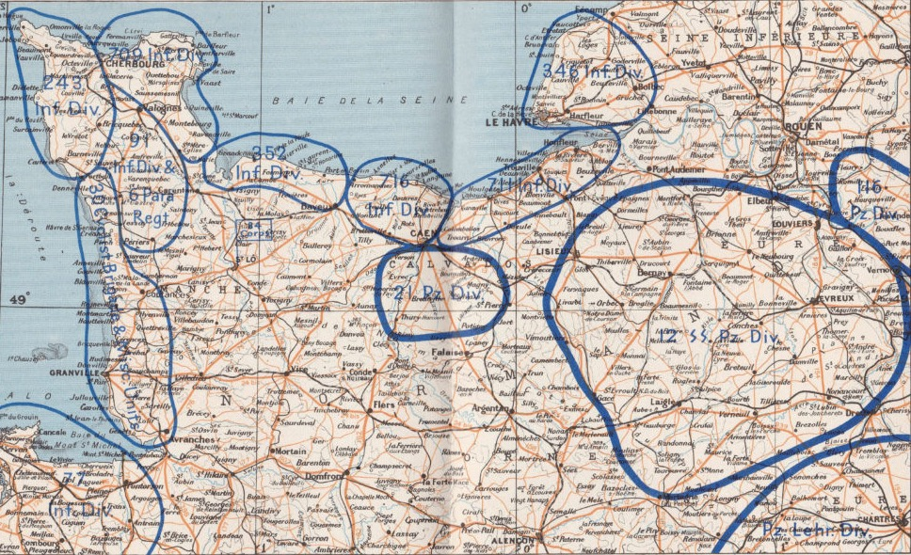



A Matter of Time and Space
21 Pz Div
12 SS Pz Div
Pz LehrDiv

Slide 10
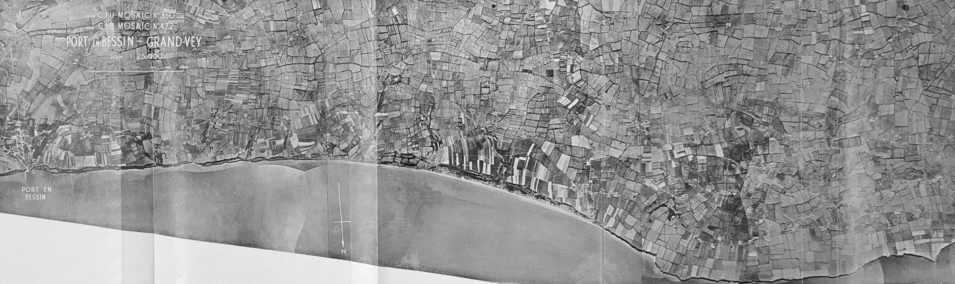
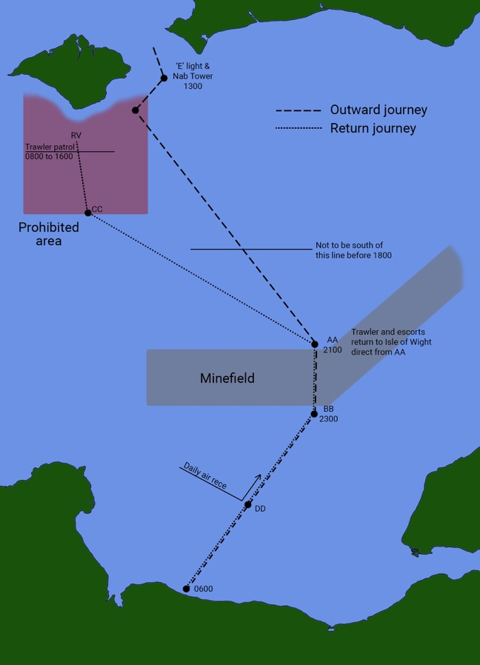
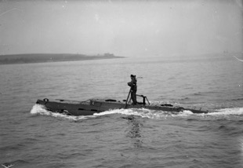
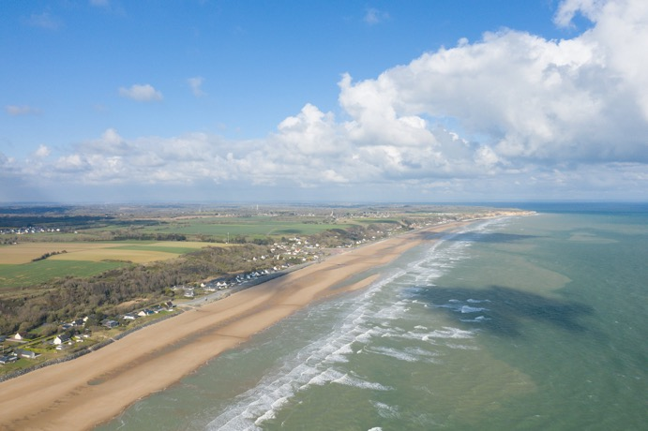
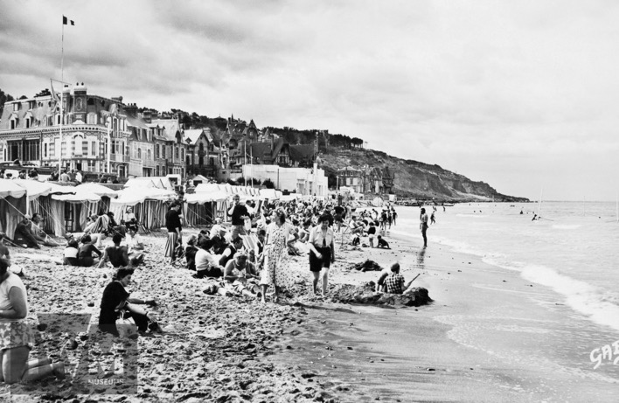
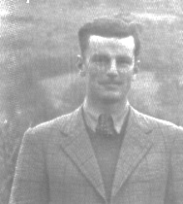
Allied Reconnaissance by Air and Sea
COPP
Operation Postage Able,
17-21 January 1944

Slide 11

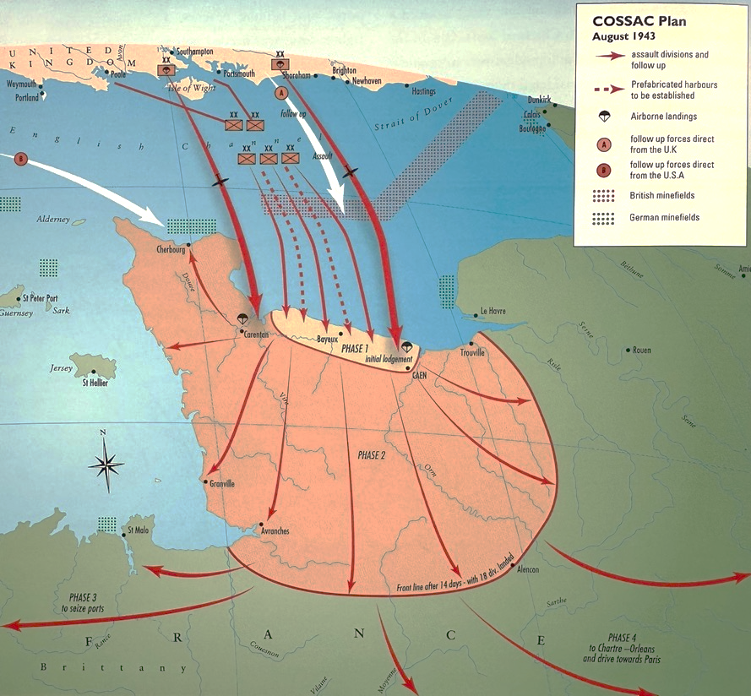
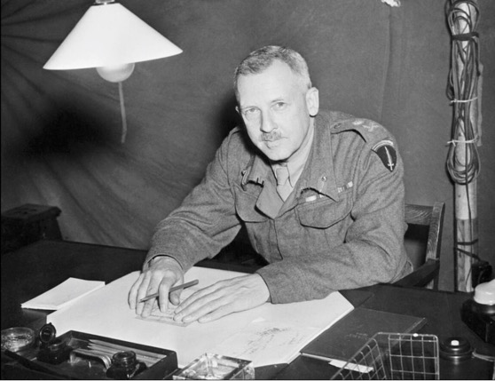
Initial Planning, 1943
Lt Gen Sir Frederick Morgan,
Chief of Staff to Supreme Allied Commander (COSSAC)

Slide 12
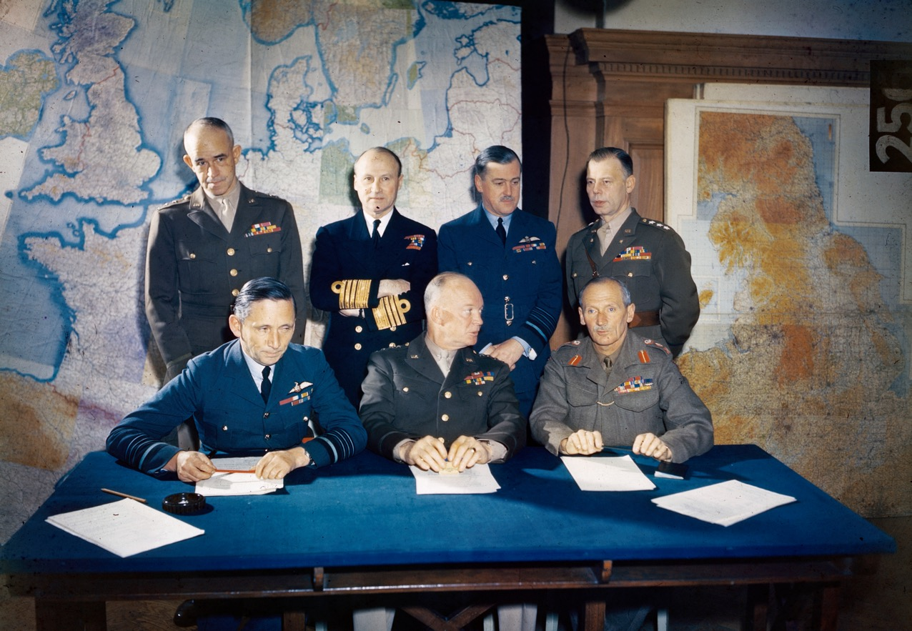
The Allied High Command, 1944

Slide 13
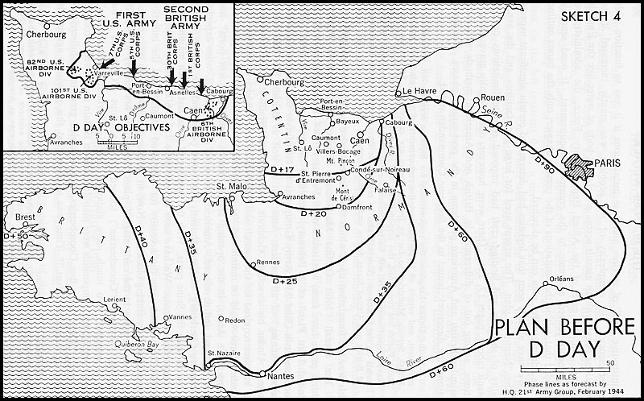
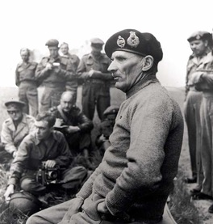
The Final Plan, 1944 (1)

Slide 14
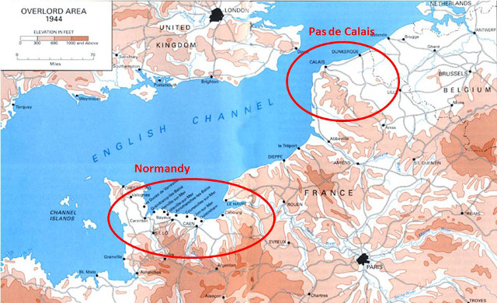
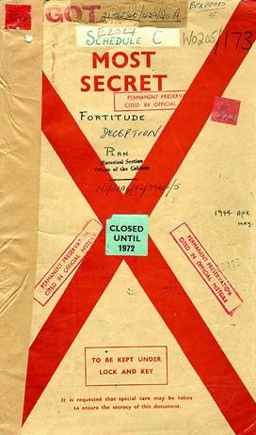
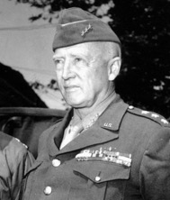

Deception – Operation Fortitude South
FUSAG

Slide 15
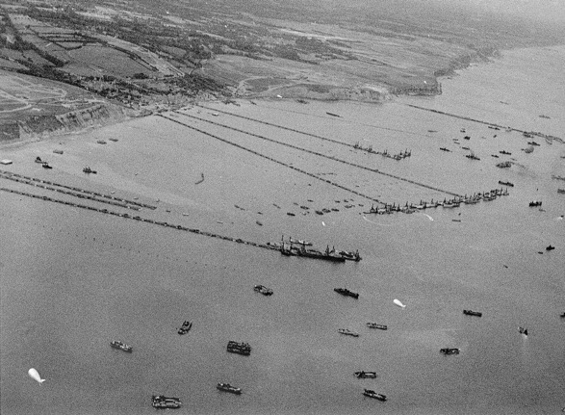
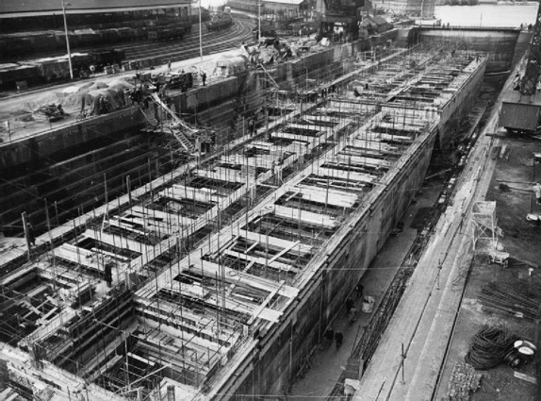
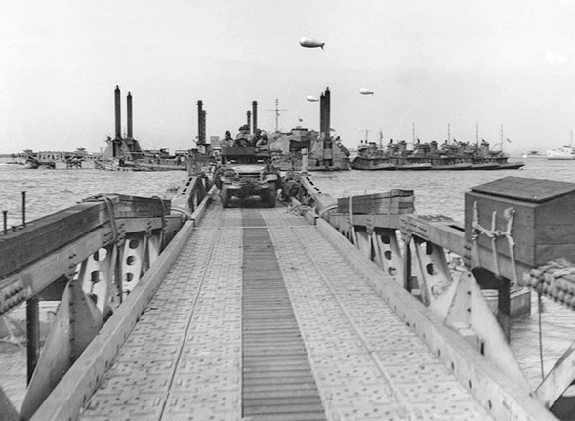
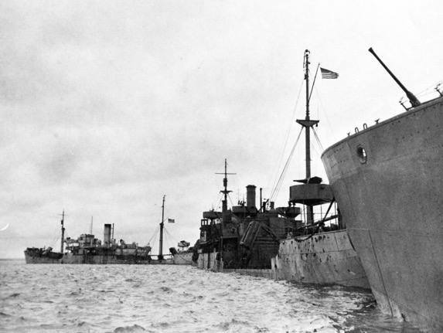
Logistics – Mulberry Harbours

Slide 16
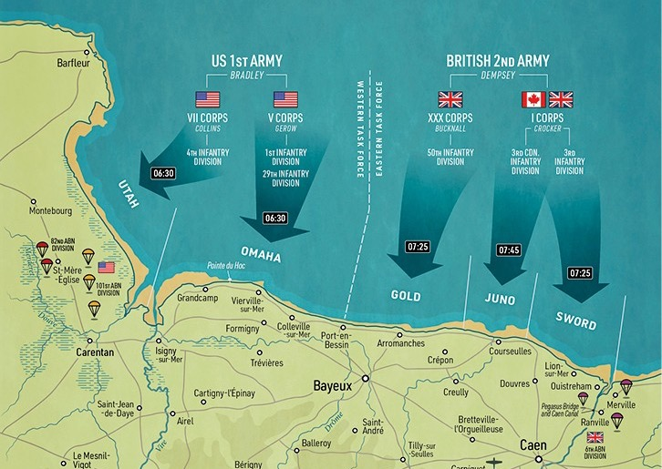
The Final Plan, 1944 (2)

Slide 17
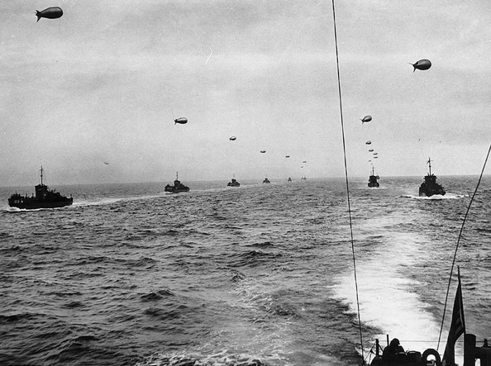
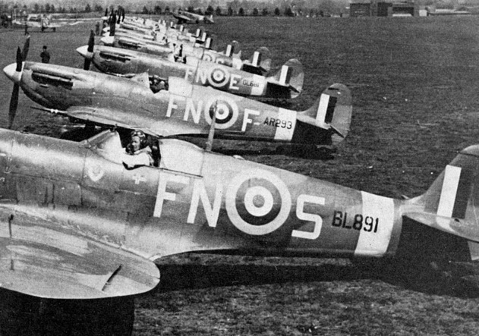
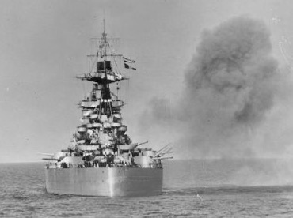
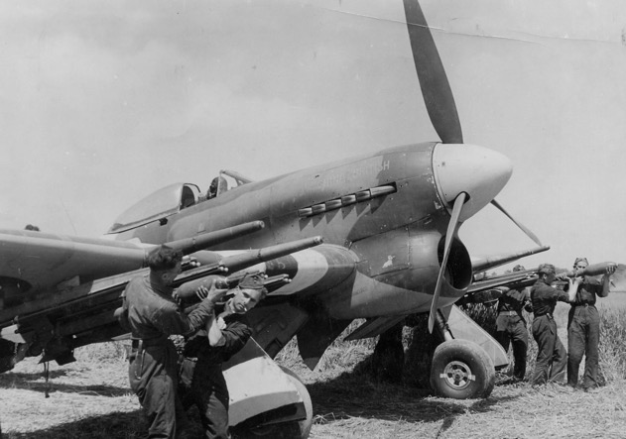
Naval and Air Forces

Slide 18















The Multinational Force
3rd US Armd Div
2nd Fr Armd Div
1st Be Bde Gp
1st Czech Armd Bde
1st Pol Armd Div
7th Br Armd Div
4th US Inf Div
29th & 1st US Inf Divs
50th Br Inf Div
3rd Can Inf Div
3rd Br Inf Div
82nd & 101st US AB Divs
6th Br AB Div

Slide 19
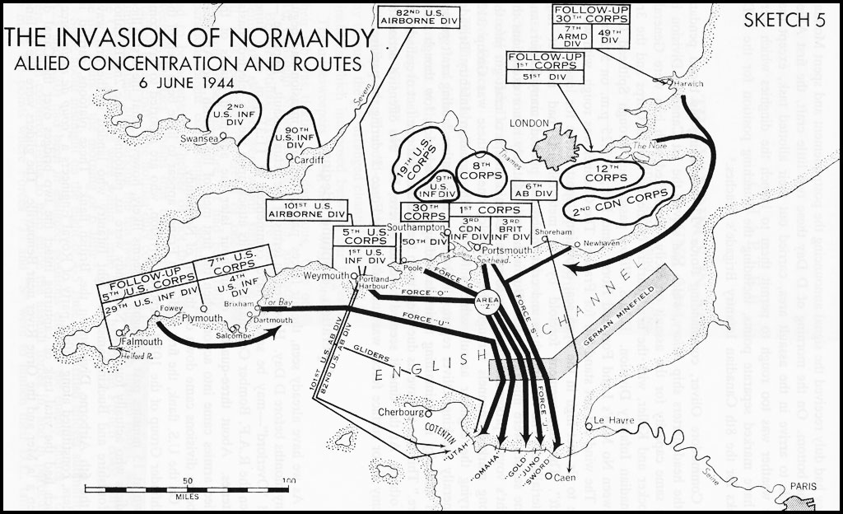
The Invasion

Slide 20
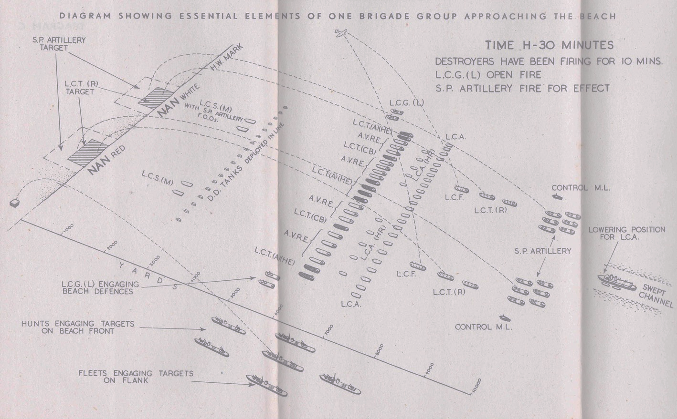
Getting Ashore – Assault Technique

Slide 21
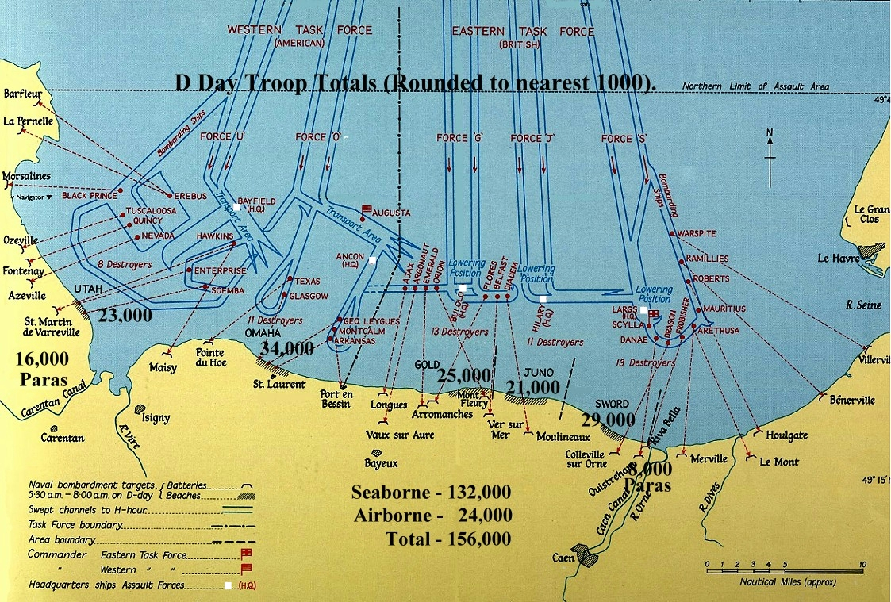
D-Day Landings by Air and Sea

Slide 22
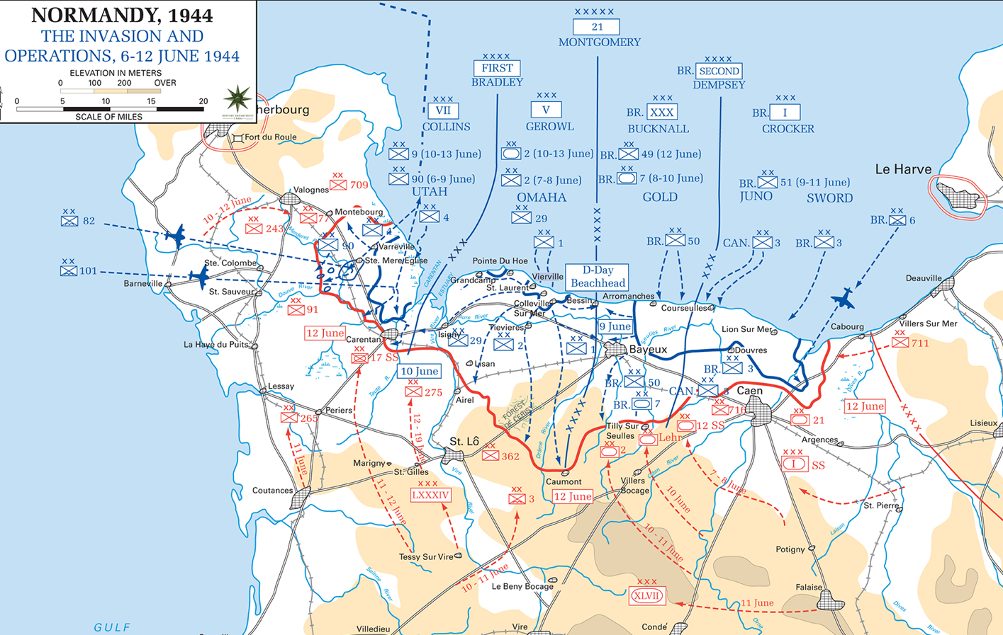
Establishing a Bridgehead

Slide 23
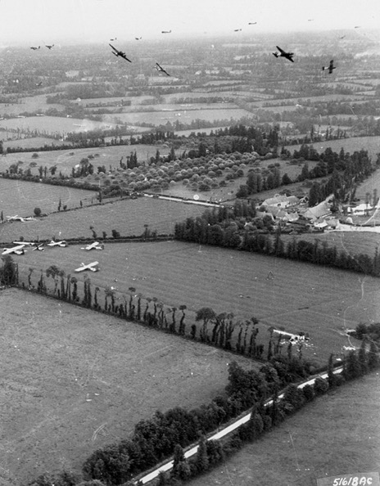
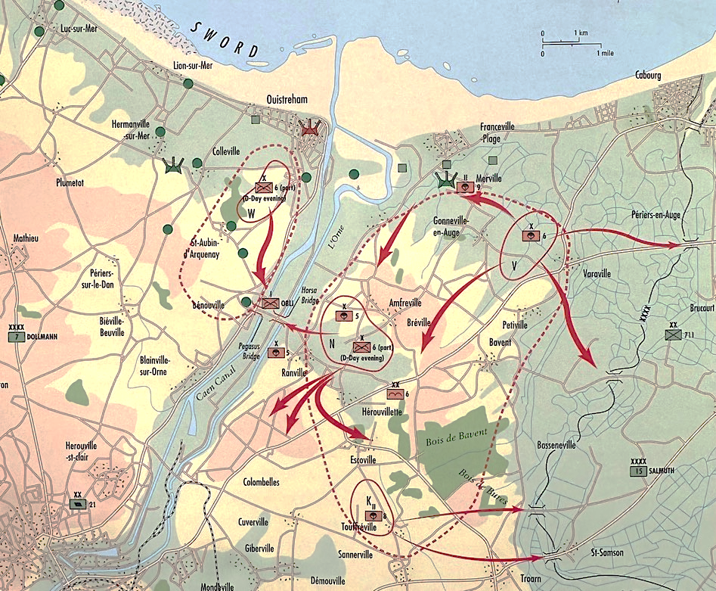
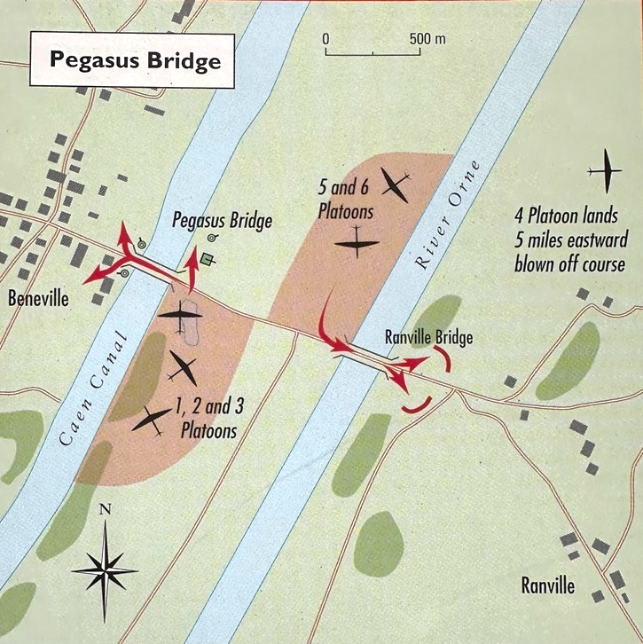
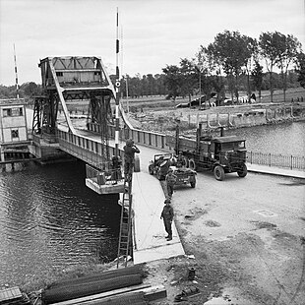
Airborne Operations on D-Day

Slide 24
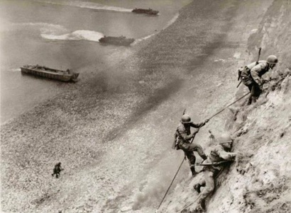




U.S. Ranger Operations on D-Day

Slide 25



Utah Beach
Brigadier-General Theodore Roosevelt Jr: ‘We'll start the war from right here!’

Slide 26


Omaha Beach

Slide 27


Gold Beach

Slide 28


Juno Beach

Slide 29


Sword Beach

Slide 30




Beyond D-Day (1)

Slide 31



Beyond D-Day (2)

Slide 32



Breakout in Normandy

Slide 33



Exploitation

Slide 34



Questions

