Slide 1

The Terrain of Italy
and the Sapper Campaign
Maj Gen John Drewienkiewicz cb CMG

Slide 2
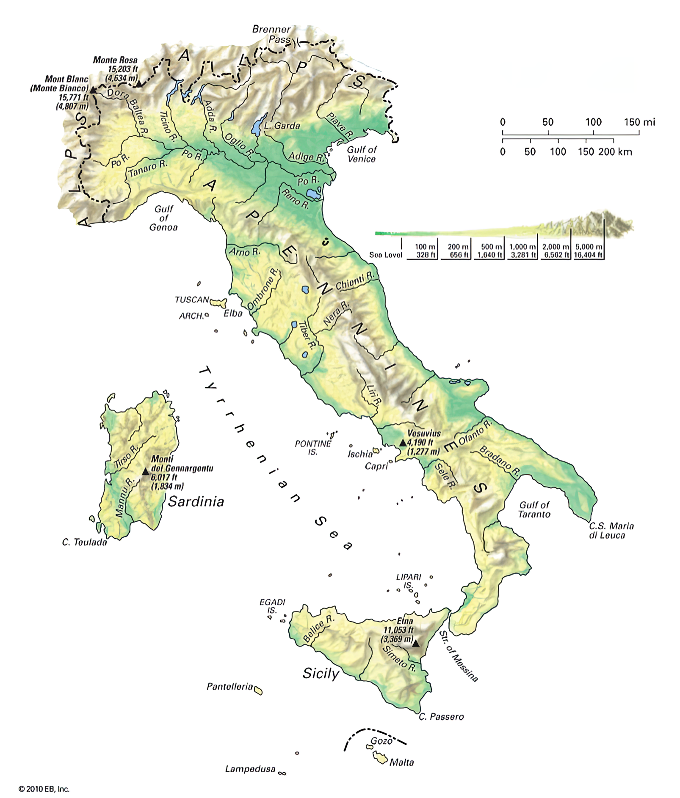
Notes:
Our study begins in September 1943 when the Allies invade southern Italy.
What was waiting for them?
While the basic geography hasn’t changed, much about Italy in 1943 was very different from today.
What hasn’t changed is that Italy was a jumble of mountains, foothills, rivers and plains, with the Alps blocking access to the rest of Europe to the north.
With twice the area of the UK, it has an extensive coastline and the Apennine mountains running down the middle.
Lots of rivers running from the mountains to the sea and narrow coastal plains.
To the north and south of the Apennines are two large plains, in the north the Po Valley and plain, about the size of Scotland. In the south is the Foggia plain, whose capture was one of the main Allied aims. Possession of Foggia would allow the Allies to bomb enemy industrial targets in Austria, southern Germany, and of course the highly strategic Rumanian oilfields at Ploesti.
The climate was variable, with harsh extremes. It rains a lot in the spring and autumn with snow, sleet and ice in the harsh producing
The population, at 42 million was slightly small than that of the UK.
The big difference from today was that the infrastructure was very poor compared with 1930s northern Europe..
Such industry as there was, was in the north, especially around Milan and Turin, having been run by the Austrians for most of the 19th Century, and living standards were relatively good there, with most living in the reasonably well in the north.
But in the south the Italians lived in agricultural squalor, with sanitation an optional extra.
Agriculture was the main industry of Italy at the time. There were very few tractors, horses and mules did the hauling and pulling.
Life was very hard and basic in the south

Slide 3
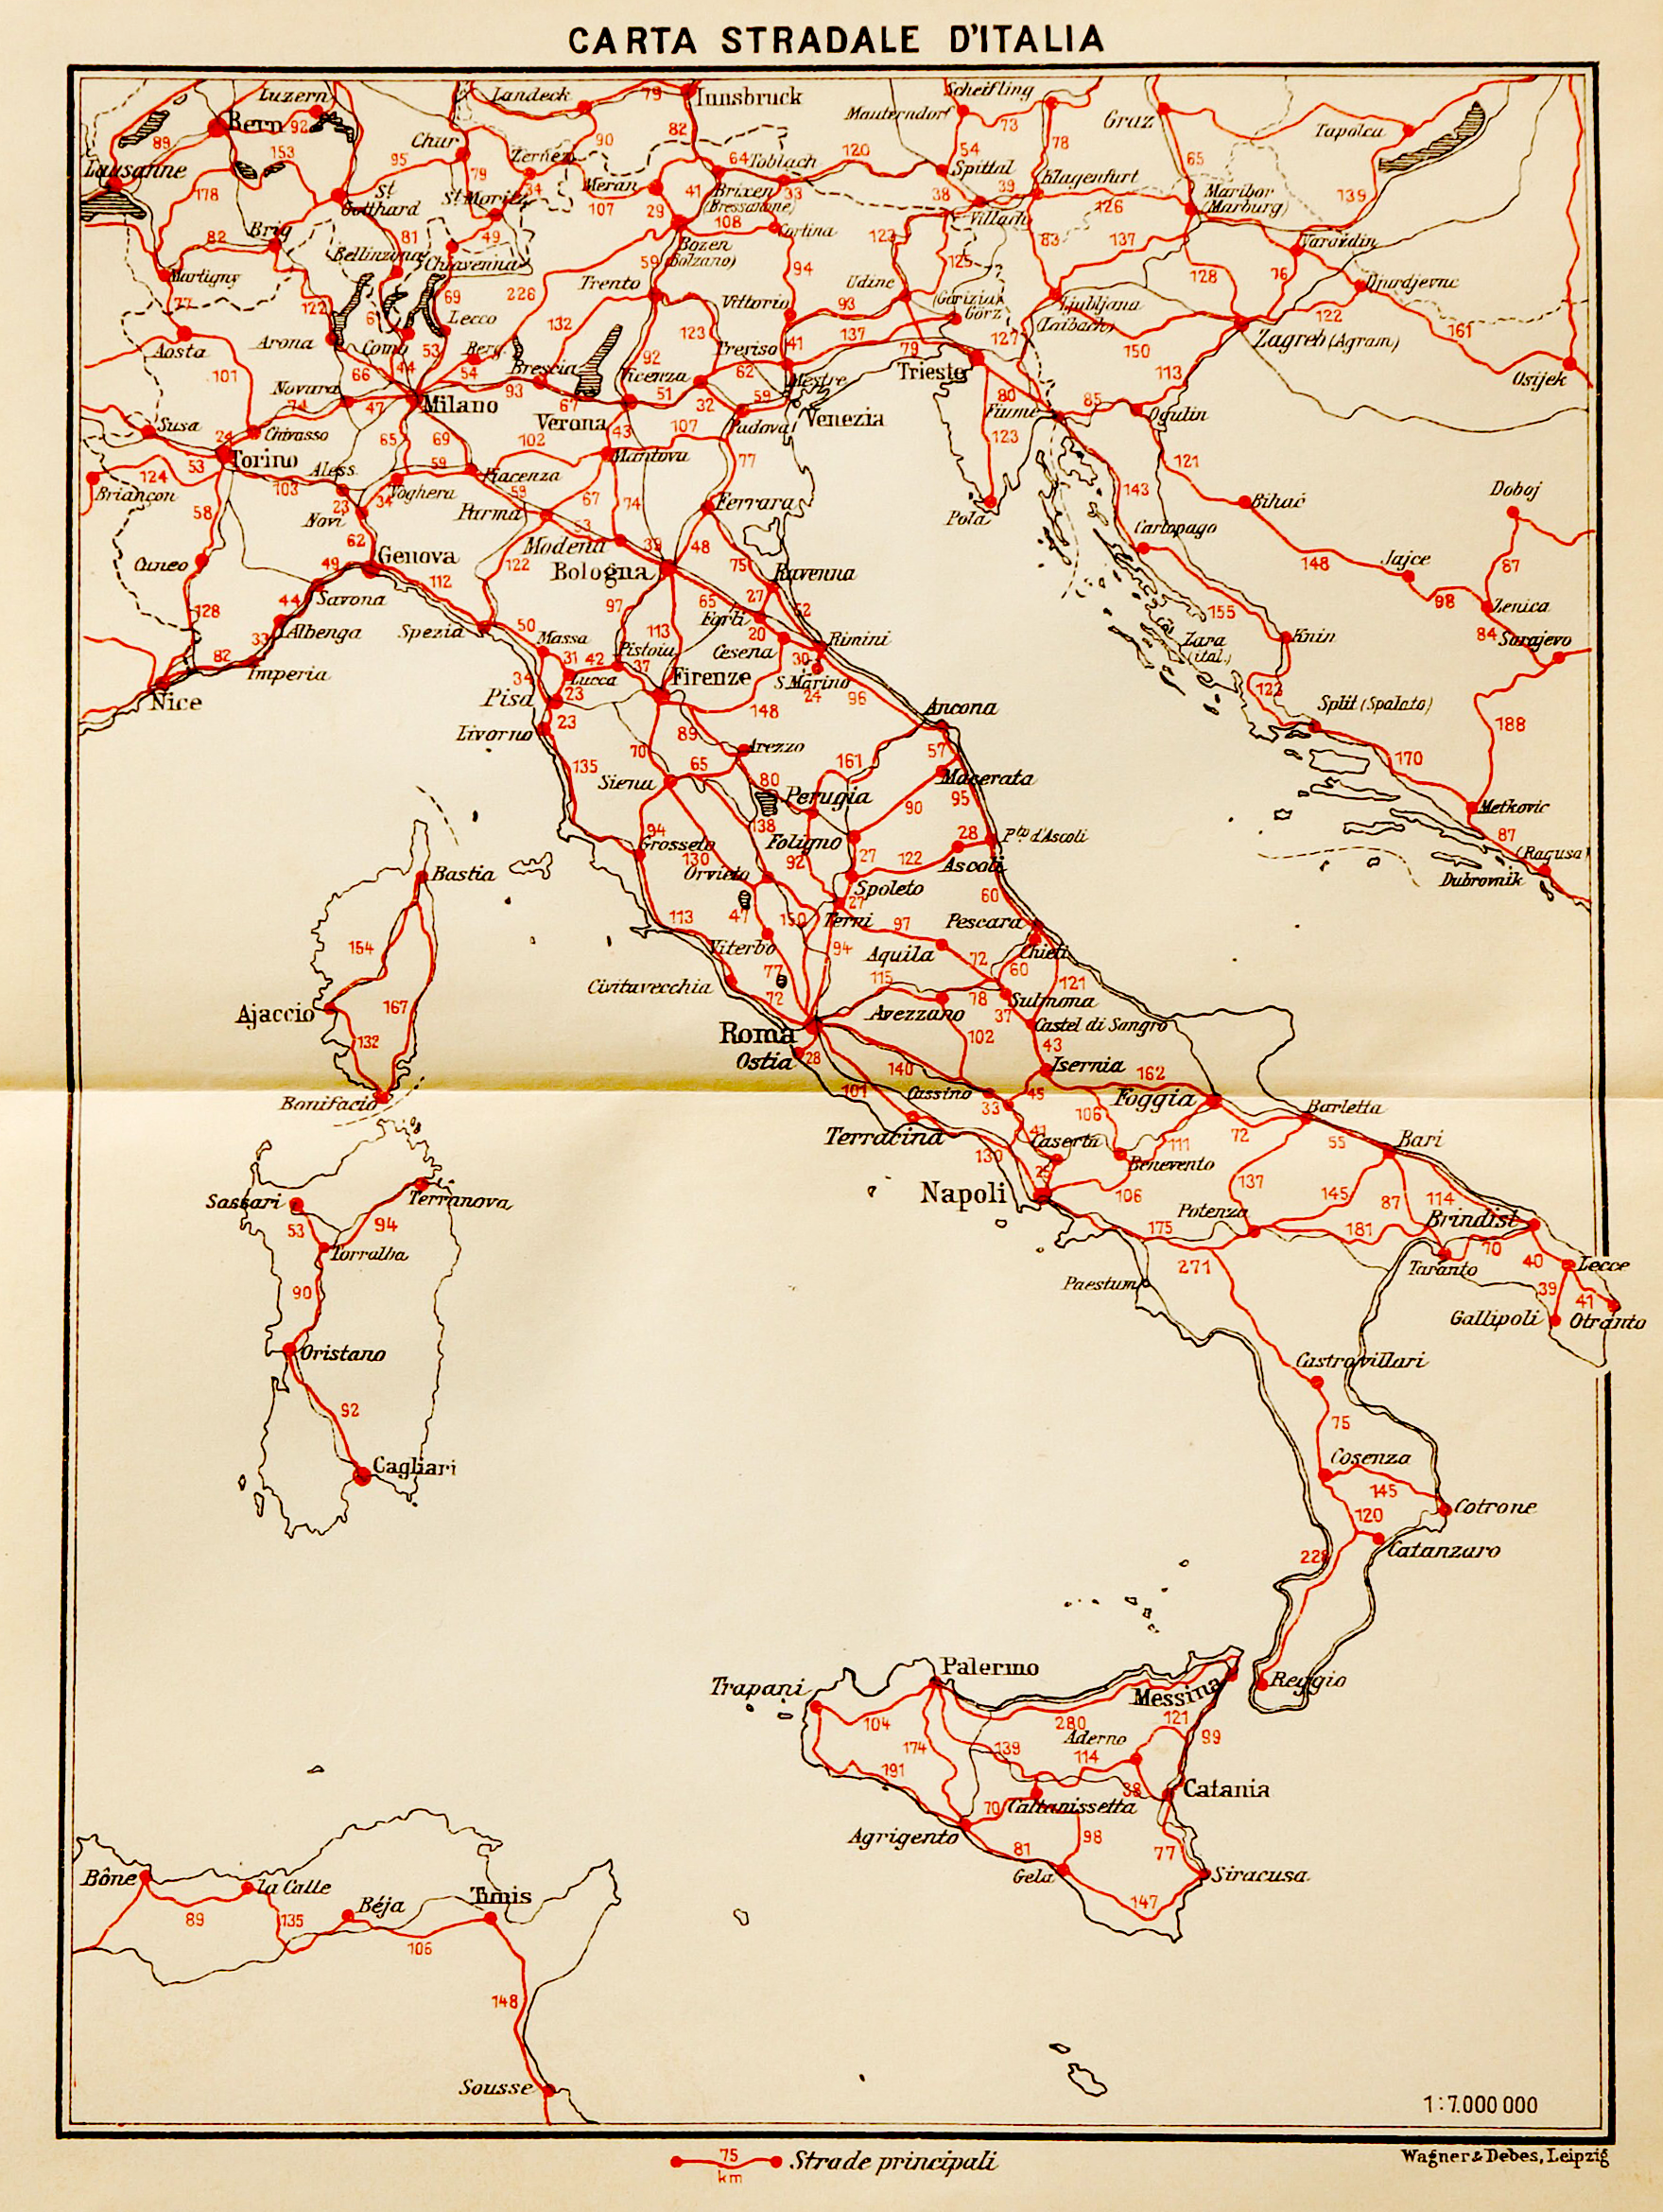
Notes:
.
As we can see, the roads in 1943 were better, and there were a lot more of them, in the north, rather than in the south.
The railways often ran alongside the roads and again they were much better in the north.
Ports were few and far between, and of limited capacity. The only major port in the south was Naples, which handlds 9% of Italy’s prewar maritime trade.
It was thus very important to take Naples quickly and to get it operating at full capacity to supply the Allies.
Given the scarcity of roads in the south, it can be argued that the Allies arrived with more vehicles than the road system could cope with.
Formations such as the French and the Indians, who were used to operating in mountainous terrain, and who were familiar with pack animals, found the mountains less formidable.
For the record, it must be recalled that the British did have 52 Lowland Division which wasorganised for mountain warfare. But it was kept in the UK, to be used in Norway,
Eventually, in the autumn of 1944, it was used at Walcheren, in the Netherlands, mainly below sea level!

Slide 4
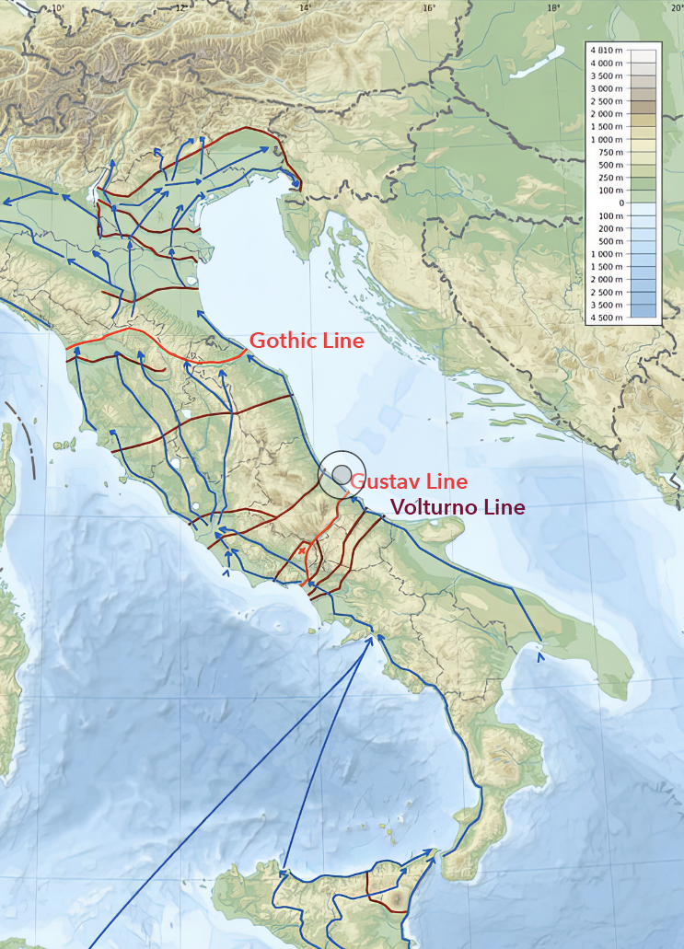
Notes:
To quote from Notes from the Theatre of War:
The Germans’ great advantage has been that they have been able to fall back to chosen defensive positions in very suitable ground,
delaying our mechanized army with demolitions and mines in a country of mountains and rivers, where roads are scarce..

Slide 5
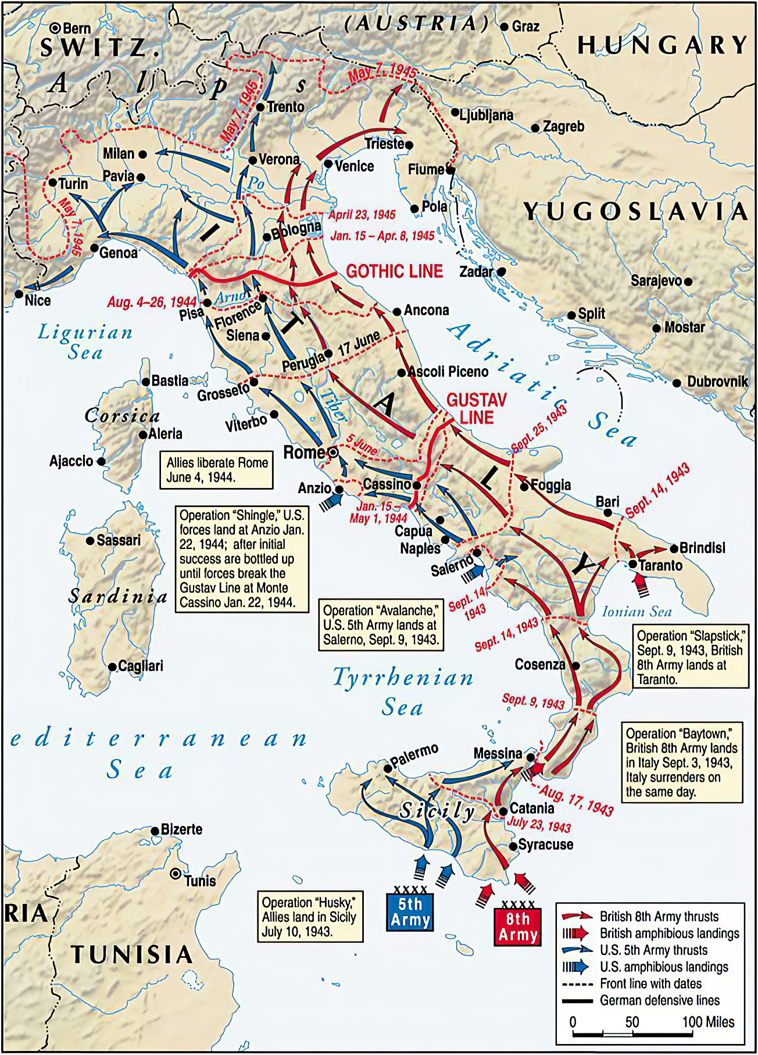
Notes:
Here is the campaign in its entirety.
After a relatively successful amphibious landing, Sicily was taken in 6 weeks of hard fighting by the Americans, British and Canadians.
Southern Italian Ports were sized quickly within 3 weeks and Operation Avalanche delivered the US 5th Army to Salerno with two British Divisions on 9th September 1943, but it then took 20 months of hard fighting to get all the way up Italy.
We will start our detailed study from the Salerno landings.
The themes will then be:
Learning and improvising on the Volturno
Confident and innovative use of new equipment at Cassino
Operating under armour up to the Po
Restoring and creating infrastructure

Slide 6
The Allied Aims of the
Italian Campaign
To begin the Invasion and Liberation of Europe
To take pressure off Russia
To divert Axis Forces from the Russian Front
To pin down Axis Forces that might intervene in France
Notes:
First let us remind ourselves of the The Allied Aims of the Italian Campaign
They were are shown here:
To begin the Invasion and Liberation of Europe
To take pressure off Russia
To divert Axis Forces from the Russian Front
To pin down Axis Forces that might intervene in France

Slide 7
The Aims of the Italian Campaign
Allied Aims
To begin the Invasion and Liberation of Europe
To take pressure off Russia
To divert Axis Forces from the Russian Front
To pin down Axis Forces that might intervene in France
But German Aims:
To defeat or at worst to pin down Allied Forces that might intervene elsewhere
To continue to exploit Italian resources for the Axis
Notes:
With the German aims, as agreed between Kesselring and Hitler.
It can be argued that both sets of aims were achieved successfully

Slide 8
The Weather
Persistent cloud, torrential rain, widespread flooding and ubiquitous mud in the autumn of both 1943 and 1944 hindered observation, artillery support, air support and movement. They damaged or destroyed infrastructure such as roads and bridges and undermined morale.
In the summer, Italy is hot and there are malarial areas …
Heavy rain in the autumn of 1943 impeded operations on the east coast and at Cassino in Feb and Mar 1944. Snow and ice interrupted road movement over wide areas in the winter and mud seriously influenced tactics and administration in the mountains.
Linklater The Campaign in Italy p 402
Notes:
The weather was a recurring theme. Even the Yeomanry mentioned it more in their war diaries than they mentioned playing cricket.

Slide 9
Notes:
Mud and mines appeared to be a lethal combination.

Slide 10
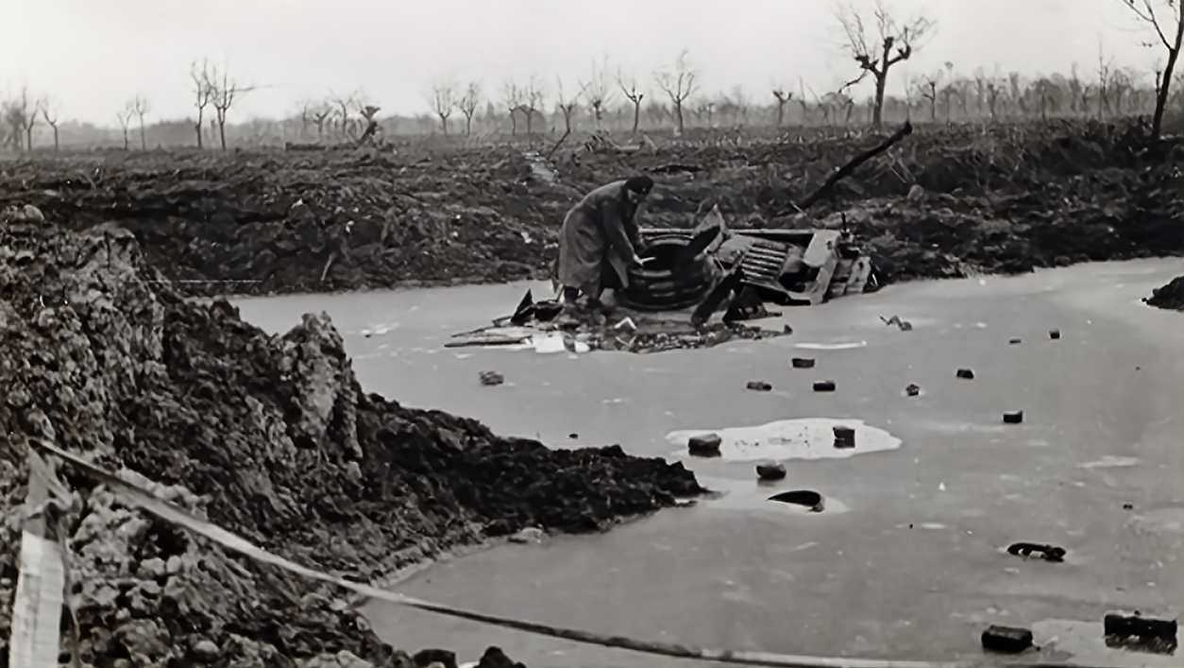
Notes:
This appears to be a Crusader tank.

Slide 11
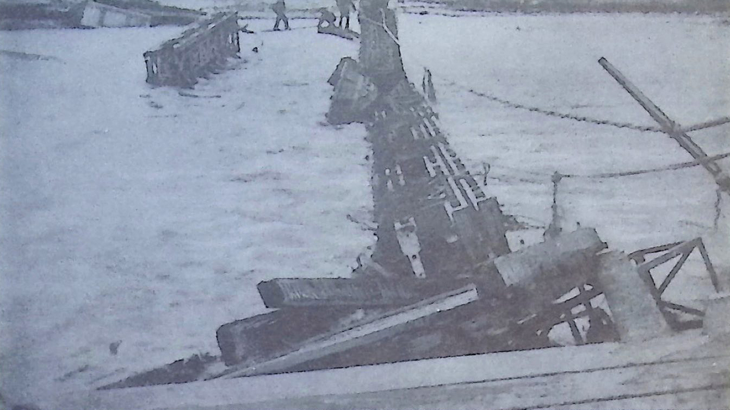
Notes:
This is what happened to bridges that didn’t allow for rapid rises in the water level.
Effects of the Sangro spate of 4th December 1943

Slide 12
An Engineering Challenge of
the first order (1)
Anybody who knows Italy or studies a map of Italy will appreciate how great were the engineering problems that would be encountered due to the physical configuration of the country. There are comparatively few good tarmac roads leading northwards through Italy.
On the east coast there is virtually only one road. This crosses innumerable watercourses which are liable in winter to big spates. West of the Central Apennines there are two main roads leading north from Naples to Rome, thence there are four roads, converging into three roads before Florence is reached.
Notes:
Rather stilted language by Maj Gen Coxwell-Rogers, but the sentiment is clear.

Slide 13
An Engineering Challenge of
the first order (2)
Many parts of these roads are tortuous with steep gradients and untarred stretches. They all cross many mountain streams, watercourses and occasional ravines. Good lateral roads are few and all go over high mountain passes.
The main rivers west of the Apennines between Naples and Florence are the Volturno (350 ft), the Garigliano (350 ft), the Tiber (600 ft) and the Arno (450 ft), all perennial rivers with high banks. There are a countless number of smaller rivers from 80 to 250 ft in width.
Maj Gen NA Coxwell-Rogers, Engineers in the Italian Campaign, 1946, Introduction

Slide 14
How many Sappers were involved?
Total numbers of Field Engineer Companies in Italy 1943-1945, excluding US, French, Brazilian
 | Fd Coys | Fd Park Coys | Works & Artisan | Road Const | Mech Eqpt | Other
British | 76 | 18 | 32 | 8 | 16 | 16
Indian | 16 | 5 | 2 | nil | nil | nil
South African | 7 | 2 | 1 | 3 | nil | 1
Canadian | 8 | 3 | nil | nil | nil | 1
Polish | 11 | 4 | nil | nil | nil | nil
New Zealand | 3 | 1 | nil | nil | 1 | 2
Palestine & Levant | 1 | nil | 4 | 1 | nil | nil
Total | 122 | 33 | 39 | 12 | 17 | 20
Total 243 Engineer Companies, assuming average strength of 220= 53,500
Notes:
The numbers of Sappers involved is difficult to count. This is the total extracted from Engineers in Italy, not counting the Americans, French and Brazilians.
Not all were in Italy all the time, with some divisions being extracted to train for D Day, and then some American and all the French leaving for southern France, and then the Canadians all being off to France when it was decided to group all the Canadians together. But it is a staggering sum nonetheless.
Armoured Engineer Squadrons are not included as each one was an existing squadron or company, re-equipped and renumbered.
Also, by the end of the War each company had lots of Italians under command, which would inflate the figures by a factor of two or three.
The Americans had rather more Engineers, although they tended to be more specialised and less multi-purpose.
So with the French and the Brazilians, we can see that the total numbers were in excess of 100,0000.

Slide 15
Sapper Units
Field Company: today’s Squadron: major OC, 250 all ranks;
3 fd platoons 60 strong, MT, support (not much), QM
Field Park Company: today’s Support Sqn: major OC,
    150 all ranks; workshop platoon, stores platoon, bridge platoon, MT, QM
Infantry Div: Lt Col CO, 2 or 3 Fd Coys, Fd Park Coy
Armd Div Engrs: Lt Col CO, one or two Fd Sqns, Fd Park Coy
Corps Engrs: Lt Col CO, 2 or 3 Fd Coys, Fd Park Co
Notes:
Quickly comparing todays units with those of WW2, they were very similar, except that they were manpower heavy, with hardly any machinery or powered tools.
Plant was scarce and like all scarce resources, controlled at higher level. War Dairies always mention when they got a bulldozer.
Until 1945 armoured divisions had fewer sappers as an armoured division had only one infantry brigade, and unarmoured sappers couldn’t do a lot for tanks.

Slide 16
How did they get to Italy?
Regular Companies
Prewar Companies assigned to the 12 TA Divisions
Companies raised in 1939 assigned to the 12 Second Line TA Divisions
Companies raised from 1940 onwards
To Italy:
via 8th Army in the Western Desert
via Iraq and Palestine
via Tunisia
direct to Italy via staging/acclimatisation in Eqypt
Notes:
There were about 50 prewar companies, and about as many prewar TA companies, so most of the sapper units were raised during the war.
By 1943 most of the OCs were acting majors who had been lieutenants in 1939. The same could be true in a couple of years of course.
They had got to Italy in a variety of different ways.
A few had been to France in the BEF in 1940 and had been introduced to chaos there.
The 8th Army Field Companies were experienced in desert warfare, possibly a bit cautious by this time.
Those who had spent time in Iraq and Palestine had had a gentle introduction to the war, and this is reflected in their War Diaries which are rich in cricket matches and concerts.
Others has arrived in Tunisia and had had a baptism of fire there, and were still pretty keen.
And lastly there were those who arrived direct from the UK, who were very keen, often still commanded by elderly types who had to be weeded out, and who had been trained in the UK with lots of restrictions on their training, so were inexperienced.

Slide 17
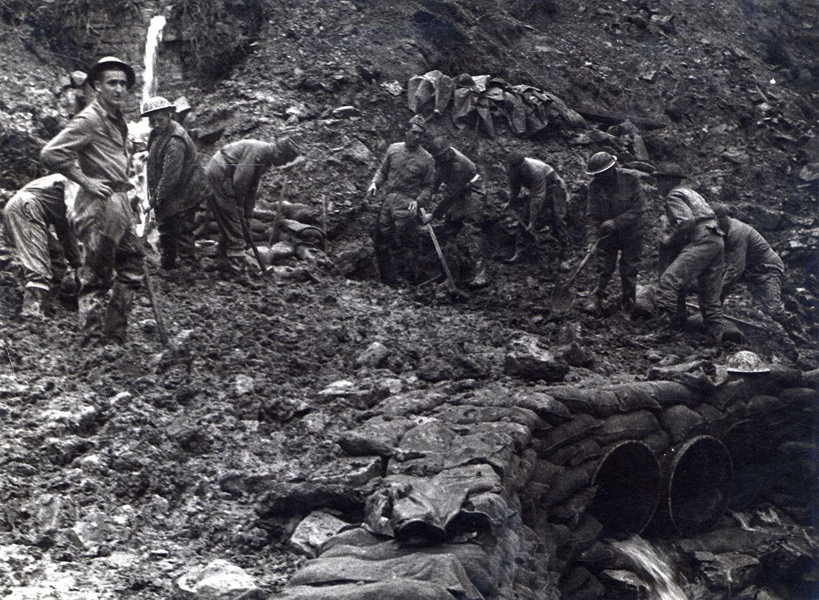
Notes:
Most sapper work was done with hand tools, as seen here.

Slide 18
Notes:
Bulldozers were very rare, unless you happened to be working with the Americans.

Slide 19
Notes:
More mud.

Slide 20
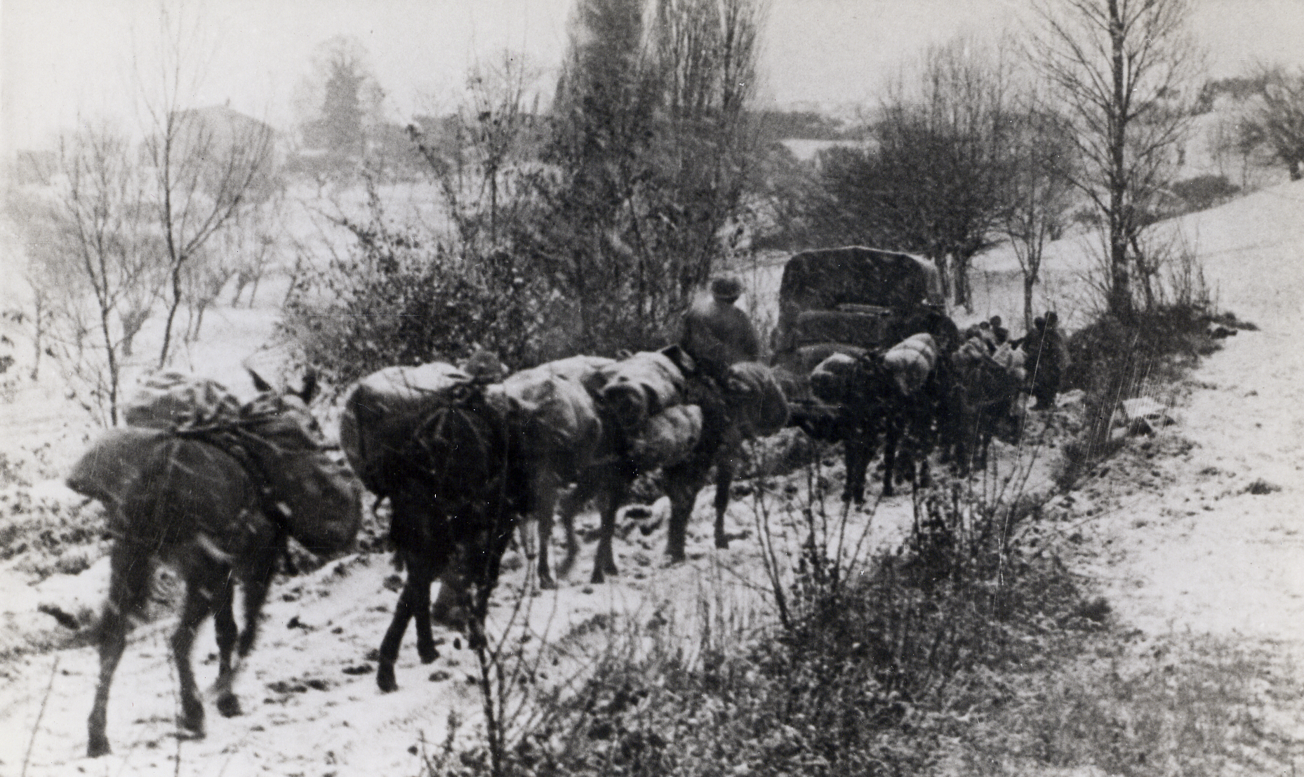
Notes:
As the campaign went on, mules were used more often.

Slide 21
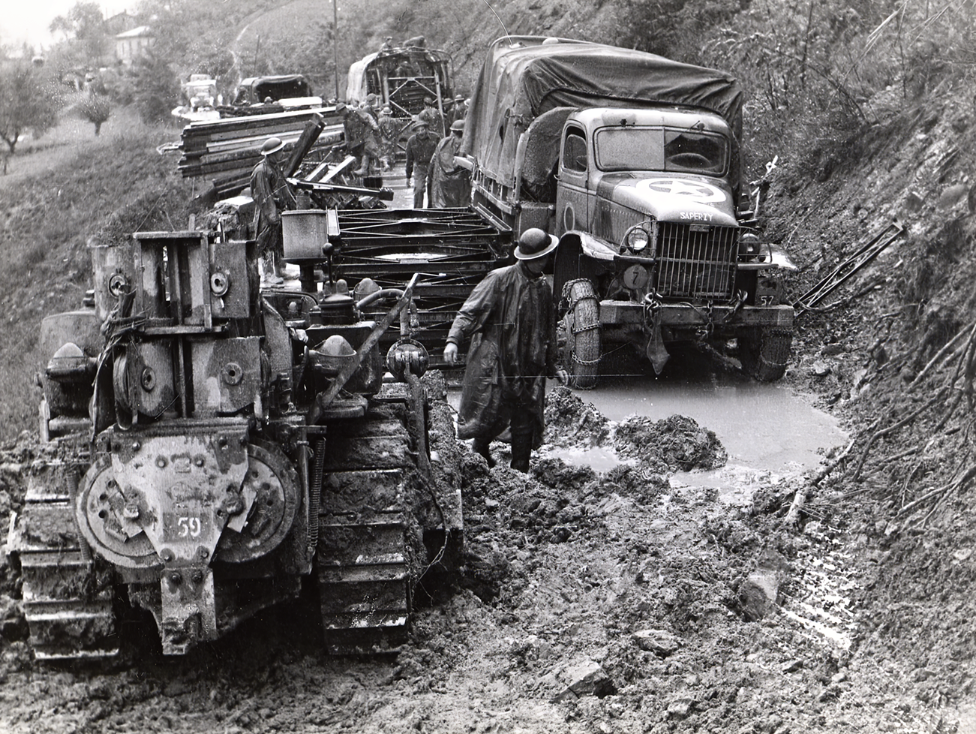
Notes:
Even the American trucks, which had four-wheel drive, were defeated by the mud, although their better traction meant that where there were detours around demolitions, they bogged in less and the Americans consequently used less Bailey than did the British.
As De Guingand said, we advanced as quickly as the Sappers would allow us.

Slide 22
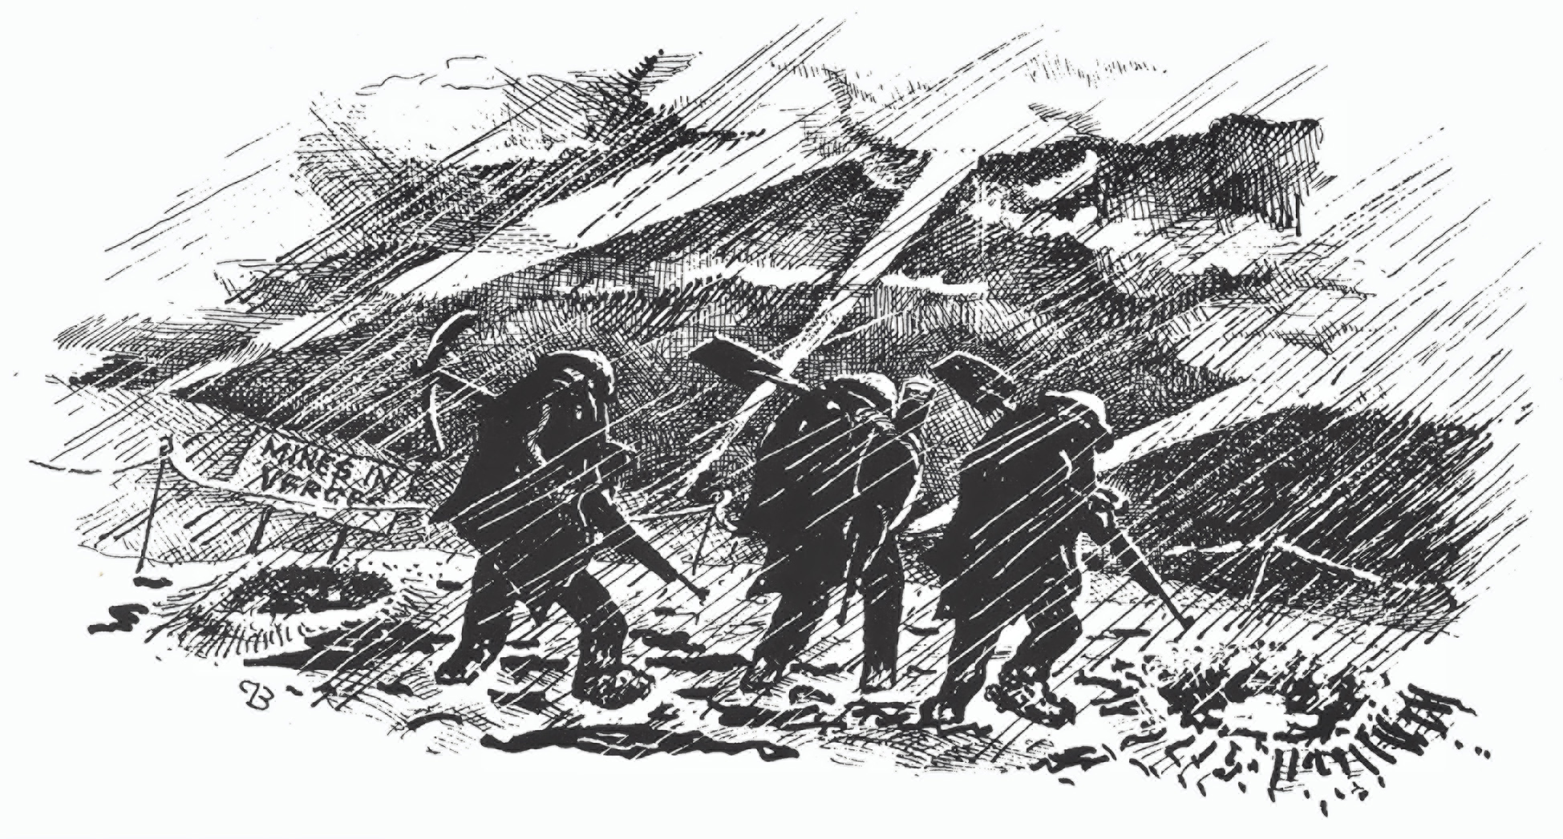
The Lasting Impression
Notes:
Three sappers with picks and shovels, in ponchos and steel helmets, trudging along a muddy road at night in pouring rain: This sums it all up.
Thank you.

