Slide 1
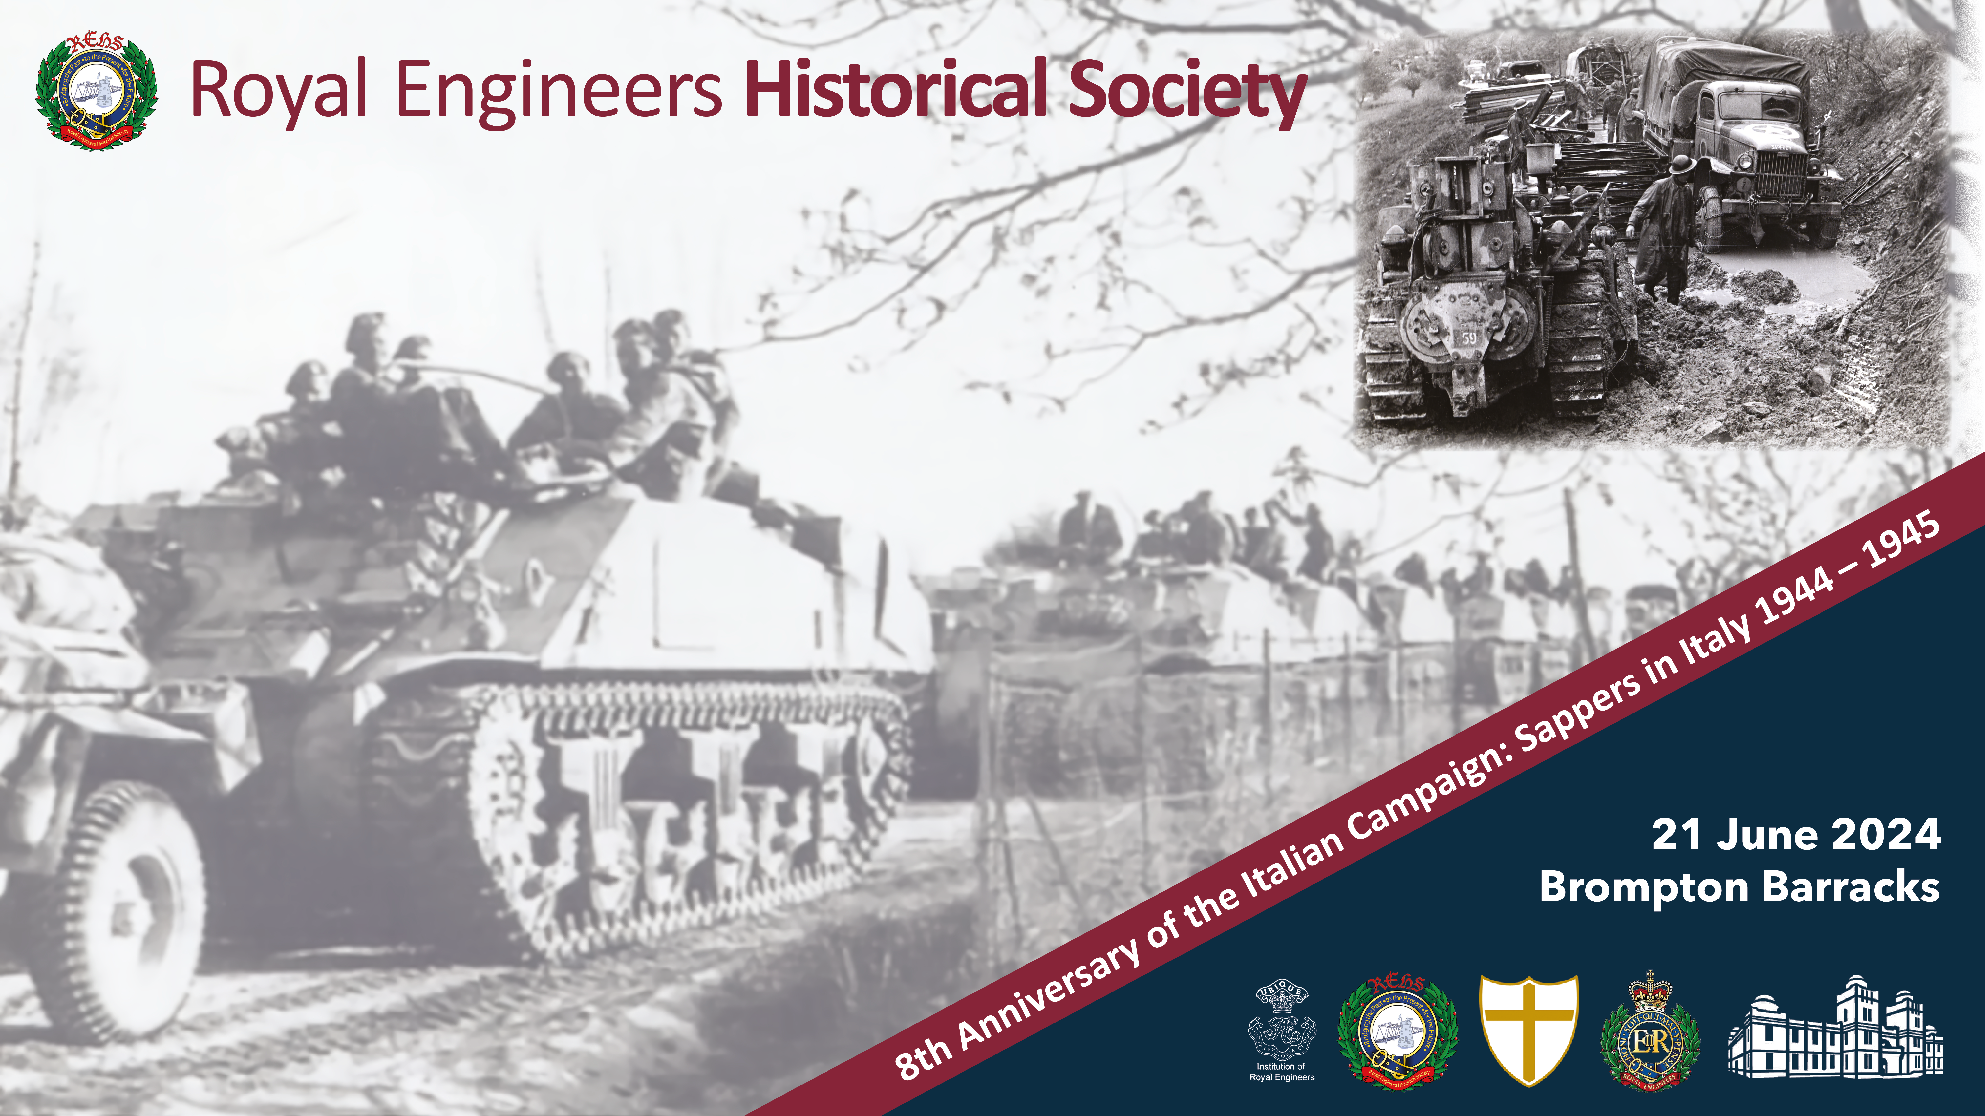
Early Days
Crossing the Volturno
Maj Gen John Drewienkiewicz CB CMG

Slide 2
Outline
Salerno
Salerno to the Volturno
Preparations for the Crossings
The Crossings
Conclusions and Lessons

Slide 3
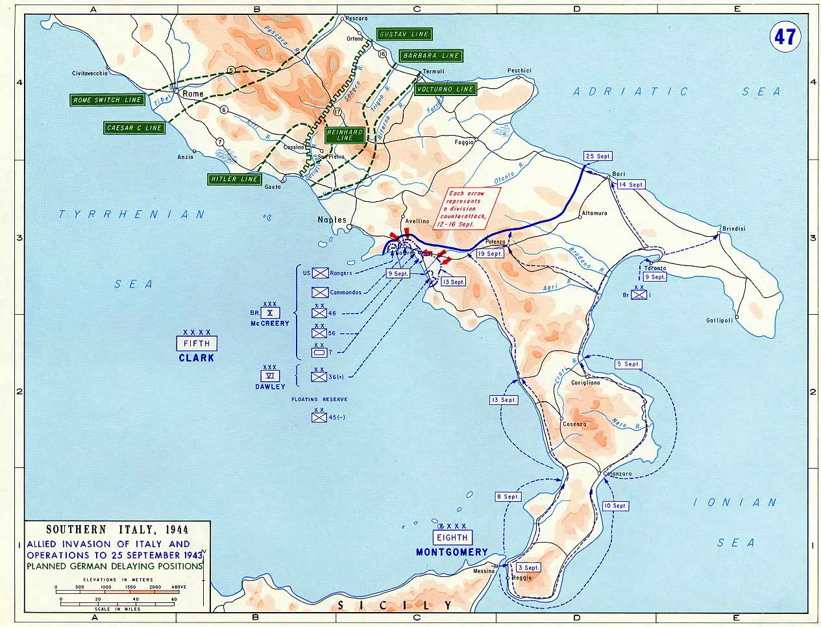

Slide 4
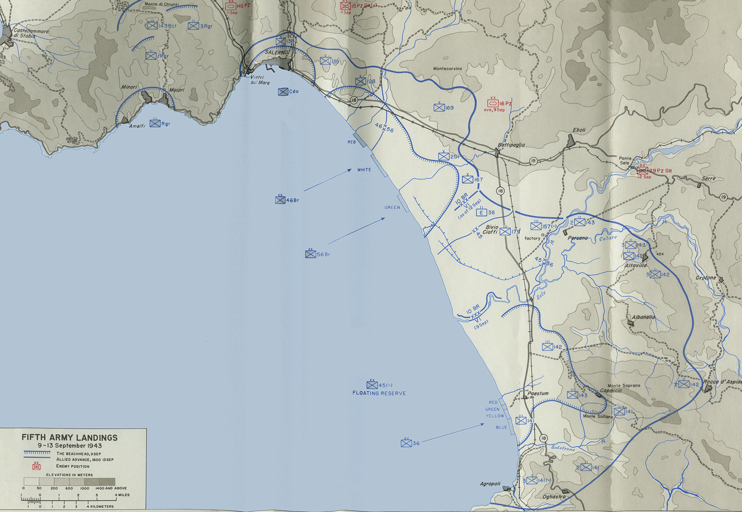
Notes:
The British contribution to the Salerno Landings was X Corps. It consisted of 46th Infantry Division (Inf Div), 56th Inf Div and 7th Armoured Division (Armd Div).
46 inf Div War Diary recorded: from early August the div was preparing to land in the Bay of Salerno to capture Naples and cut the retreat of the German forces extracted from Sicily. The area selected was the Sele Plain. It has a 23-mile-long sandy beach but the plain was criss-crossed with irrigation canals and dykes. 16 miles inland the ground rose in a series of cultivated terraces. Light opposition was assumed. The early plan, (which was quickly discarded), was to drop the 82 US Airborne Division to hold and or destroy the Volturno crossings to prevent the German armour from arriving. ‘Even without opposition, the clockwork assembly of so many parts into a cohesive whole was not easily to be achieved’.
With the benefit of hindsight, the planning was rushed and the forces assigned were barely adequate (but were as many as the available landing craft would allow). Much store was placed on the likelihood that the opposition would be Italian, as had been the case in the Sicily landings, and it was rumoured that the Italian Government was negotiating to switch sides. However, the Germans were suspicious of Italian motives and had been quietly moving formations into Northern Italy. In late August they moved 16 Panzer Grenadier Division into the Salerno area.

Slide 5
Sappers at Salerno
Notes:
The CRE of the inf div had three field companies (fd coy) and a field park company (fd pk coy) each, a total of about 900 all ranks, and the Corps Chief Engineer (CE) had extra sappers, about a divisional CRE’s worth. A couple more fd coy were attached from higher formation.
The sapper units’ training concentrated on engineer equipment, especially Bailey bridge construction. Two extra fd coy, (102 and 213 Army Fd Coys) were attached to X Corps. 46 Division Engineers (Div Engrs) and 213 Fd Coy were the only units trained on Floating (Pontoon) Bailey in mid-1943, since it had just started to arrive in the Middle East. The training ended with just one amphibious landing exercise. Engineer units were typically about 10% below their established strengths at the start of July, mostly from sickness. Battle casualty replacements, needing in-theatre training and integration in the units, arrived in late August.

Slide 6
Salerno Timings
7 Sep 43: Invasion Convoy sailed. News of Italian capitulation.
9 Sep 0230: Landings at Salerno, advance slowed by flooded fields behind beaches
Salerno village/small port captured
Work on beach exits, bridging ditches, demining, water points
German 16 PzGren Div counter attacks
11 Sep evening: six fd coys ordered into the line to bolster inf brigades
three more German divs arrive and counterattack
14 Sep: Salerno port open for traffic by 573 Fd Coy
16 Sep evening: 56 Div Engrs released back to CRE
18 Sep: 7 Armd Div armour lands in second wave of landing craft
18 Sep evening: 46 Div Engrs released back to CRE
19 Sep: breakout from bridgehead
Notes:
The invasion convoy sailed on 7 September 1943. While it was at sea the news of Italy’s surrender was received, raising hopes of a largely unopposed landing and a swift capture of the port of Naples. The infantry landed from 2.30 am on 9 September according to plan, 46 Div on the left and 56 Div on the right, and with US Rangers and British Commandos on the far left, and with the US VI Corps on the right. All began to push inland, but were slowed down by flooded fields behind the beaches. The Germans promptly counter-attacked with tank and self-propelled guns, throwing the invaders onto the defensive, severely limiting the depth of the bridgehead, and preventing the link up of X Corps with the Americans 7 miles to the south. On the far left the small fishing harbour of Salerno was quickly taken and the CE X Corps put 573 Fd Coy to work there, opening it for traffic late on 14 September. But everywhere else the situation was critical as the Germans moved three more divisions into the area in the space of three days and counter attacked vigorously.
The first tasks for the sappers of 46 and 56 Divs were to improve the beach exits, to bridge the many irrigation ditches, to demine and repair tracks and to set up water points. This all went ahead from the moment they disembarked on 9 September until 11 September. But by that evening the infantry brigades’ losses were such that they urgently needed bolstering. The six fd coys of the Div Engrs were ordered into the line, each reinforcing an infantry battalion. (A fd coy on light scales was 200 strong, so could occupy an infantry company position and still have spare capacity). In the 56 Div area they remained in the line until late on 16 September, when they were returned to the CRE. In the 46 Div area they stayed in their defensive positions even longer, until 18 September. The chaos in the bridgehead was described in the 46 Div War Diary: ‘There was a considerable co-mingling of battalions and newly arrived reinforcements, who could hardly as yet be said to belong to any particular battalion’.
The first crisis had passed by the end of 18 September when armour was landed. Then the two divisions were able to advance. The 56 Div sappers were quickly required to build three Bailey bridges on 19, 20 and 22 October. 46 Div pushed north from Salerno on 22 September and secured the defiles across the neck of land leading to Pompeii. One bridge was captured intact when a 271 Fd Coy NCO crawled onto the bridge in daylight and removed the charges, earning a MM in the process.

Slide 7
Salerno Results
German delaying measures became more effective.
Two more German divs arrived in the area.
The offensive spirit of 46 and 56 Divs was diminished by the losses at Salerno. (More than 3,000, predominantly infantry)
The flow of engineer equipment was reduced, and far more engr eqpt was needed than had been allowed for.
Notes:
The advance had only been maintained with the construction of 23 single span Bailey bridges. The 56 Div AQ War Diary recorded: ‘One reflects with admiration on the inspired work of the RE whose rapid opening of roads made administration possible’. However, three malign factors then combined:
German delaying measures became more effective.
The offensive spirit of 46 and 56 Divs was diminished by the losses at Salerno.
The flow of engineer equipment was reduced.
German delaying measures: Over the course of September two more German divisions arrived to thicken the defence. The scale of the defence was seen as the number of mines in a cluster increased from 5-10 to 40-50.
British Offensive Spirit: The scale of infantry losses in the fight for the Salerno beachhead absorbed all the preplanned battle casualty replacements. In 56 Div, the 13,000 all ranks landed on 9 September had been reduced to 10,000 by 15 September, mainly through losses in the infantry battalions. To obtain more numbers, large-scale replacements were extracted from 50 and 51 Inf Div, before they left for the UK. Sappers were also affected. 501 Fd Coy was told they were going home with 50 Div three times and the order was rescinded three times in the course of four days, before they were switched to 56 Div in October. As the 46 Div War Diary observed (and perhaps understated), ‘Naturally they were somewhat disgruntled not to be going home with their divisions, and the short rest before the Volturno was insufficient to recapture the spirit which had distinguished the Salerno Landings’.

Slide 8
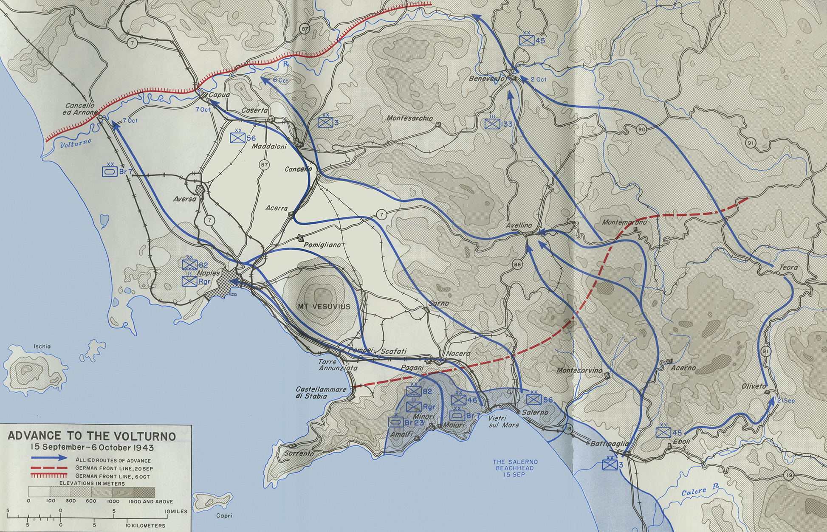

Slide 9
Salerno to the Volturno
22 Sep: Defiles leading north secured
28 Sep: 5th Army link up with 8th Army
Germans destroy Naples power and harbour facilities and fell back 40 miles to line of Volturno
1 Oct: 46 Div reaches Naples
5 Oct: Advance north of Naples
10 Oct: 46 Div reaches Volturno at coast
13 Oct: Naples dock handling back to 50% of normal capacity, most materiel still delivered over beaches.
Far more bridging being used than allowed for.
Notes:
The first crisis had passed by the end of 18 September when armour was landed. Then the two divisions were able to advance. The 56 Div sappers were quickly required to build three Bailey bridges on 19, 20 and 22 October. 46 Div pushed north from Salerno on 22 September and secured the defiles across the neck of land leading to Pompeii. One bridge was captured intact when a 271 Fd Coy NCO crawled onto the bridge in daylight and removed the charges, earning a MM in the process
Meanwhile the British 8th Army had landed further south and east and was moving to join them. 7 Armd Div made the link up on 28 September, at which the Germans fell back to the next defensible line, which was the River Volturno, 20 miles north of Naples. The Allies advanced swiftly. Naples was reached on 1 October and 46 Div advanced beyond Naples on 5 October. By 10 October 46 Div had closed up to the western end of the Volturno.
The Flow of Engineer Equipment: The Germans destroyed much of the infrastructure of Naples, notably power and harbour facilities, as they withdrew. It took months to restore the dock handling capacity fully, and it was only on 13 October, when the Volturno operation was well under way, that capacity reached 3,500 tons per day, still only 50% of its normal capacity. By early October most materiel was still being offloaded across the beaches at Salerno and through the tiny port at Salerno. All engineer equipment had to compete for priority with artillery ammunition, fuel, rations, spare parts and newly arriving units. There was also bound to be a lag of several days between indenting for special equipment and receiving it. Bailey bridges were being built faster than they could be supplied, and there was still only enough Pontoon Bailey in Italy for one Class 30 bridge that could carry tanks.

Slide 10
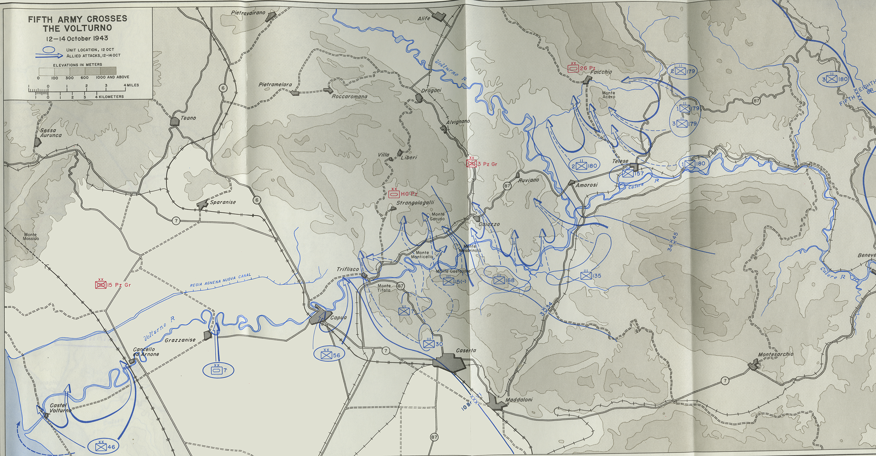

Slide 11
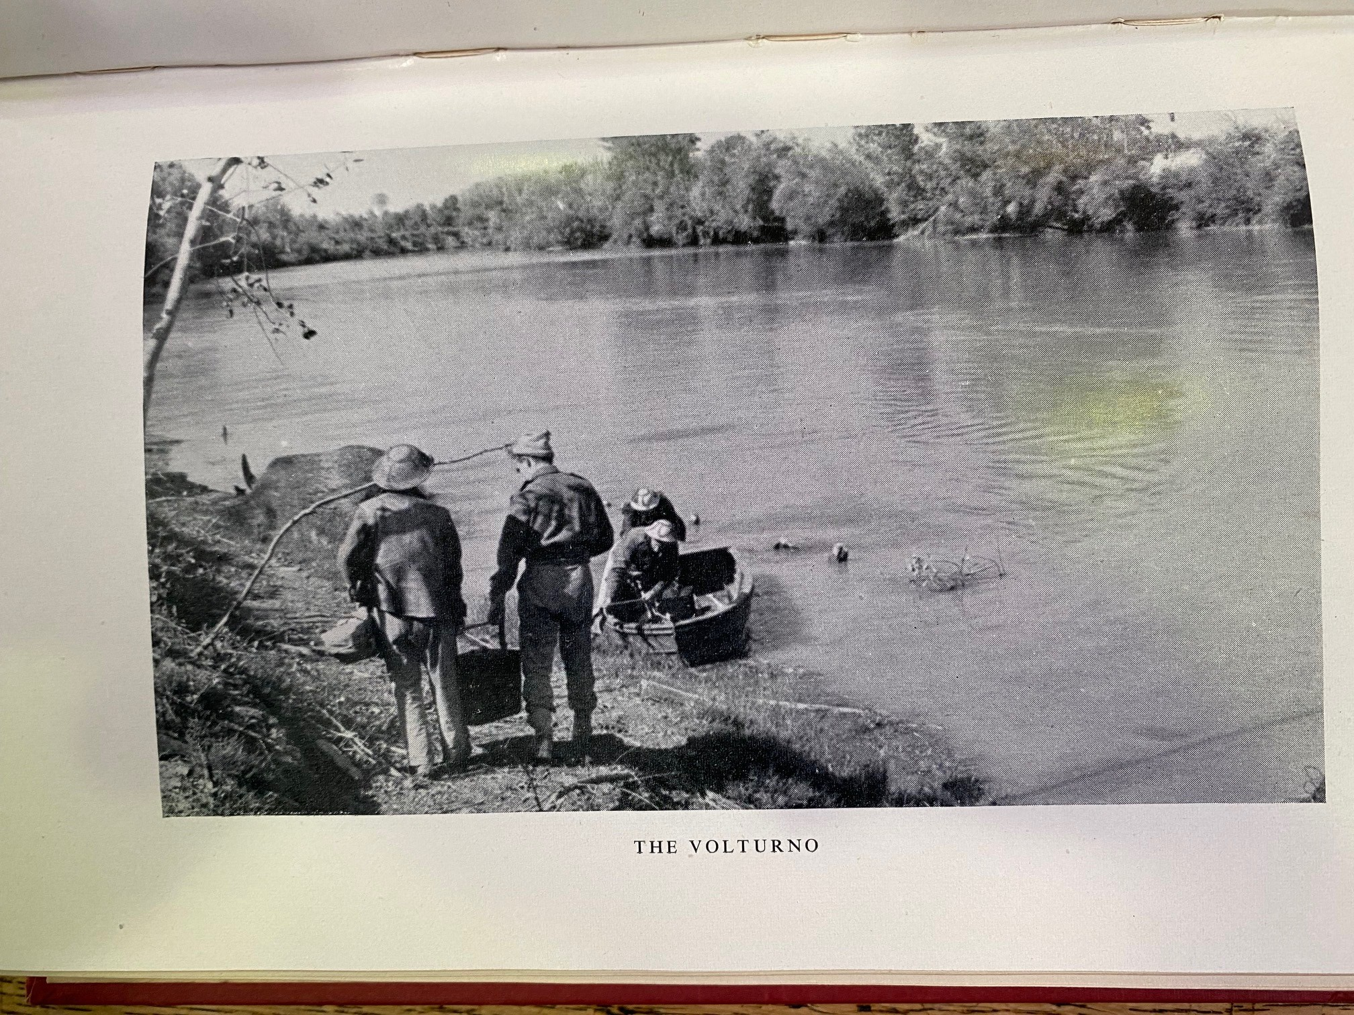

Slide 12
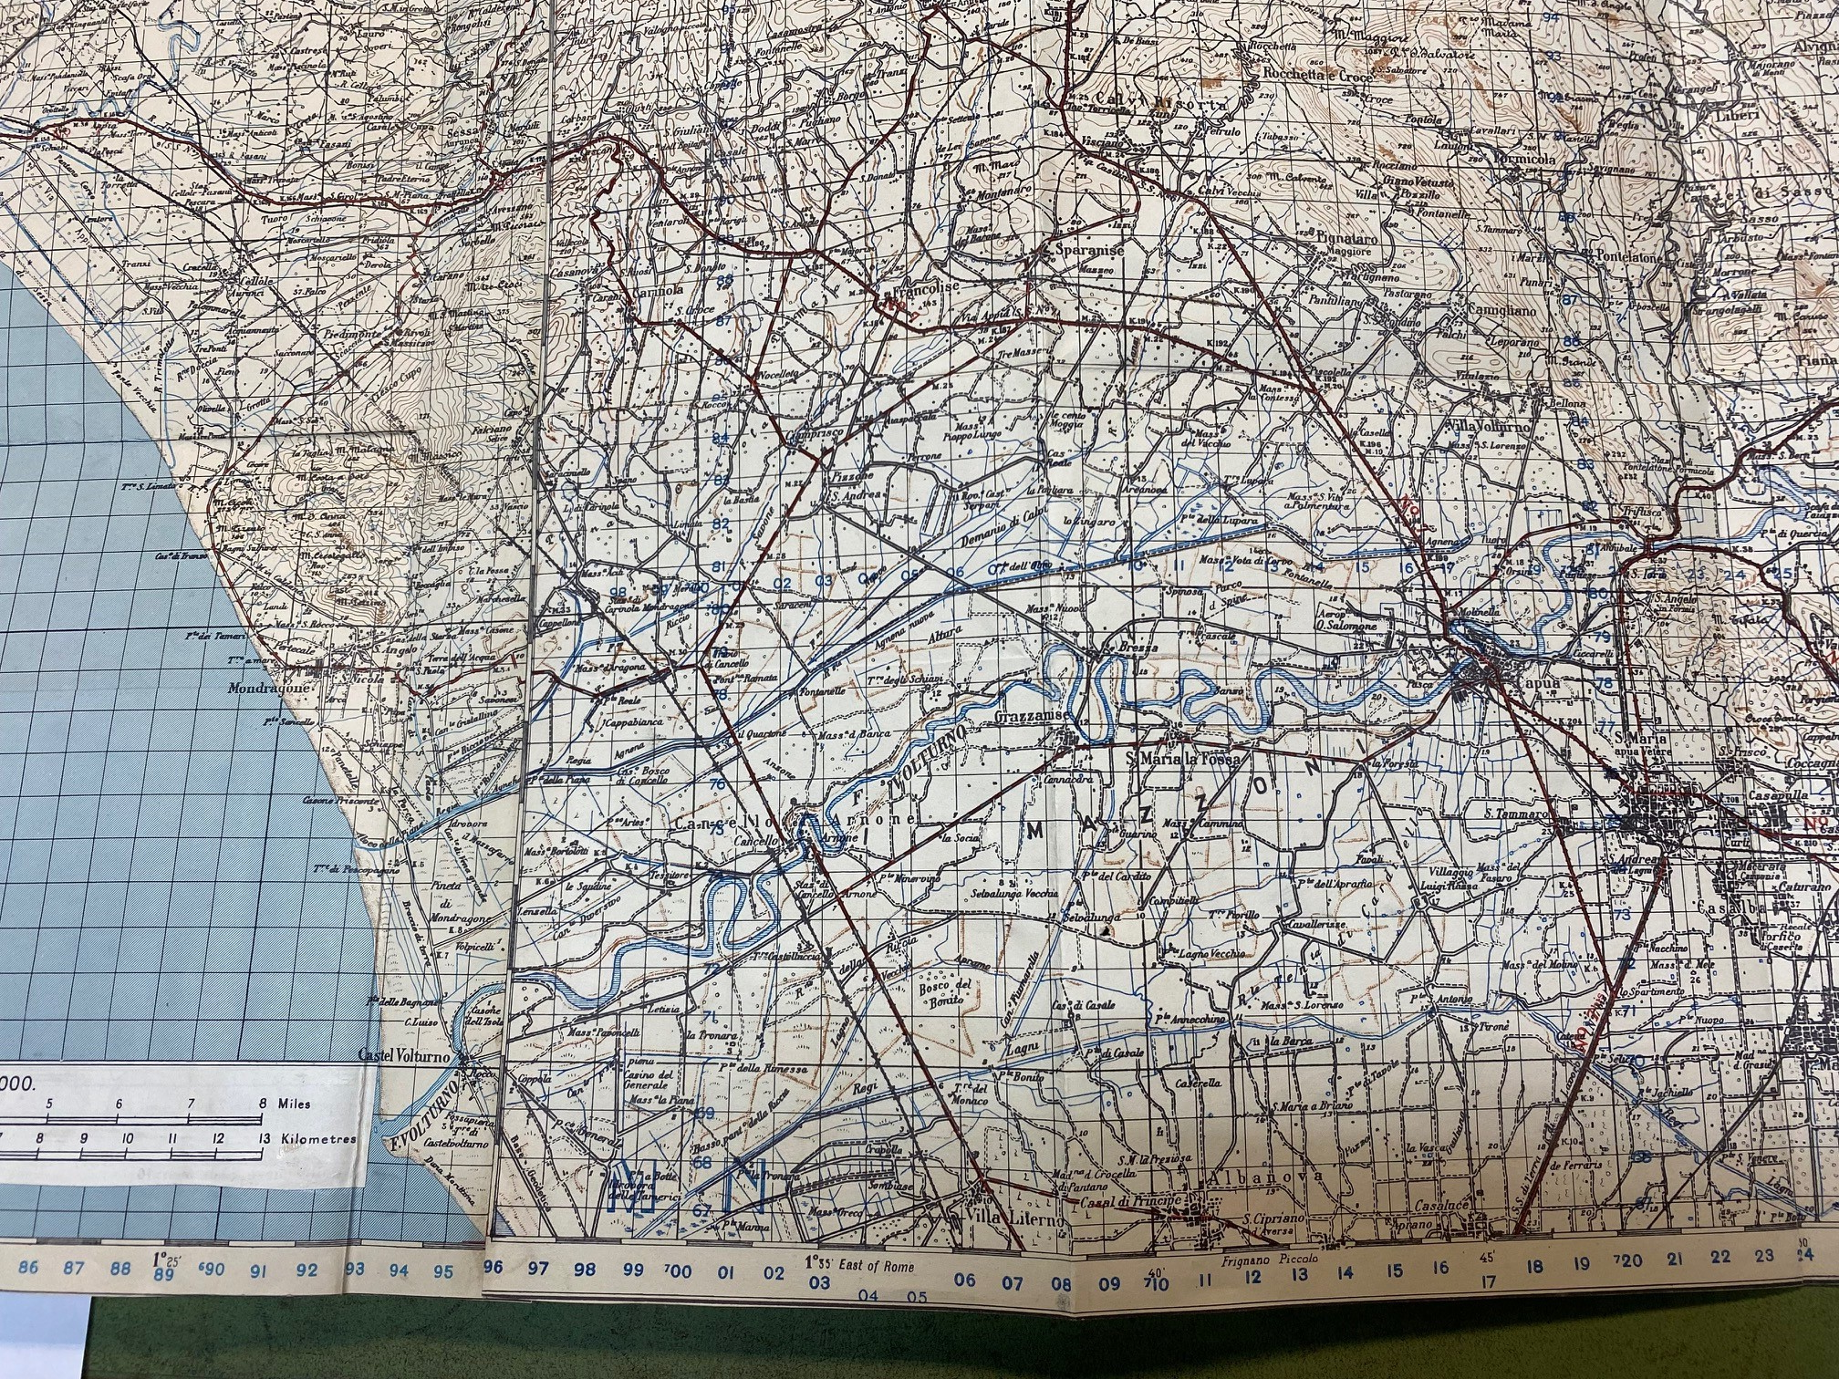
Notes:
Four main areas where crossings were attempted, shown by the arrows.
The X Corps plan tasked 46 Div, on the left, to seize a bridgehead at Cancello (Green), while 56 Div (Black) on the right was to seize a bridgehead at Capua. Tanks were to be landed from the sea at the mouth of the Volturno to turn the enemy flank (Purple) and to link up with the Cancello bridgehead. 7 Armd Div was placed in the middle (Orange), tasked with making a feint at Grazzanise to draw off enemy reserves.
The sapper task was therefore to get first the infantry, then the anti-tank guns, and then the armour, up to the river, across the 300-foot-wide river, and beyond. The snag was that there was less engineer equipment at hand than was really needed. Specifically, there was one set of Pontoon Bailey, one Class 9 bridge (which could take most wheeled vehicles), and five Class 5 rafts (able to carry a jeep and a 6-pdr gun).

Slide 13
Engineer Equipment
There were 300 infantry assault boats, but less engineer equipment than was needed
one set of Pontoon Bailey to take tanks
one Class 9 FBE bridge (most wheeled vehicles)
five Class 5 rafts (able to carry a jeep and a 6-pdr gun).
Allocation:
46 Div: 2 rafts, Pontoon Bailey
7 Div: one raft
56 Div: 2 rafts, FBE bridge
Notes:
The sapper units’ training concentrated on engineer equipment, especially Bailey bridge construction. Two extra fd coy, (102 and 213 Army Fd Coys) were attached to X Corps. 46 Division Engineers (Div Engrs) and 213 Fd Coy were the only units trained on Floating (Pontoon) Bailey in mid-1943, since it had just started to arrive in the Middle East. The training ended with just one amphibious landing exercise. Engineer units were typically about 10% below their established strengths at the start of July, mostly from sickness. Battle casualty replacements, needing in-theatre training and integration in the units, arrived in late August.
The snag was that there was less engineer equipment at hand than was really needed. Specifically, there was one set of Pontoon Bailey, one Class 9 bridge (which could take most wheeled vehicles), and five Class 5 rafts (able to carry a jeep and a 6-pdr gun).

Slide 14
Ground
All bridges dropped
Volturno 300 feet wide, swift, deep, unfordable
Flat and soggy
Large ditches
Steep river banks 15 feet high
Notes:
The approaches were flat and soggy, and riddled with large ditches; the riverbanks were steep and wooded, and the river itself swift, broad and unfordable. All the bridges had been dropped, and the soft going off-road confined movement to the existing approaches. These were, starting at the sea, at Castel Volturno, (very minor road), at Cancello (metalled road and railway), at Grazzanise (minor road) and at Capua (major road and railway).

Slide 15
Improvisation
7-12 Oct:
Ramps for the five class 5 rafts to carry bren carriers and 25pdr guns
Footbridge from kapok , petrol drums, stadium decking
Manufacture of fascines
Gins and sheerlegs to surmount 15-foot riverbank
Notes:
The approaches were flat and soggy, and riddled with large ditches; the riverbanks were steep and wooded, and the river itself swift, broad and unfordable. All the bridges had been dropped, and the soft going off-road confined movement to the existing approaches. These were, starting at the sea, at Castel Volturno, (very minor road), at Cancello (metalled road and railway), at Grazzanise (minor road) and at Capua (major road and railway).
7-12 Oct:
Ramps for the five class 5 rafts to carry bren carriers and 25pdr guns
Footbridge from kapok , petrol drums, stadium decking
Manufacture of fascines
Gins and shearlegs to surmount 15 foot riverbank

Slide 16
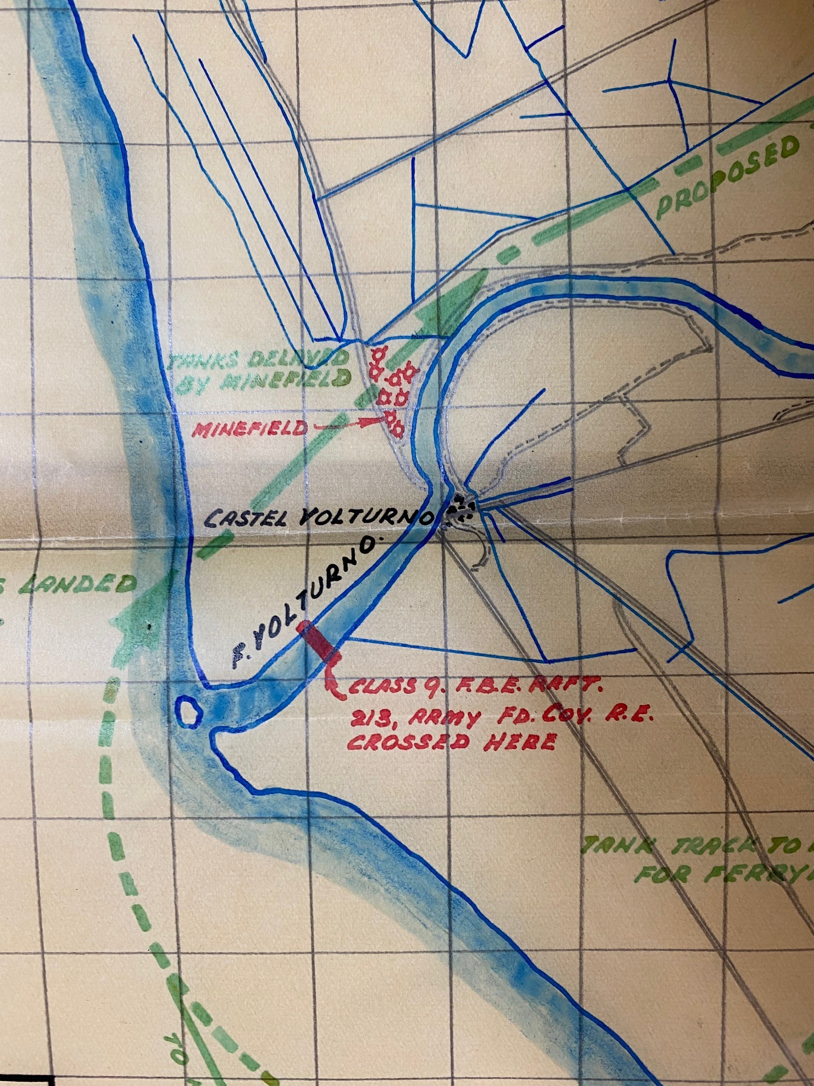
40 RTR route around
Mouth of Volturno
H Hour 0300 13 Oct: sqn tanks landed but halted by wooden mines. RE offr killed, safe lane prodded by 1500 10 Oct.
Early 14 Oct: second tank sqn landed, hit more mines and halted until 0615. More mines encountered. Gap created by 0900.
1200 14 Oct: tanks linked up with 46 Div at Castel Volturno.
Enemy flank turned, Germans withdraw north and east.

Slide 17
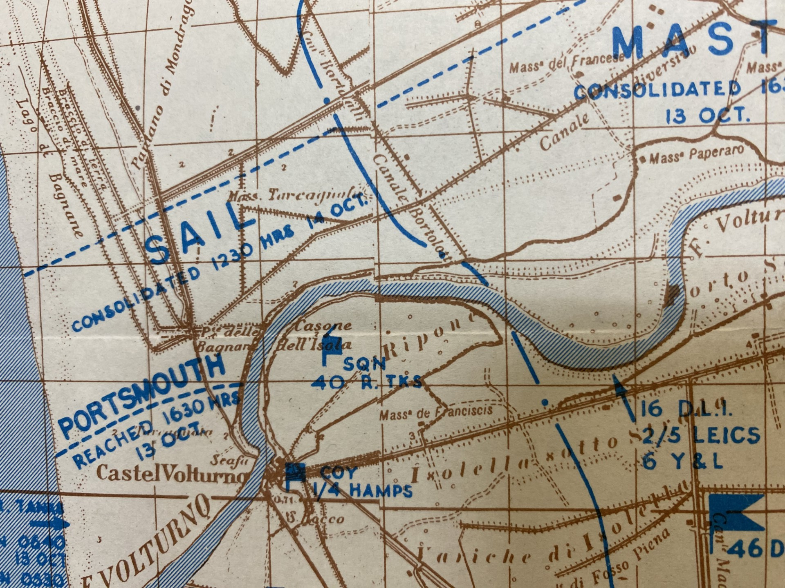
Castel Volturno area
H Hour 2100 12 Oct:
Inf cross but one ferry sunk. Ge C attack.
1800 13 Oct: 2 ferries operating, 16 A/Tk guns cross.
Notes:
H Hour 2100 12 Oct:
Inf cross but one ferry sunk. Ge C attack.
1800 13 Oct: 2 ferries operating, 16 A/Tk guns cross.

Slide 18
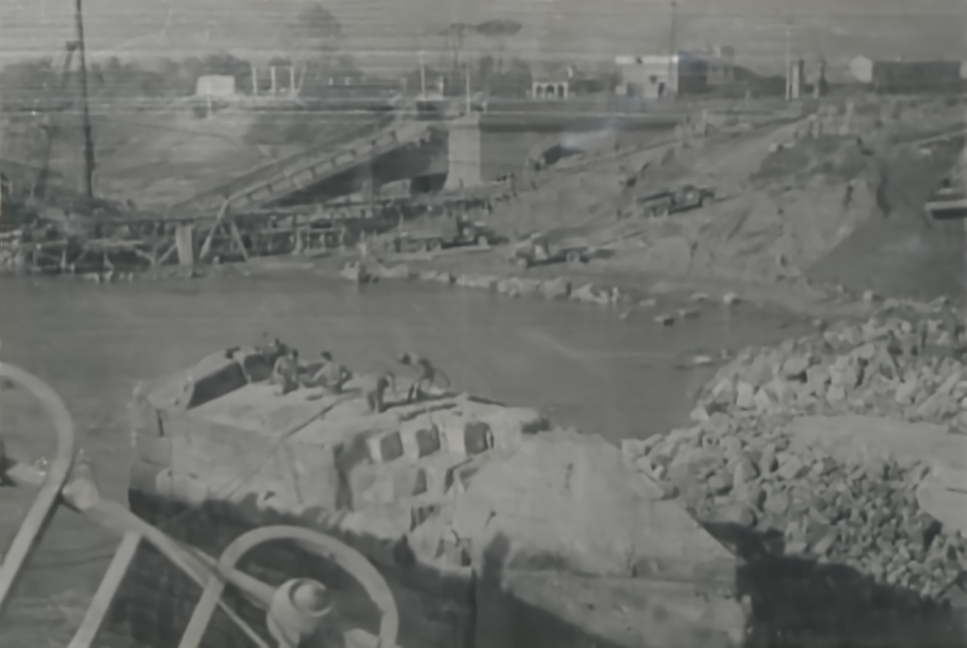
Notes:
Demolished bridge at Cancello

Slide 19
Cancello Bridge Site
Notes:
This was the site selected for Pontoon Bailey as it had the best roads in area for approaches.

Slide 20
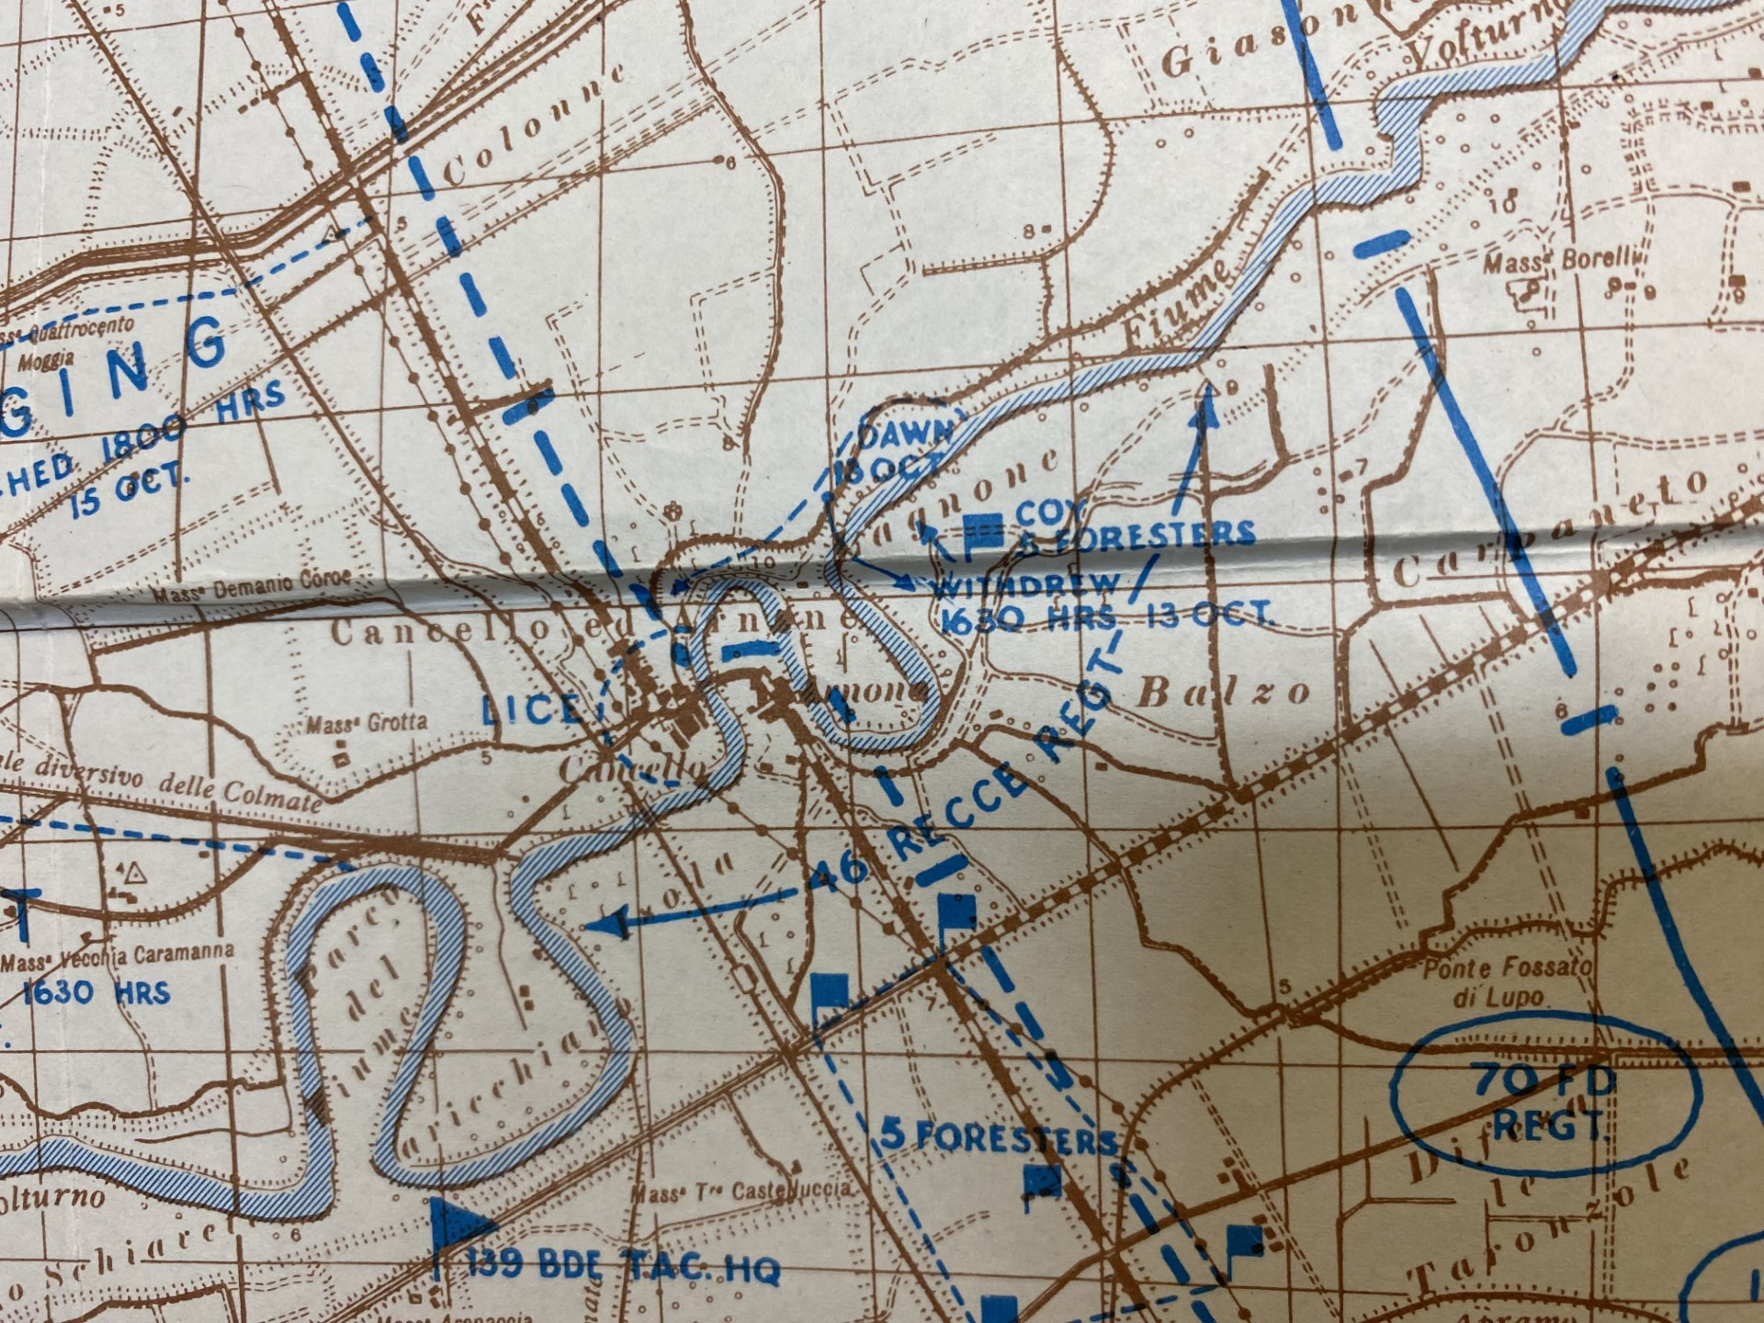
Cancello area
Notes:
However the town was not cleared of the enemy until dawn on 15 Oct. The pontoon bailey was called forward and completed.

Slide 21
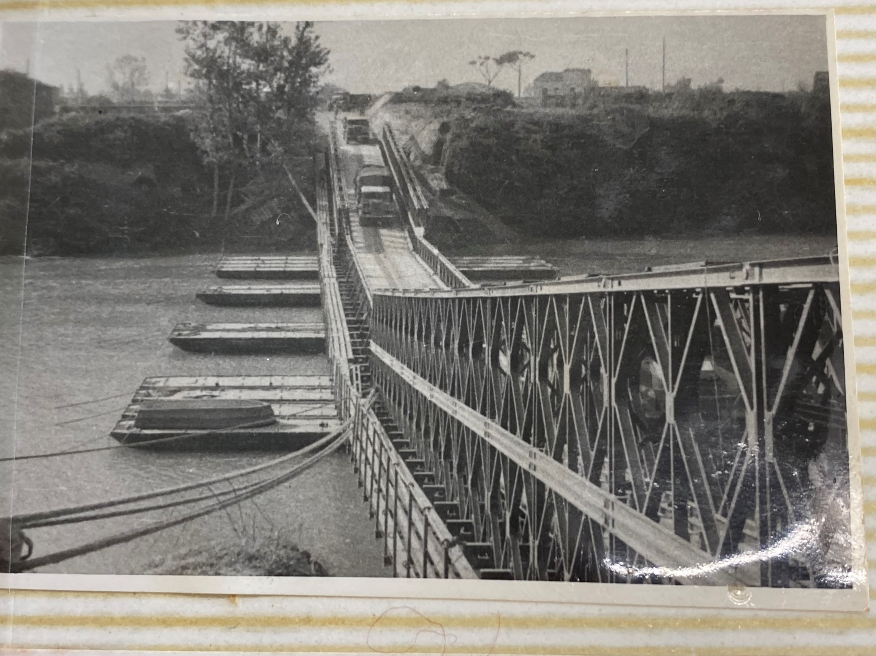
First Floating Bailey
Notes:
Here it is, but no sooner had it been opened when the X Corps commander decided to revert to his original plan of using the main road through Capua as the main axis. This meant that the Pontoon Bailey at Cancello, which had just been completed, was stripped out, reloaded and moved to Capua.

Slide 22
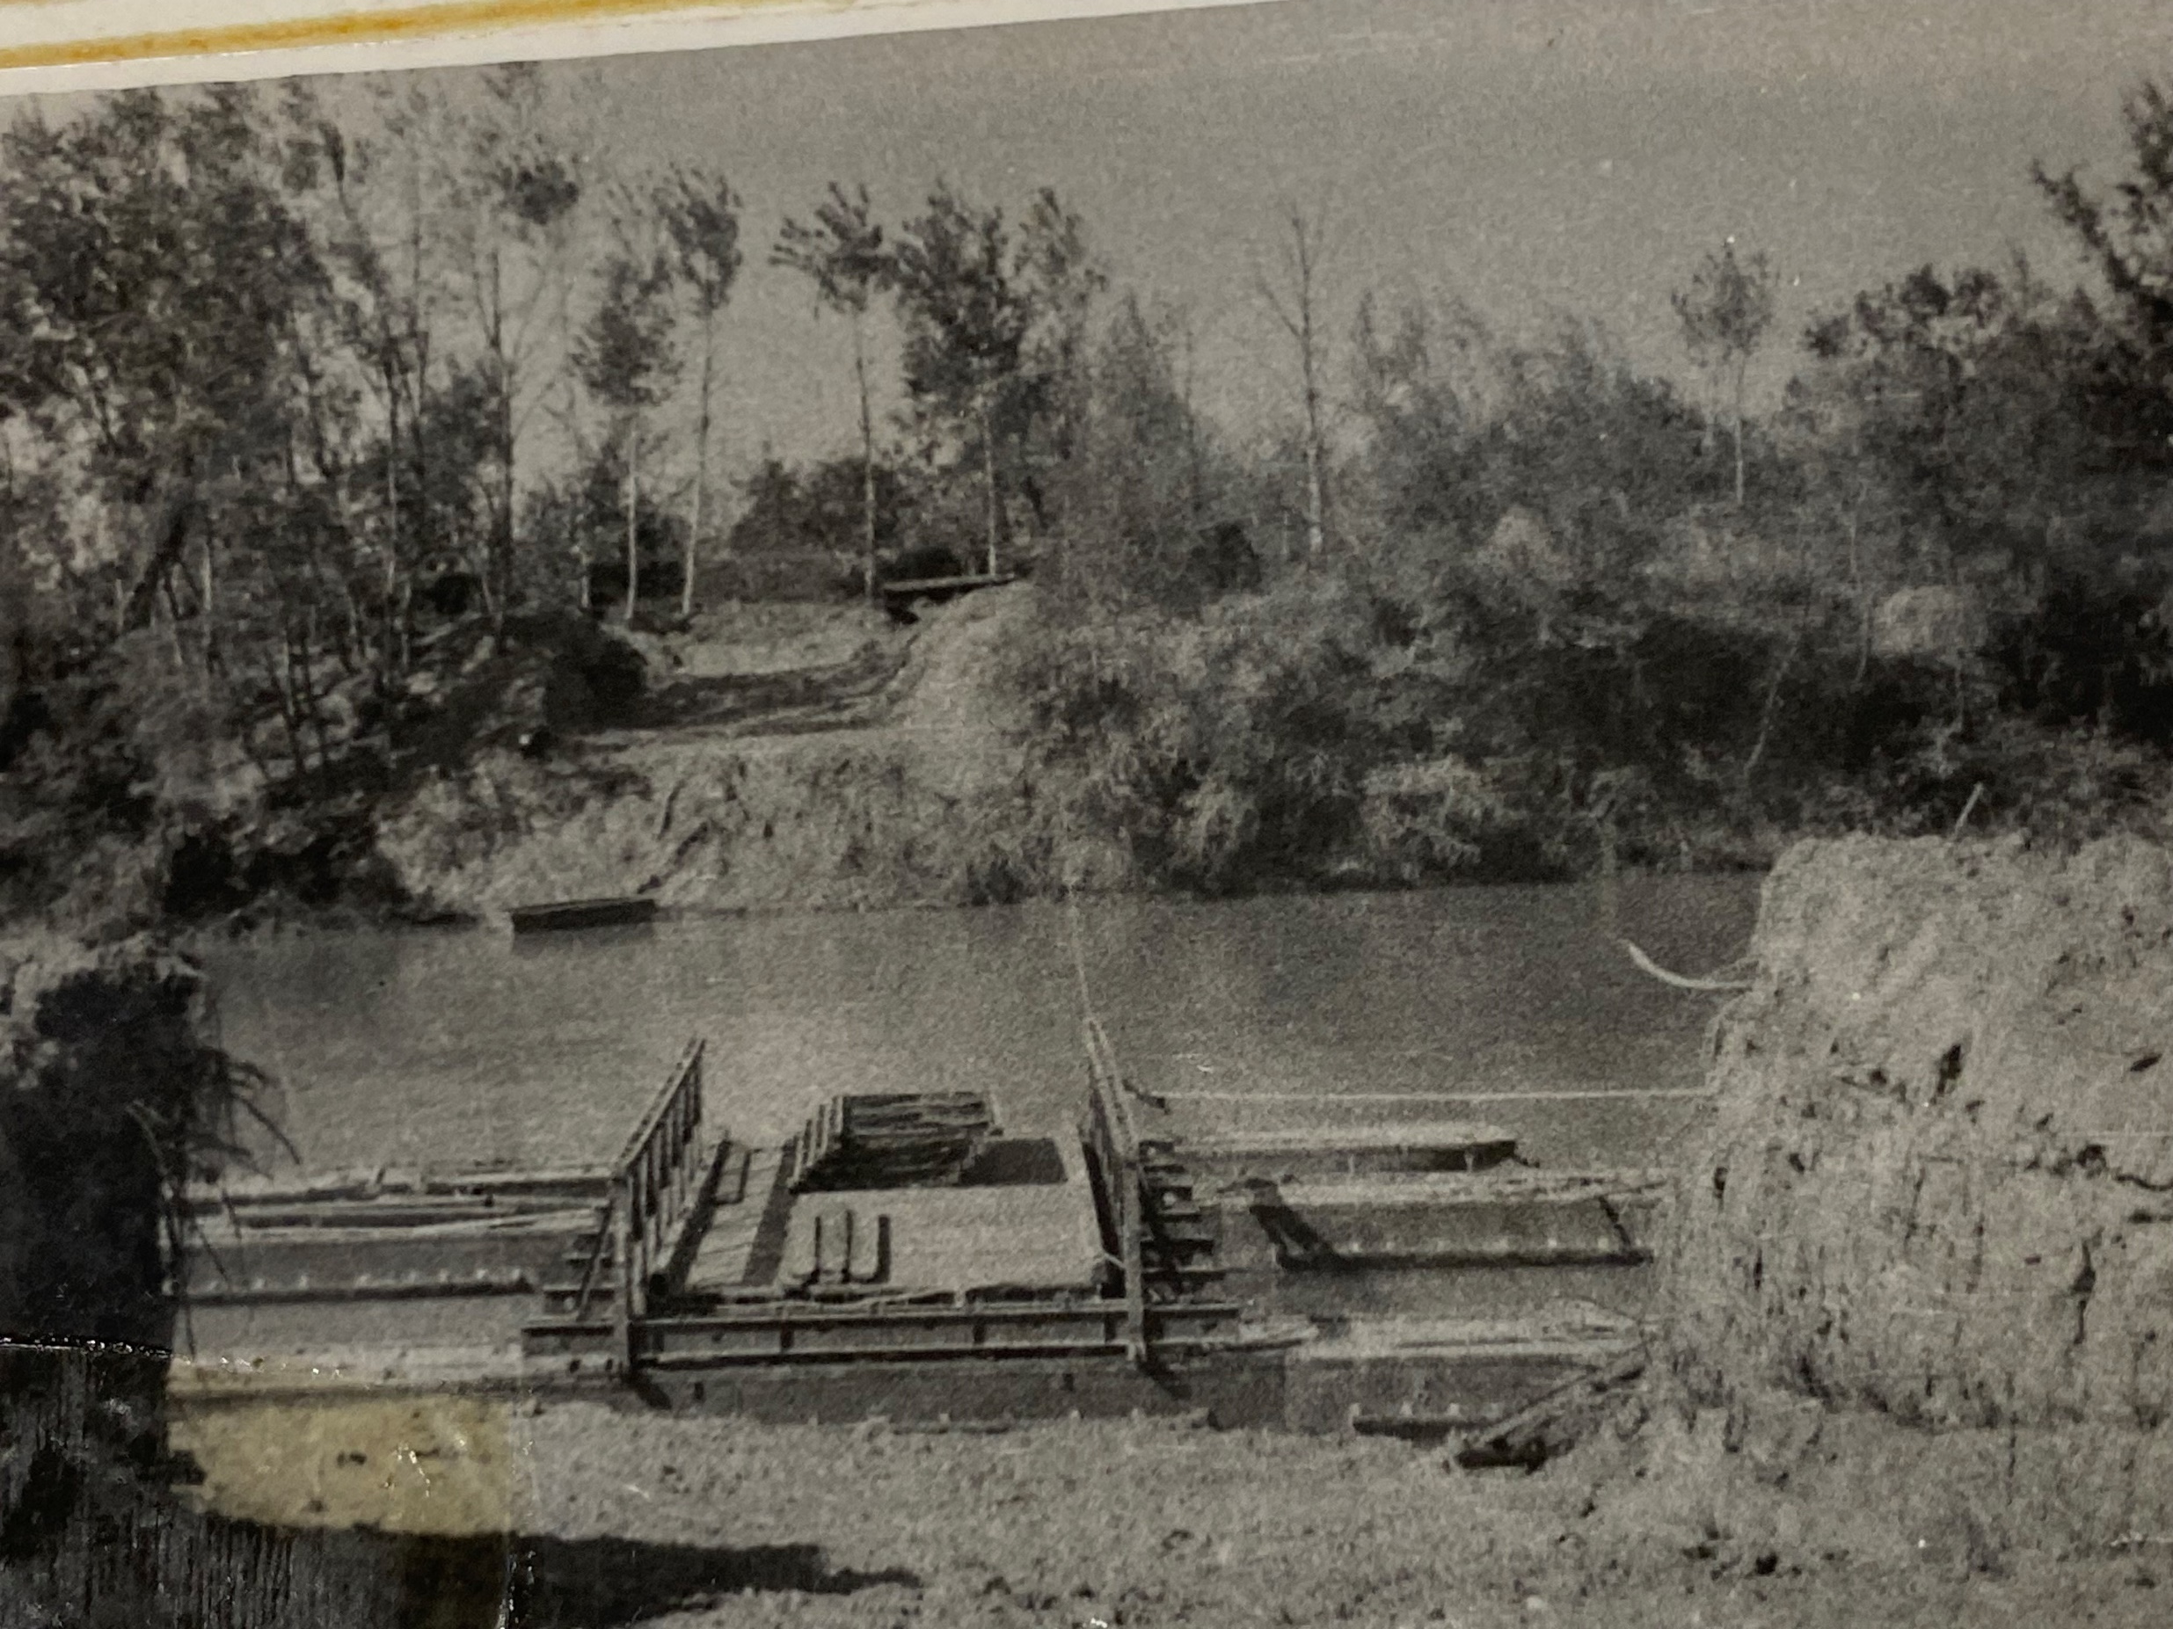
Ferry at Floating Bailey site
Notes:
It was replaced with a ferry.

Slide 23
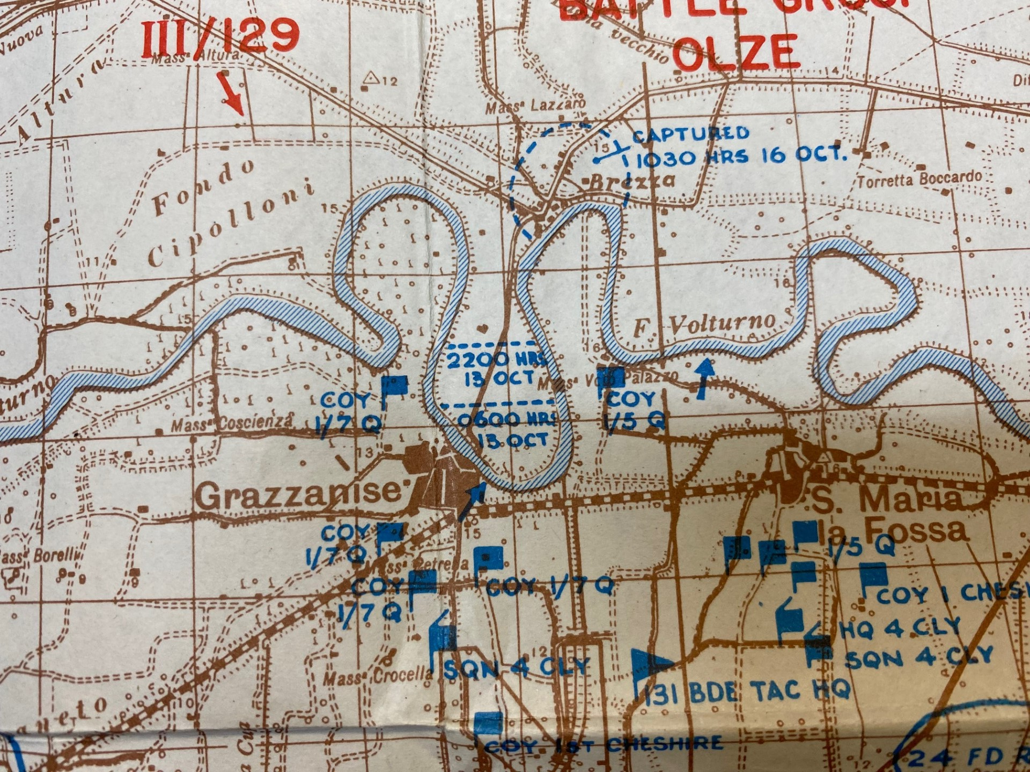
Grazzanise area
Notes:
Further east, as Grazzanise a partly demolished trestle bridge had been left with its central span intact and it was possible to build a 100-foot Bailey from the home bank to the intact span, and then from the intact span to the enemy bank. This allowed a bulldozer to cross and it was then able to winch tanks out of the deep ford they had found.
Meanwhile at Capua the US VI Corps, further inland on the right, where the Volturno was lesswide, had succeeded in crossing and were pushing ahead. 56 Div finally managed to advance, using an American Class 30 bridge. At that point, with the far bank secure, the Ponton Bailey could begin to be constructed.

Slide 24
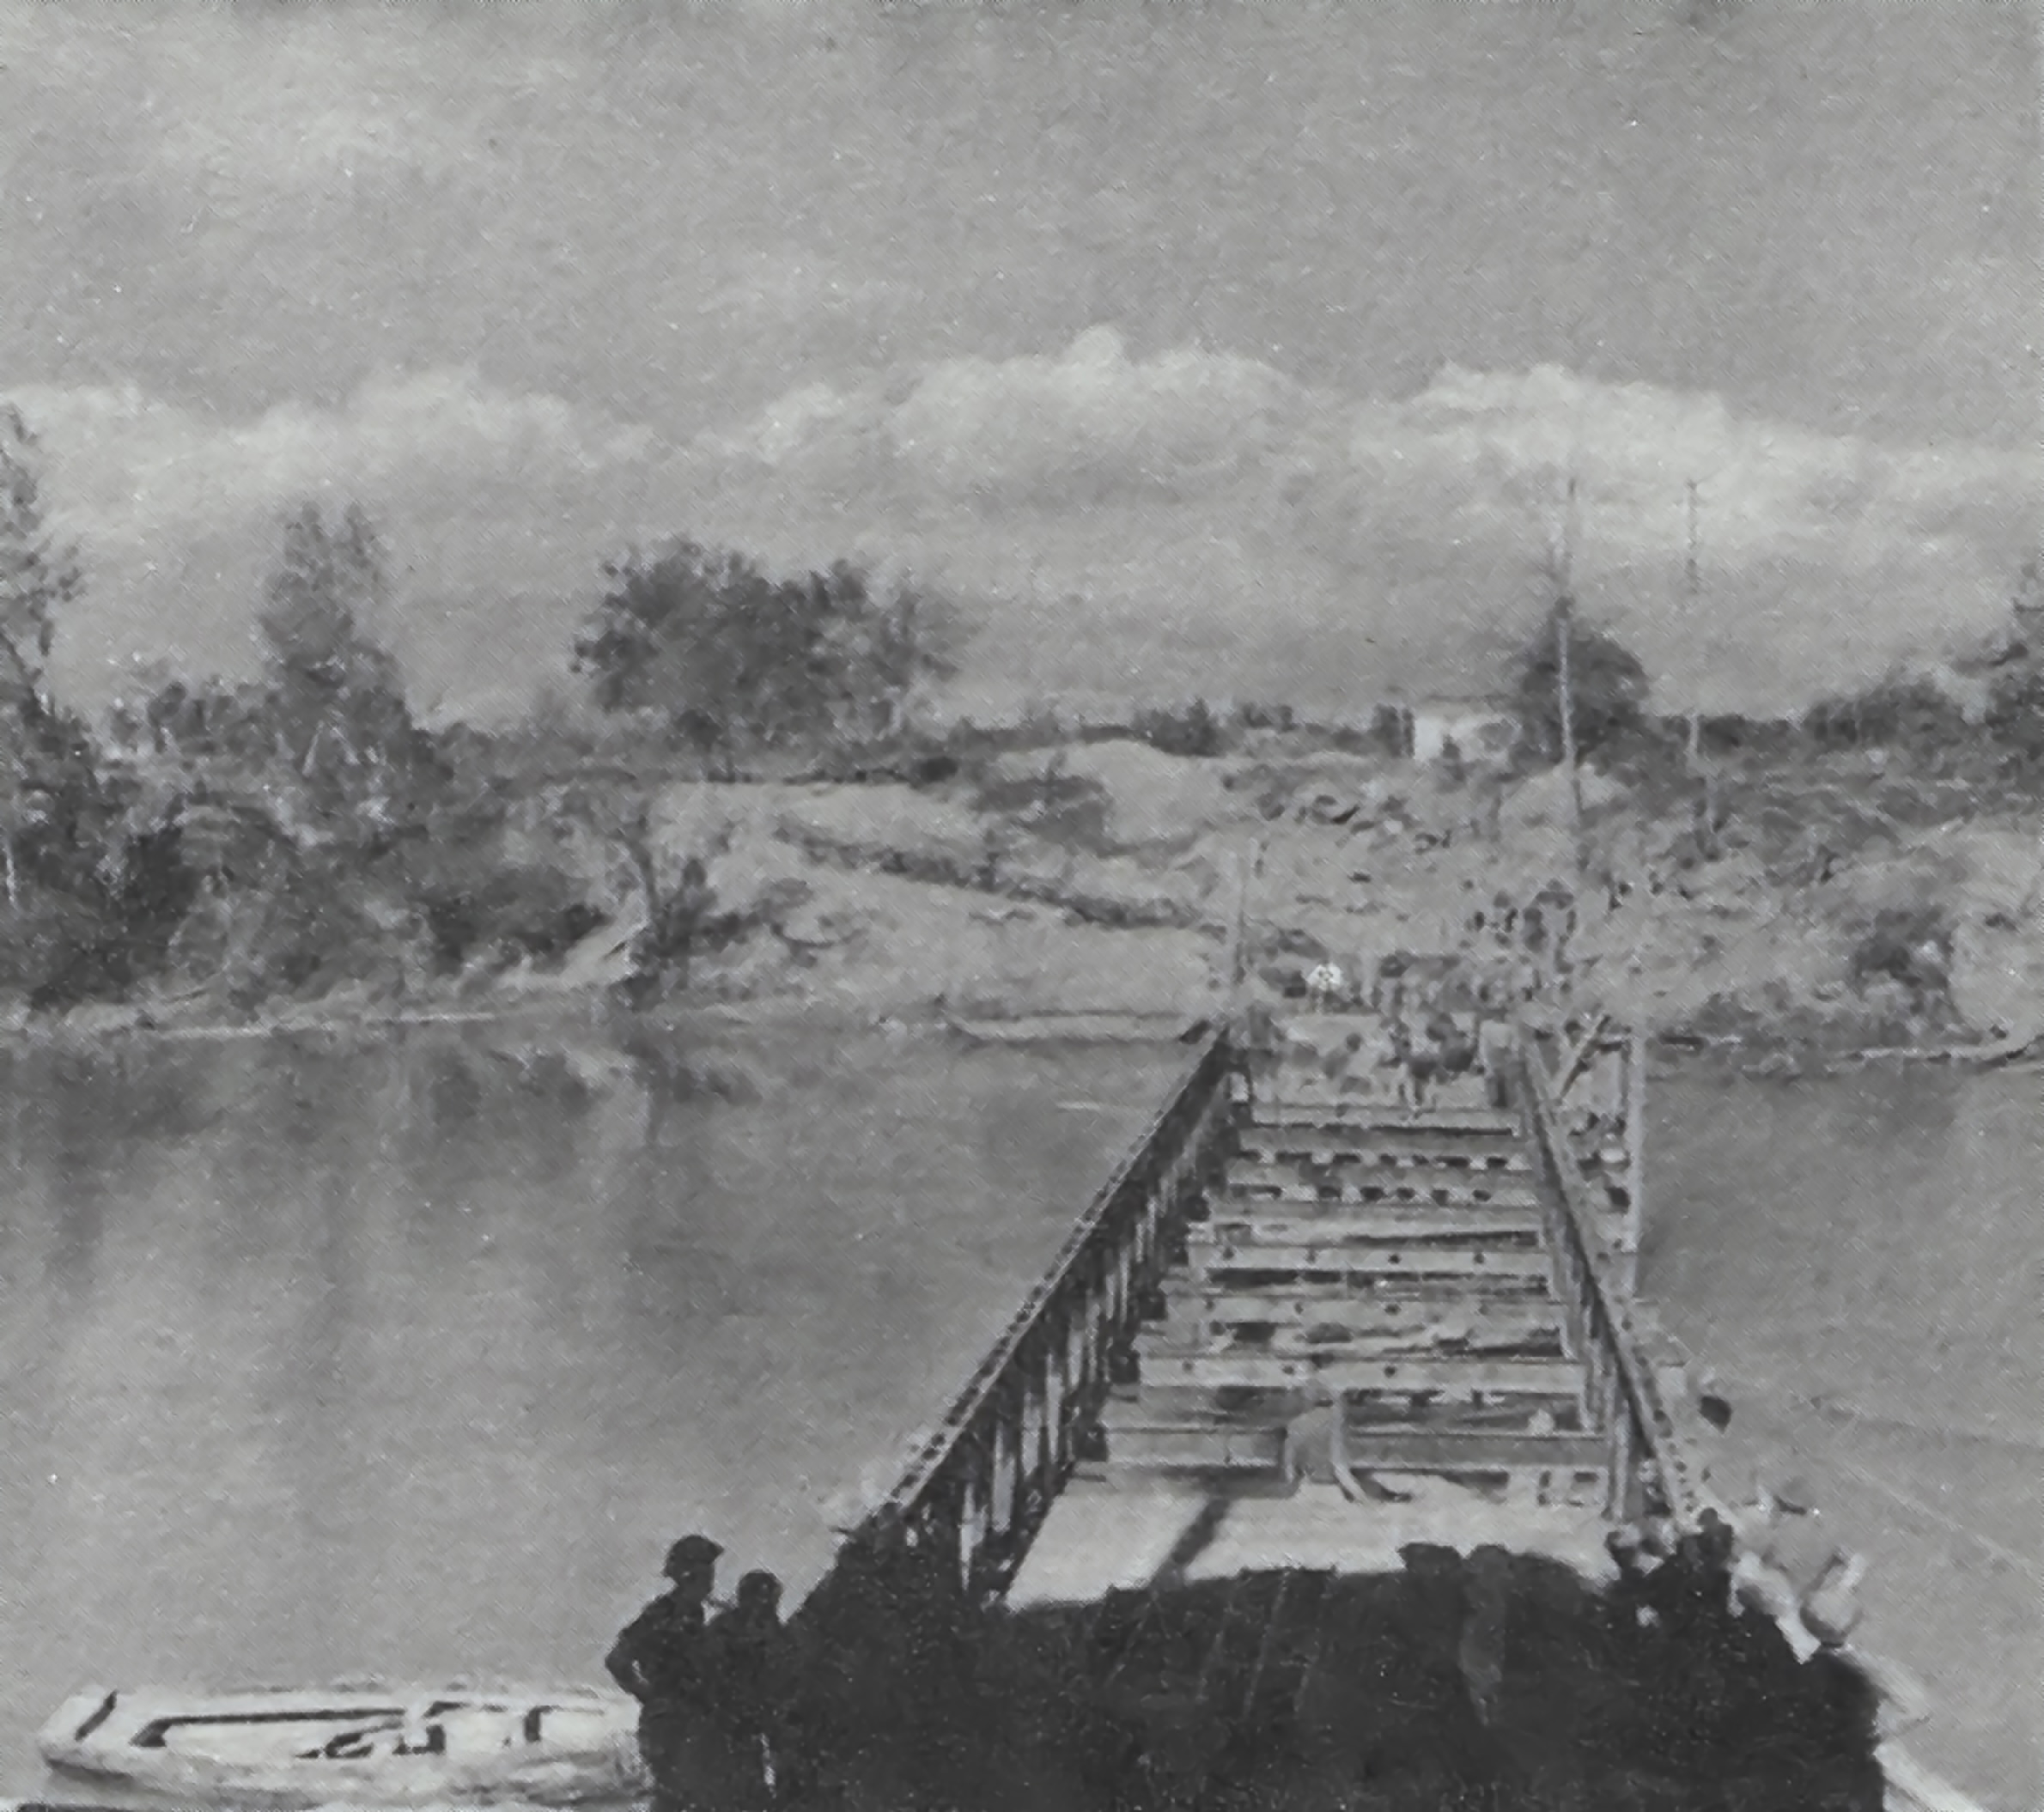

Slide 25
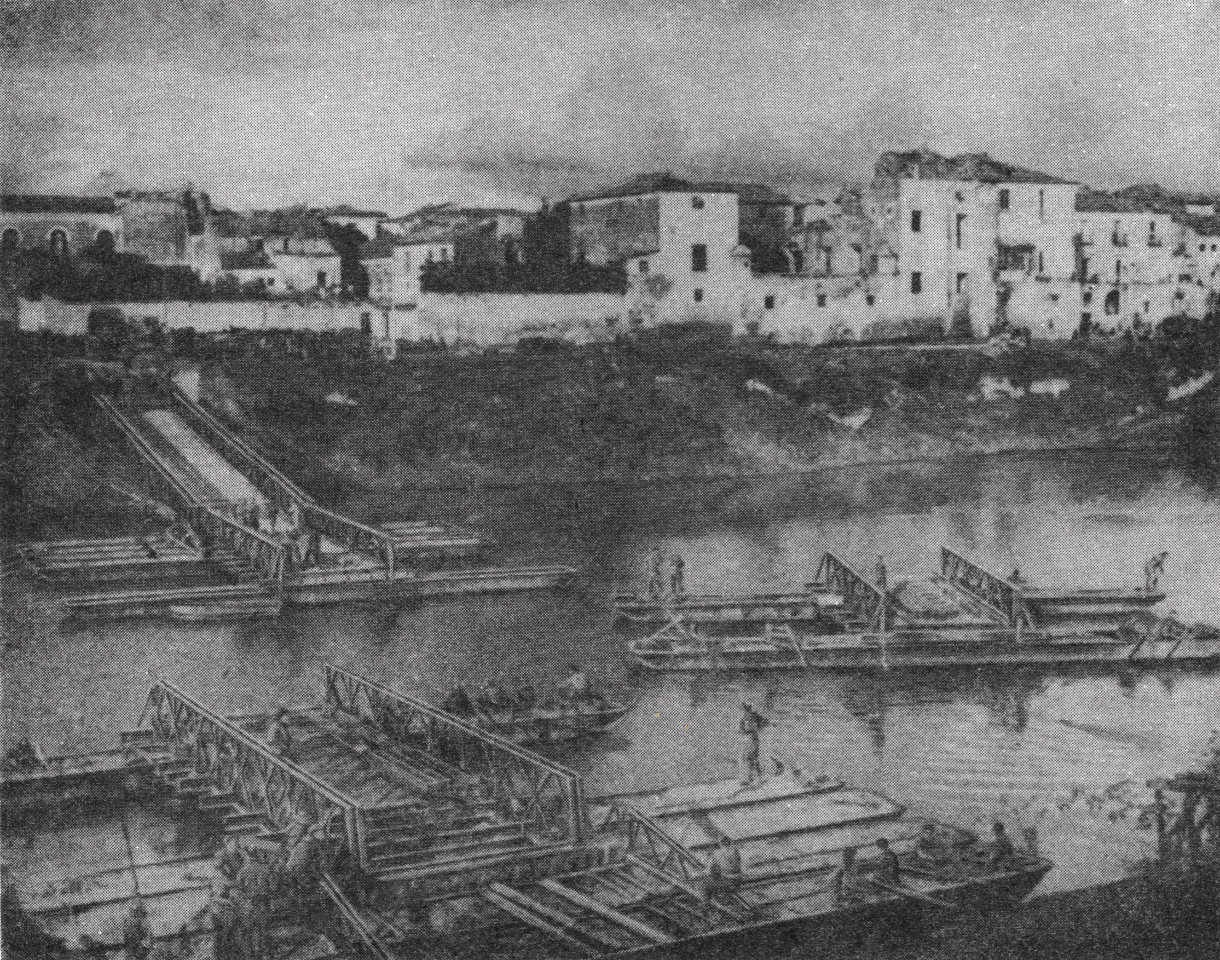
Notes:
Meanwhile at Capua the US VI Corps, further inland on the right of 56 Div, where the Volturno was less formidable, had succeeded in crossing and were pushing ahead. 56 Div finally managed to advance, using an American Class 30 bridge.
By the evening of 15 October all the towns on the north bank of the Volturno had been occupied and cleared. A Class 5 ferry was working at Castel Volturno. The Class 9 FBE bridge at Cancello was being constructed, while the Class 9 bridge at Grazzanise had been opened at 4 pm on 16 October. The Germans began to withdraw under cover of a strong rearguard which mined roads and tracks and thoroughly demolished every bridge and culvert.

Slide 26
Capua Pontoon Bailey Timings
Time | Event
170015-171100 | Mines cleared and near ramp cut
171500-171730 | Bridge offloaded
171899-180300 | End floating bay constructed
180700-181600 | Approaches completed
182045 | Bridge complete
190100 | Bridge open, 340 feet long, after 48 ½ hours
Bridge built in 27 hours by three fd coys
Notes:
At Capua 213 Fd Coy, who were the only sappers outside 46 Div Engrs who were trained on Pontoon Bailey, were switched from the coastal area to Capua, and on 23 October were tasked with reconfiguring the Pontoon Bridge landing bay from DS to DD as a precaution in case a rise in the river level required that the bridge be lengthened. The next night the north (enemy bank) landing bay was extended by 10 feet. This involved digging out 25 cubic yards of earth using only hand tools. Again, on 26 October both landing bays were extended by 20 feet on each side to 120 feet DD.
The precautions, in case the Volturno level rose, were entirely justified. On 16 November the Volturno rose 8 feet, carrying away the Class 9 Bailey at Grazzanise, before subsiding on 19 November. Then on 23 November the river rose 12 feet overnight, before falling on 25 November.

Slide 27
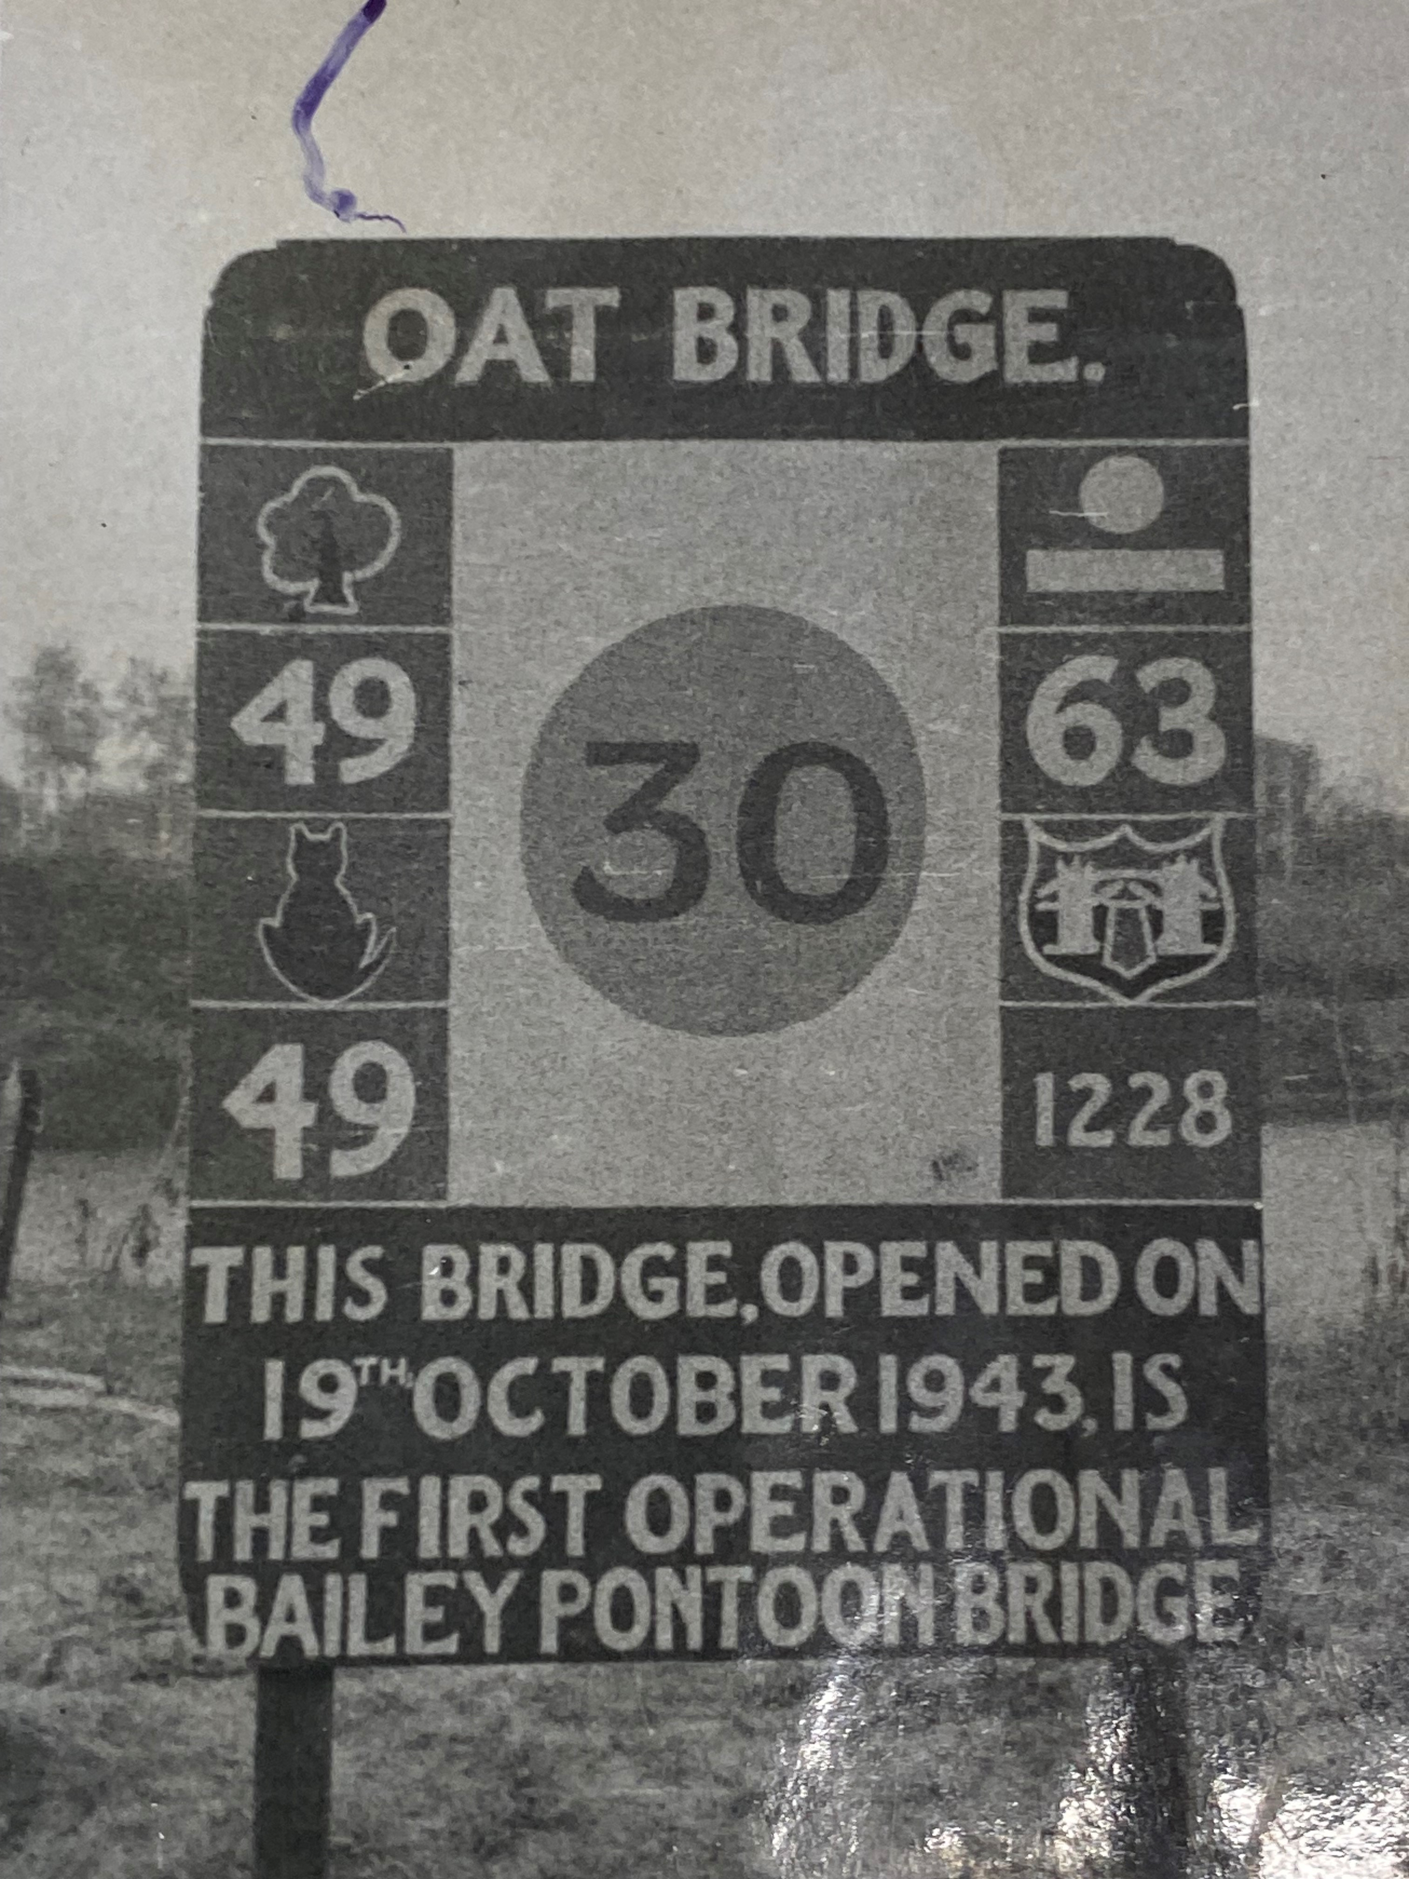
Bridge Tac Sign

Slide 28
And then, after 19 October
213 Fd Coy switched from coast to Capua.
On 23 Oct told to reconfigure the Pontoon landing bay from DS to DD ‘just in case’ of a rise in the river level
Next night the far landing bay was extended by 10 ft, by digging out 25 cu yds of earth using only hand tools.
On 26 Oct both landing bays were extended by 20 ft to 120 ft DD.
The precautions, in case the Volturno level rose, were justified. On 16 Nov the river rose 8 feet, carrying away the Cl9 Bailey at Grazzanise, falling on 19 Nov. Then on 23 Nov the river rose 12 ft overnight, before falling on 25 Nov.
Notes:
At Capua 213 Fd Coy, who were the only sappers outside 46 Div Engrs who were trained on Pontoon Bailey, were switched from the coastal area to Capua, and on 23 October were tasked with reconfiguring the Pontoon Bridge landing bay from DS to DD as a precaution in case a rise in the river level required that the bridge be lengthened. The next night the north (enemy bank) landing bay was extended by 10 feet. This involved digging out 25 cubic yards of earth using only hand tools. Again, on 26 October both landing bays were extended by 20 feet on each side to 120 feet DD.
The precautions, in case the Volturno level rose, were entirely justified. On 16 November the Volturno rose 8 feet, carrying away the Class 9 Bailey at Grazzanise, before subsiding on 19 November. Then on 23 November the river rose 12 feet overnight, before falling on 25 November.

Slide 29
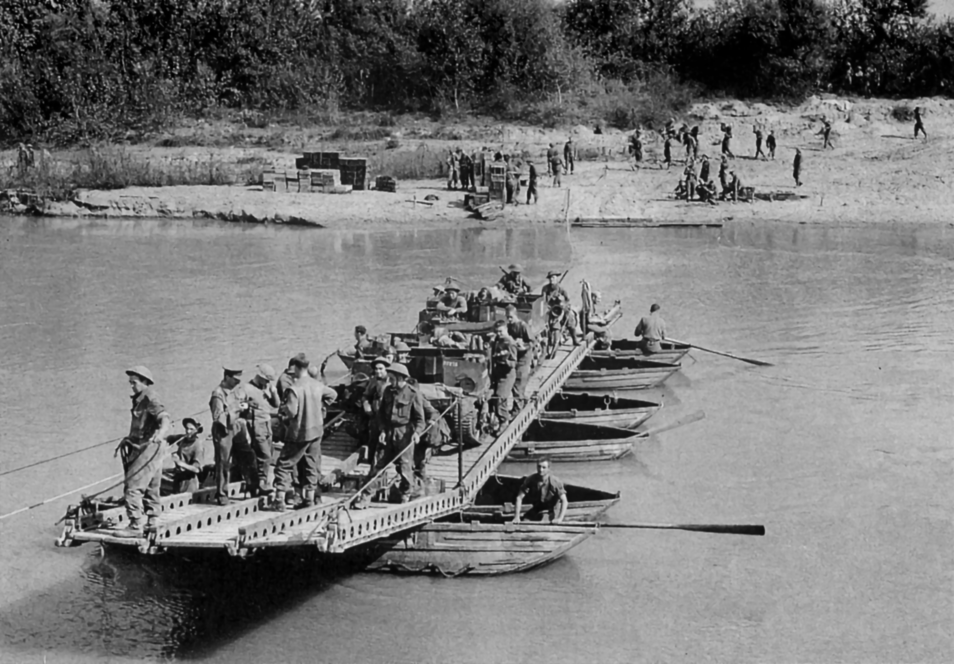

Slide 30
Photo Folding Boat Equipment
Engrs in Italy page vii

Slide 31
Lessons
Engr offrs and NCOs must be highly trained in patrolling
Training bridging
Notes:
The Review of Engineer Lessons was conducted by the CE of X Corps, Brig Godfrey-Fawcett. The list reflected the need to change from ‘exercise mode’ to ‘operations mode’. In some cases the lessons ring as true today as they did 80 years ago, even if the language is stilted to our ears. The main points are below.
Patrolling:
The importance of engineer officers and NCOs being highly trained in patrolling have been emphasised in these operations……
During training in UK stretches of river suitable for bridging sites are chosen beforehand, to avoid damage to land and riverbanks.
Equipment. In training, adequate bridging equipment is allotted to carry out a given task and delays are seldom imposed through lack of it.
Bridge Approaches and Siting
The necessity of siting bridges as close as possible to existing road approaches was again brought out. This usually entails building very close to the demolished bridge…..,
As much work as possible should be done on the approaches before the assault takes place. Work close to the river will often not be possible, but it must be remembered that very heavy traffic will use the approach once the bridge is open. Much waste of time can be avoided before bridge building starts by improving roads, removing bottlenecks and debris, and by clearing spaces for equipment dumps and vehicle turning and parking places.
Where time or the enemy does not permit of approaches being well prepared, care must be taken that the bridge is not open prematurely, or incessant trouble will result. This brings out the value of rafting, which allows essential ….vehicles to cross while work on the bridge is proceeding.
Rafting
There is a tendency during training in UK to consider that rafting is too slow and that it is quicker to construct a bridge at once, thereby getting a faster flow of traffic. This is often true on sites selected for exercises. In actual practice the preparation of bridge sites on nearly all rivers involves construction of approaches and bulldozing of banks. This takes time and little…. can be done before a successful infantry assault has been launched. Rafting and manhandling are the only ways to get anti-tank guns into the bridgehead really quickly.
Rafting must therefore be a very important item in training.
Assault Boats
Training of infantry in the use and handling of assault boats has been seriously neglected in the past. Reliance on doing this training immediately before the operation is unsound.
Mechanical Equipment (plant to us)
Bulldozers have proved essential for bridge construction.
The speed of advance greatly depends on an adequate supply of bridging equipment and bulldozers. The present holding of bulldozers in a corps is considered insufficient.
Manpower
This operation has shown that the number of engineers available in a corps or division is inadequate to deal with the large amount of work involved in bridging, rafting and constructing approaches and deviations.
The construction of a 300-foot Bailey Pontoon on one division front could not be undertaken by the divisional engineers without either seriously reducing the number of personnel engaged in rafting etc, or in delaying the building of the bridge. In fact, RE personnel from Corps Troops had to reinforce the divisional effort.

Slide 32
The Long View
‘The crossing of the Volturno was an amateur performance which would have suffered a severe rebuff had it not taken place at the time that Kesselring had set as the target date for holding the river…. The river was a major obstacle 200-300 feet wide with no obvious fords. The flood plain was flat and after the heavy rains, so soft that vehicles were forced to stay on the roads.’ Gen Sir William Jackson, The Campaign for Italy

