Slide 1
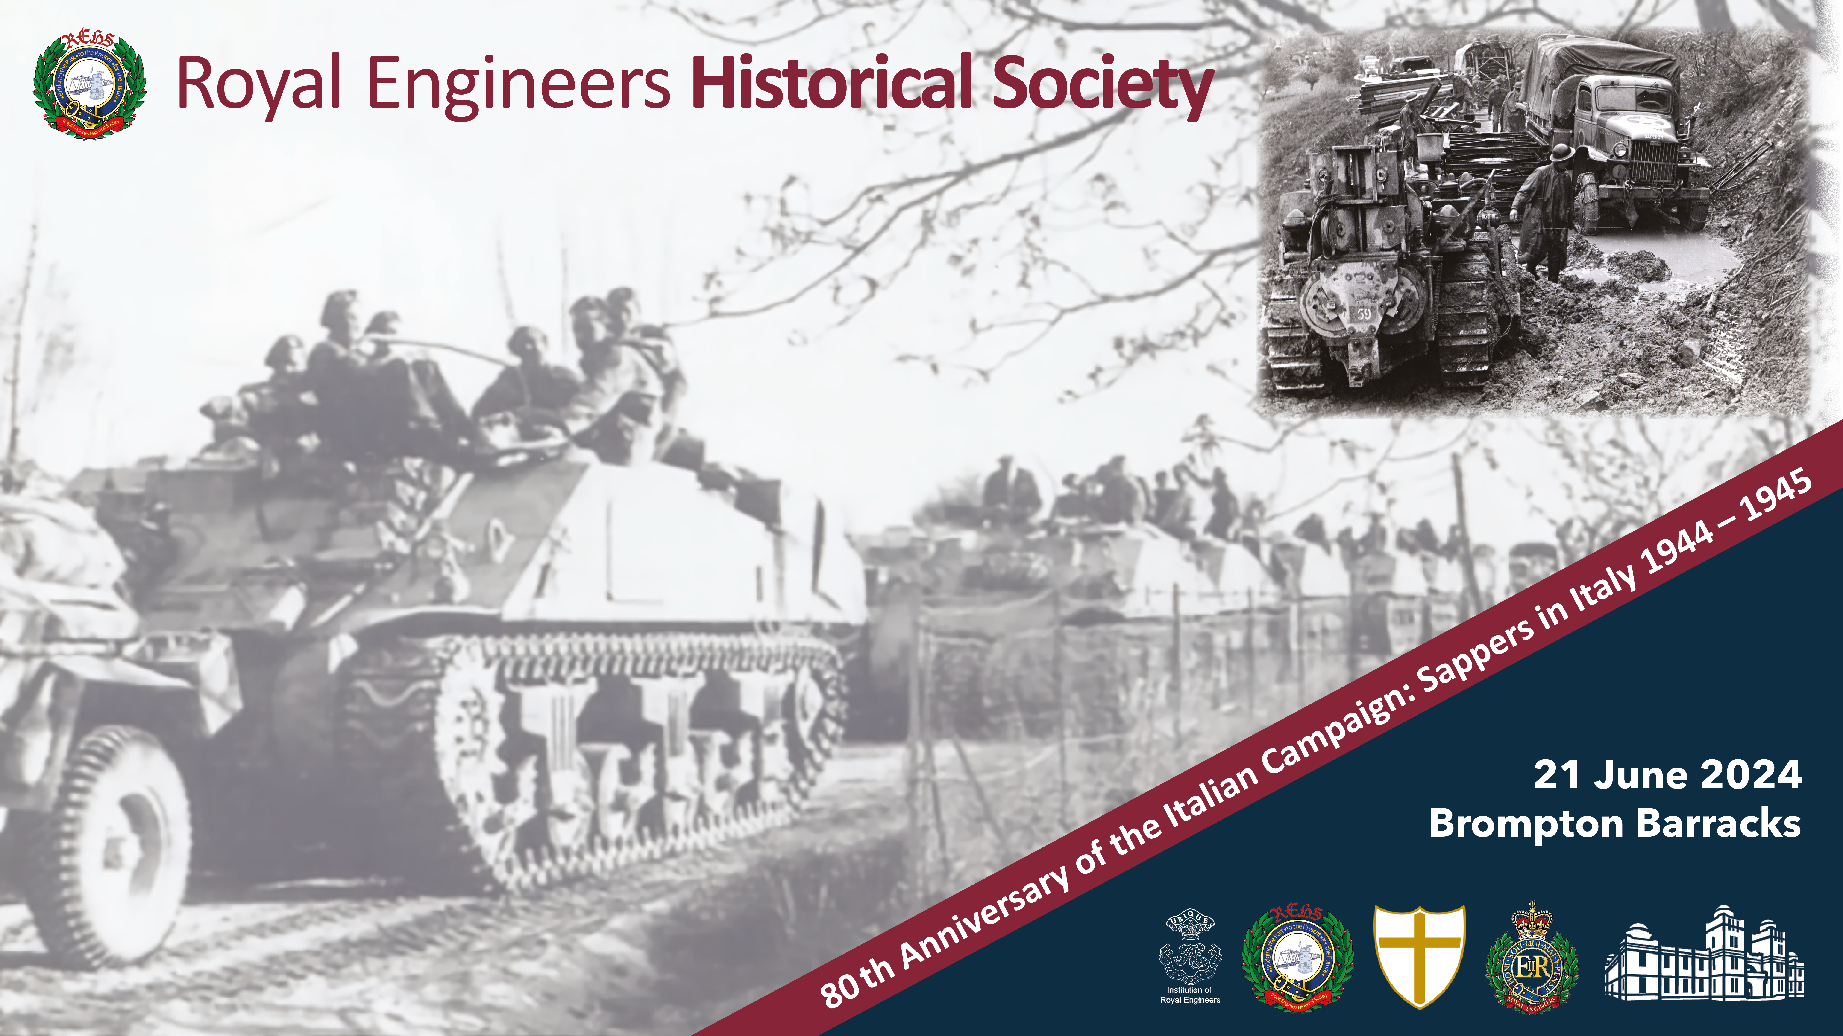
The Amazon Bridge Crossing
Martin Stoneham

Slide 2
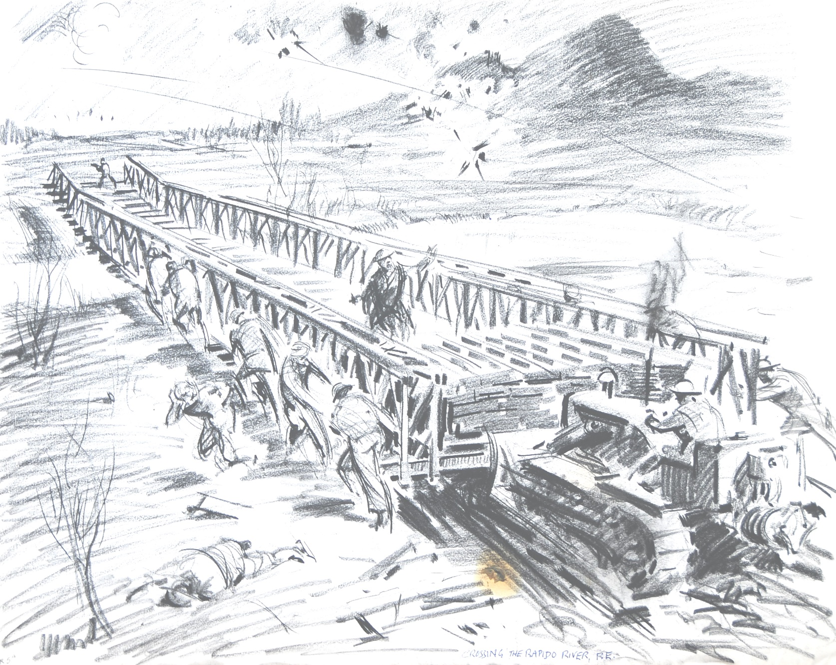


Slide 3
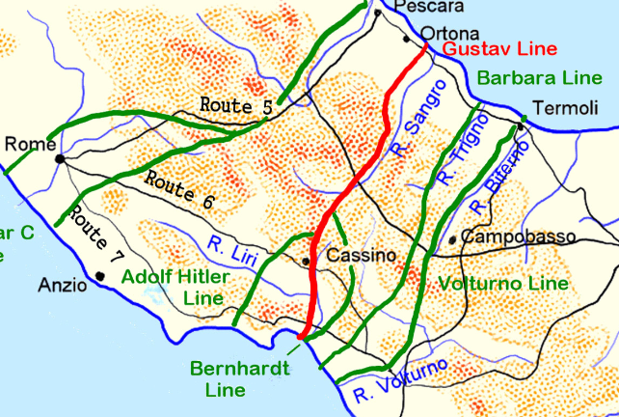
River Garigliano
Notes:
In early January 1944 the Allies began their attempt to break through the Gustav Line. The town of Cassino which lies on Route 6 to Rome had to be taken. On the mountain above the town is the Monastery from which any movement over a wide area of the land below could easily be observed. This made it a key objective for the Allies.

Slide 4
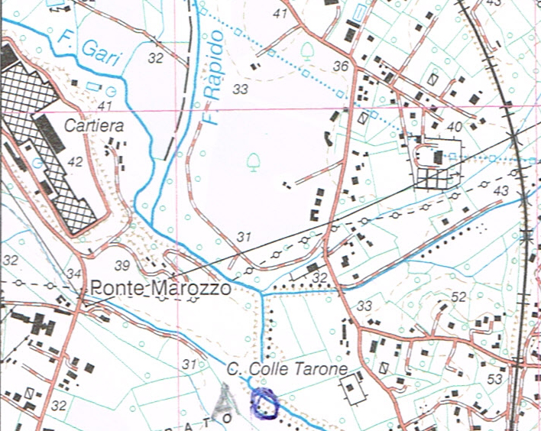
The Gari or Rapido river which further downstream joins the Liri
from which point it is called the Garigliano
Notes:
All of the rivers in Italy could change from a fast flowing stream to a roaring torrent overnight which represented a major challenge to the engineers. The River Gari passes through the town and joins the River Rapido. From their confluence the river is known as the Gari or Rapido, confusingly both names were used on contemporary maps. Further downstream it meets the Liri and from that point on is known as the Garigliano.

Slide 5
The Four Battles of
Monte Casino
12 Jan – 9 Feb: 46th British plus the 36th & 34th US Divisions & the French Expeditionary Force.
15 – 18 Feb: New Zealand Corps (4th Indian & 2nd NZ Divisions).
Notes:
The Allies began their first attempt to take Cassino on 12 January. The British 46th Division successfully crossed the Garigliano River but to their right the US 36th Division’s advance ground to a halt. Relieved by US 34th Division they subsequently crossed the Rapido north of Cassino but their attempt to take the town failed. The French Expeditionary Force’s attempt to advance through the mountains to take the Monastery was beaten by a combination of the German forces and the appalling winter weather which Moroccan and Algerians soldiers were not equipped for. On the 15 February the newly formed New Zealand Corps were tasked to relieve the now exhausted troops. The plan was for the 4th Indian Div to attack Monastery Hill from the north with the 2nd New Zealand Div attacking across the plain to take the railway station and town.

Slide 6
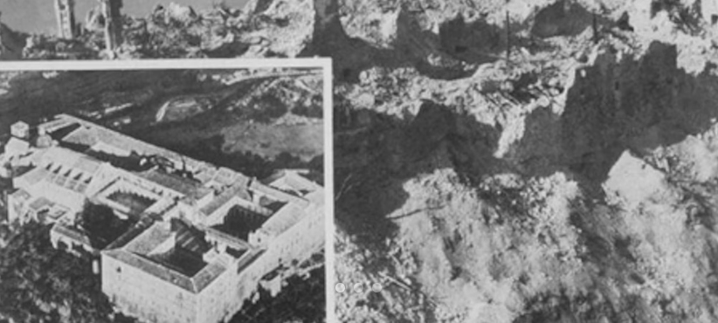
The Casino Monastery
before and after
Notes:
This attack was preceded by the very heavy bombardment of the Monastery reducing it to rubble. The 4th Indian Div were not in a position to exploit this which gave the Germans the opportunity to occupy the shattered ruins. On the night of 17/18 February the Indian, Gurkha and British Troops of the 7th Indian Bde attacked but were forced back. On the plain below the 28th New Zealand Māori Battalion reached the railway station but were also forced back. The second battle of Cassino ended on the 18th.

Slide 7
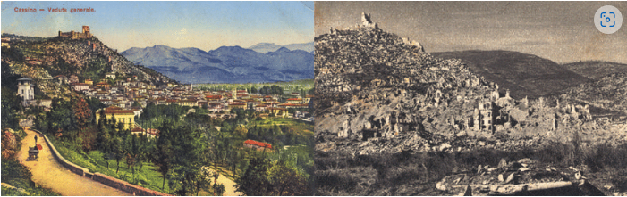
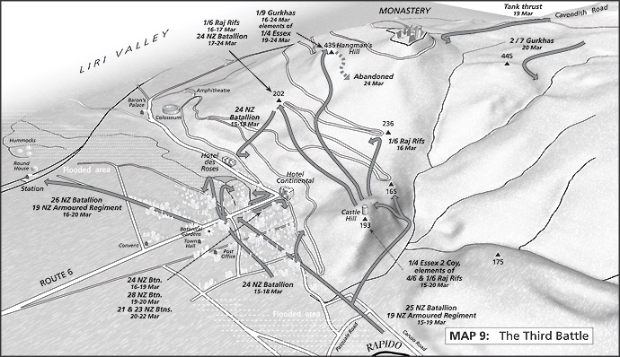
Casino town – before and after
Hangman’s Hill
Point 202
Notes:
Delayed by extreme weather the third battle commenced on 15th March. It was now the town that was subject to a heavy bombardment but its decimated defenders hung on which resulted in vicious house-to-house fighting. The New Zealanders being badly hampered by the fact that the tanks could not easily get into the town. To the north the Indian troops took Hangman’s Hill and Point 202 but the Germans were tenacious in their defence of the ruined Monastery which they continued to hold.

Slide 8
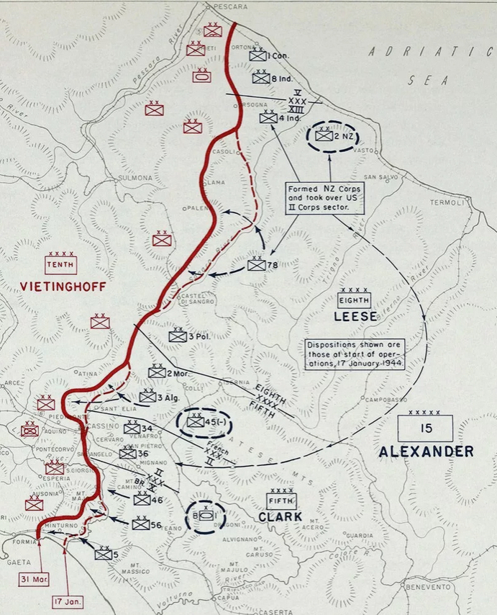
Front line on
17 January
31 March
The dispositions shown are those at the start of the operation on
17 January.
Notes:
This attempt to break through at Cassino ground to a halt on 23 March. The Allies front on 31 March is shown by the solid red line. The dotted red line indicates their start position on 17 January, as can be seen only a limited amount of ground had been taken. The fourth battle commenced on 11 May with the British 13th Corps planning to take the Monastery and advance up the Liri Valley along Route 6.

Slide 9
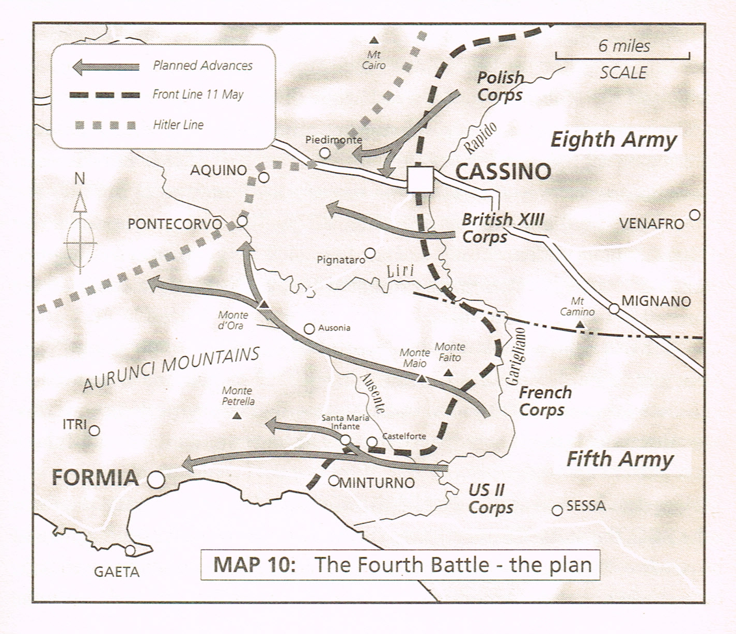
4th British Div
8th Indian Div
Notes:
The 4th British and 8th Indian Divisions were tasked to create river crossings for the 78th British Infantry Div, 1st Canadian Infantry Division and 5th Canadian Armd Division to use to break out from the bridgehead. Two Divisions of the Polish Corps were detailed to move from the north onto Monte Cassino. On the coastal flank the US 2nd Corps were to advance along route 7 with the French Expeditionary Corps going into the Aurunci mountains.

Slide 10
XIII Corps Engineer Units
deployed on bridingc
Operation Honker
8th Army Troops: 586 Fd Coy.
XIII Corps Troops: 56, 577 & 578 Fd Coys.
4th British Infantry Div: 7, 59 & 225 Fd Coys, 18 Fd Pk Coy,
10 Mech Eqpt Sect, 3 Bridging Pn.
Plus 8 Fd Sqn from 6 Armd Div under command.
8th Indian Div: Indian Engineers of 7, 66 & 69 Fd Coys,
46 Fd Pk Coy. [King George V Bengal Sappers & Miners]
I Canadian Corps: 12 Fd Coy RCE.
1st Can Inf Div: 1, 3 & 4 Fd Coy RCE, 2 Fd Pk Coy RCE, 1 Bridging Pn RCE.
Notes:
This is the situation which the Sappers found themselves facing on 11 May. The twenty-one engineer units from 13 Corps were to be deployed primarily on bridging in accordance with the orders for Operation Honker. The Divisional engineers were supported by both Army and Corps troops. This is the plan,

Slide 11
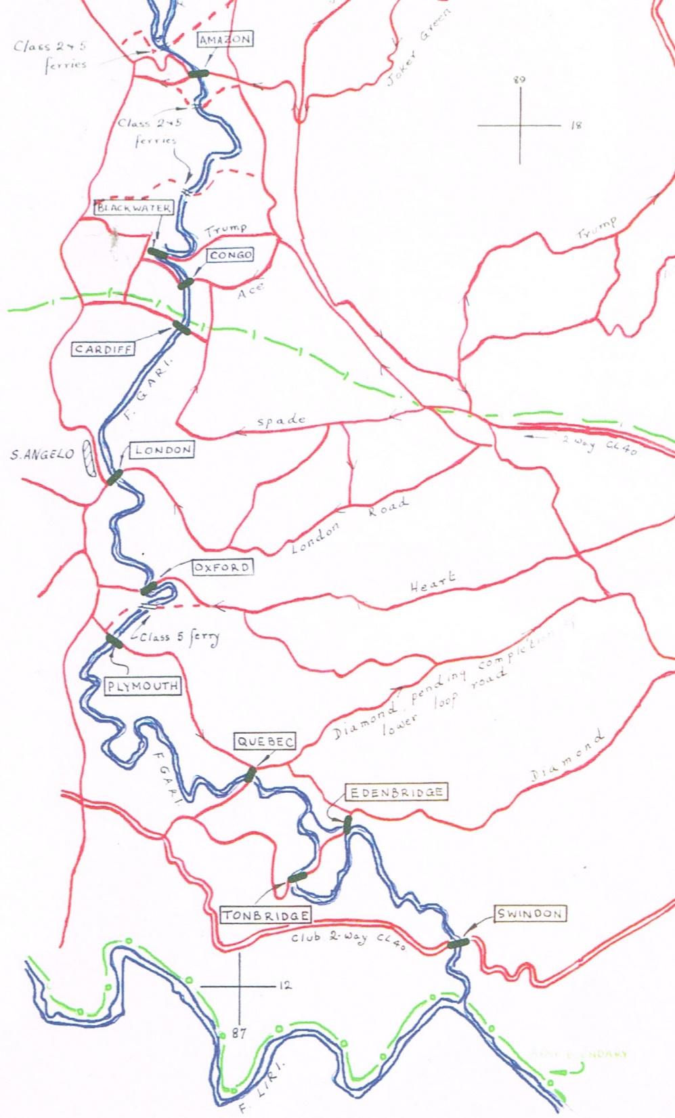
Amazon
Blackwater
Congo
Cardiff
London
Oxford
Plymouth
Quebec
Edenbridge
Tonbridge
Swindon
Op Honker
Assault Crossing
Plan
River Gari
Night 11-12 May
CE Branch
13 Corps
Ferries
Notes:
all of the bridges are shown and the blue triangles mark the three ferries. It was intended that these would all be built on the night of the 11/12 May. Moving on now to the reconnaissance of the Amazon site by 225 Field Company. The first attempt on the night of 6/7 May by Lt Moore and the recce sergeant using an inflatable dinghy failed. Suggestions as to how the recce might be completed were sought and Cpl Arthur Gibbs volunteered to try and swim across. His account, previously unpublished, appeared in the April issue of the REJ.

Slide 12
Extracts from Corporal Arthur Gibbs report (he refers to himself as the Corporal)
The night of the recce, 11 pm came. Lieutenant Moore, the recce sergeant and the corporal made their way down to the river. Near to the river was a building occupied by infantry who were covering that sector; they were to provide the covering party.
It was a lovely night, not a cloud to be seen, a full moon. In fact it was quite light and warm. The river was reached.
Dropping down on the bank to regain breath at the same time scanning the proposed bridge site, and hoping that he had not been observed by Jerry, so far so good. The officer took in the slack cable while the corporal held his end of the cable central to where he thought the bridge bank seat should be. The officer or sergeant would do the same on their side marking the cable at that point – thus the width of the bridge would be known. The corporal was crawling and looking around memorising the information, the makeup of the ground, the amount of work, the tools needed, would the ramps be sufficient? All this information was vital.
So entering the water as quiet as possible he struck out and the pull on the cable, how good that felt. The first part of the job is over he thought as he waded out and onto the home bank. No word was spoken, just a pat on the back, a helping hand on with the overcoat then back to get dressed. Lieutenant Moore gave him a tot of whisky he had thoughtfully brought with him, it went down very well.
Notes:
He recounted that, tethered to a rope, held by Lt Moore he swam across but was swept downstream 60 feet before he got onto the far bank. In trying to crawl back to the proposed crossing point he was badly cut up by the undergrowth. Risking all he stood up and dashed, fortuitously unobserved, to the correct place. Here he mentally noted the ground conditions then, with the rope taught, it was marked by Lt Moore to later determine the width of the crossing. Cpl Gibbs then slid carefully down the 6’ bank so as not to make a splash and swam back assisted by the rope party. His well deserved reward was a tot of whisky. The width at the waterline was 63 feet.

Slide 13
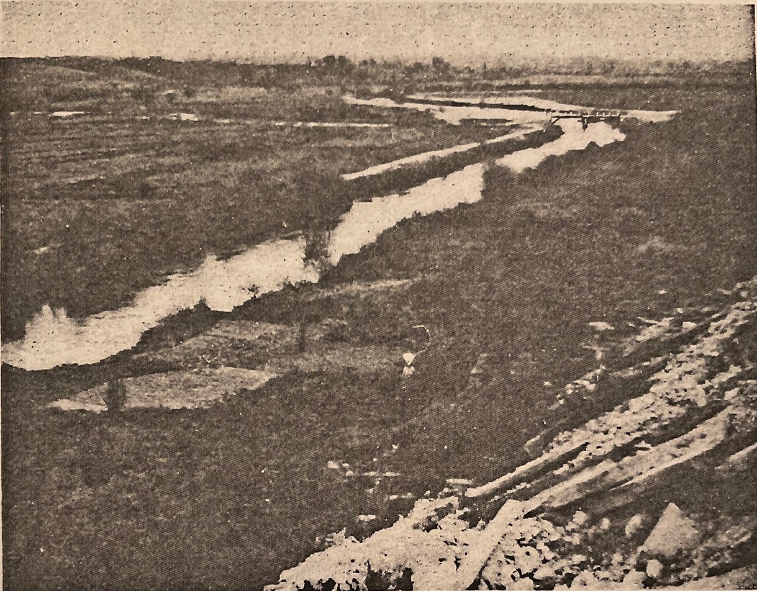
The Rapido near St Angelo
site of London Bridge
Notes:
225’s OC Major ‘Robin’ Gabbett decided on an 80 foot Double Single. He planned to cut down the home bank to within 3 feet of the field and to cut the far bank one foot lower than the home bank. The panel party would have a high, but manageable, 7 foot lift. In the end the bridge was launched on an upward slope of about 1 in 25. A considerable effort was put into training. 59 Fd Coy did 5 or 6 builds over the Volturno with a best time for a 100’ night build of 2.5 hours. 225 Fd Coys War Diary noted that ‘Expectation is high, company morale is high.’ So to action … at 2300 hours on 11 May the 630 guns of 13 Corps opened fire en masse …

Slide 14
The 4 Division G Branch log noted that at:
0100 hours work on the three bridges, Amazon [225 Fd Coy], Blackwater [59 Fd Coy] and Congo [7 Fd Coy] was under way in spite of heavy shelling.
0330 hours: the news of bridging progress was bad. All three bridges were being held up by shelling, although perhaps Blackwater was in advance of the other two.
0500 hours the Div Comd was satisfied that no further forward move could be made by either brigade unless some anti-tank guns were brought up …
0530 hours it was daylight and small packets of the enemy were able to harass the bridging sites with small-arms fire and did so to such effect that work on the ferries and bridging sites was virtually at a standstill …
Notes:
The 4th Division G Branch log noted that at:
0100 hours work on the three bridges, Amazon, Blackwater and Congo was under way in spite of heavy shelling.
0330 hours: the news of bridging progress was bad. All three bridges were being held up by shelling, although perhaps Blackwater was in advance of the other two.
0500 hours the Div Comd was satisfied that no further forward move could be made by either brigade unless some anti-tank guns were brought up …
0530 hours it was daylight and small packets of the enemy were able to harass the bridging sites with small-arms fire and did so to such effect that work on the ferries and bridging sites was virtually at a standstill …

Slide 15
The CE XIII Corps Daily Log reported:
The tank assault bridge at Plymouth (8 Indian Div sector) was held up by small arms fire, but complete by 1030 on 12 May. A number of tanks crossed over. 8 Ind Div RE lost 3 killed and 15 wounded, its bridge was complete by 120815 and tanks were moving across.
Notes:
Meanwhile CE 13 Corps Daily Log reported progress downstream: The tank assault bridge at Plymouth in the 8 Indian Division sector was held up by small arms fire, but completed by 1030 on 12 May. A number of tanks crossed over. The Division lost 3 killed and 15 wounded. At dawn all the other tasks on the Corps front were abandoned on orders from the CRE. The tank assault bridge at Plymouth came about following an off hand remark by one of the 8th Indian Divs Staff Officers. He apparently said “Well, why can't we build a Bailey Bridge and push it across the damn river—it's only a couple of a hundred yards wide!'

Slide 16
Plymouth (Kingsmill) Bridge
Notes:
The OC Calgary Tanks who was present took this idea to Captain Tony Kingsmill, Royal Canadian Electrical and Mechanical Engineers who was OC of his Light Aid Detachment. From this was born the eponymous Kingsmill bridge. With the help of the Indian Sappers and four Sherman tanks, the Kingsmill designed prototype was built and tested in just a week. On the 12th with the bridge precariously mounted on rocking rollers on the lead tank it moved forward with the second tank pushing the load as well.

Slide 17
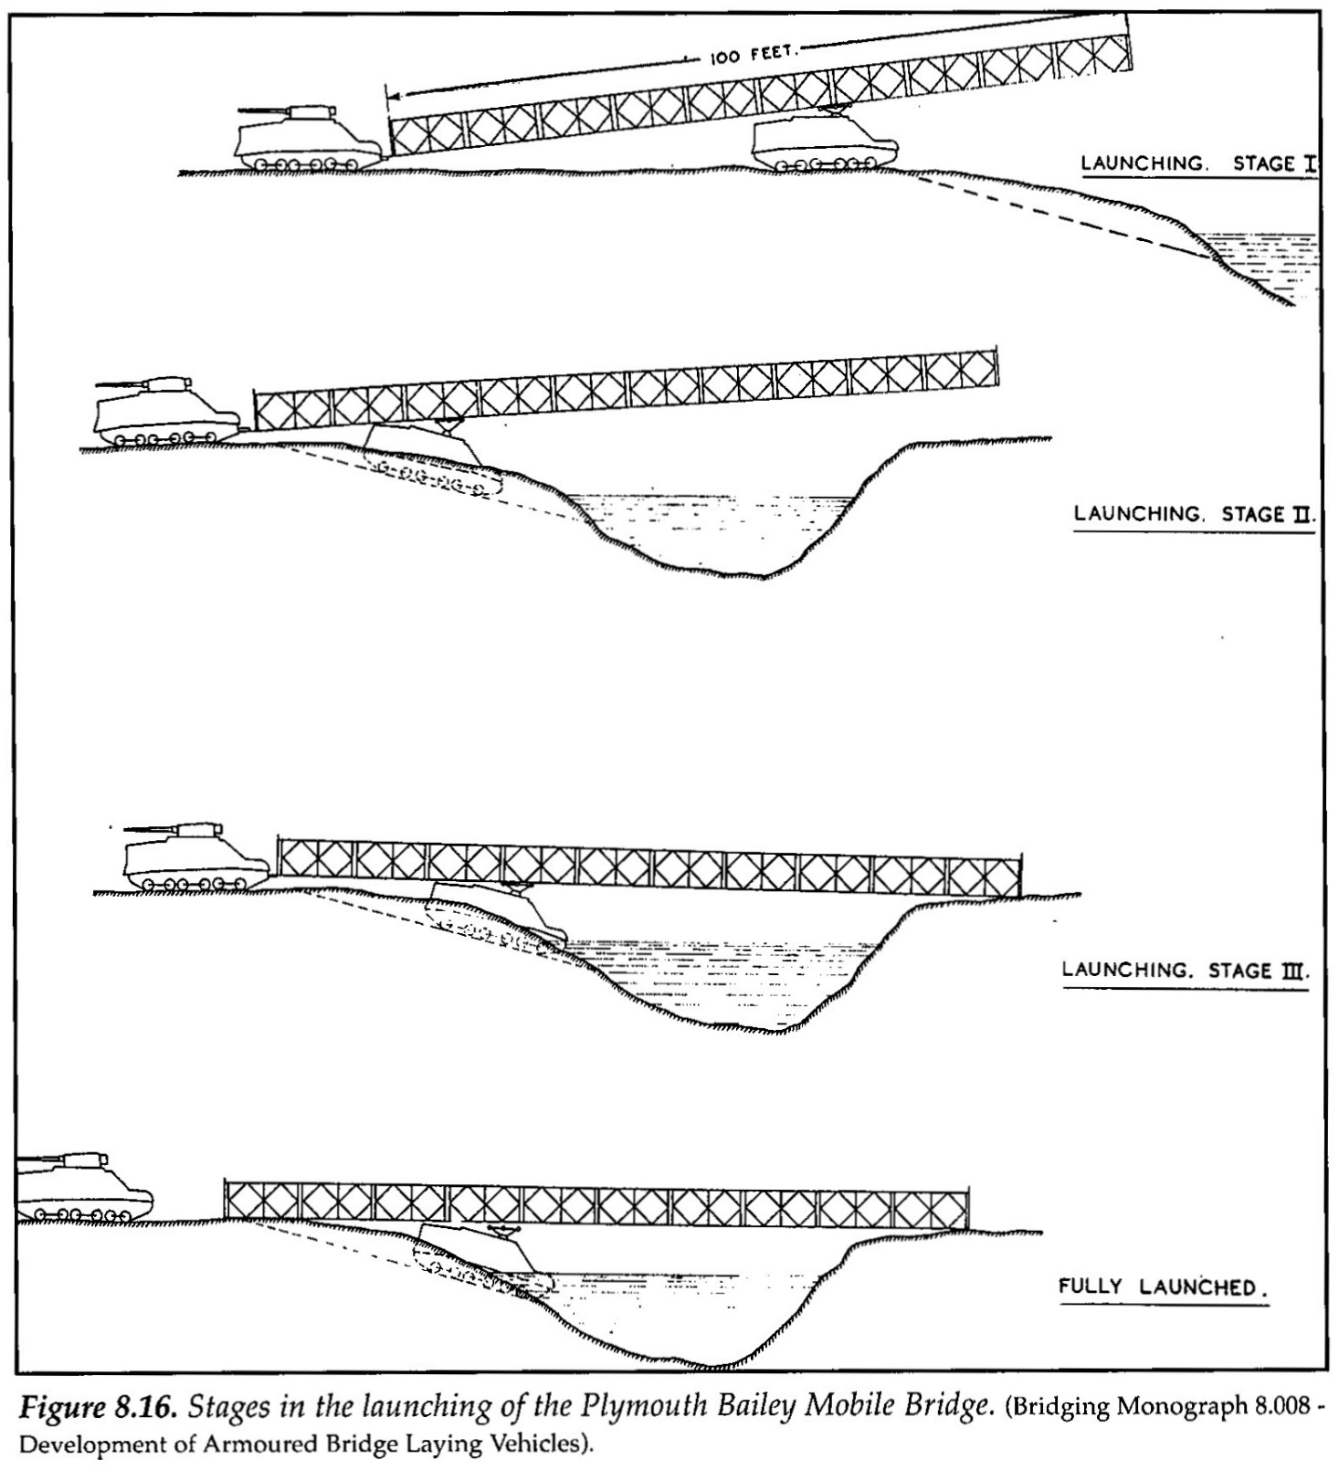
Notes:
The plan was that lead tank should stop at the waters edge for the bridge to be pushed across the gap. In reality the lead tank went into the river but the crew managed to escape. Now, although the bridge was across the gap it was still resting on the leading tank. The result was that as a tank crossed the bridge it reacted like a child's seesaw. So, until the evening, only one tank could cross at a time. But it worked! Interestingly in 1943 the EBE had already given thought something almost identical which was later designated the Bailey Mobile Bridge.

Slide 18
Status of crossing
on the morning of 12 May
Bridge | Field Company | When open
4th British Inf Div area
Amazon 80’ DS | 225 Fd Coy | Failed 11/12 May
Blackwater 100’ DS | 59 Fd Coy | Failed 11/12 May
Congo 100’ TS | 7 Fd Coy | Failed 11/12 May
8th Indian Div area
Cardiff 90’ TS | 7 Fd Coy Indian Engrs | Failed 11/12 May
London 90’ TS & 40’ DS on home approaches. | 577 Fd Coy, XIII Corps Tps | Stopped night 11/12 May
Oxford 90’ DS | 66 Fd Coy Indian Engrs | Two rafts early on 12 May Bridge 12 May
Plymouth 100’ DS | 69 Fd Coy Indian Engrs Canadian Churchill tank launched | Open 12 May – limited traffic. 40’ SS later added over boggy ground.
Quebec 80’ DS Cl. 40 | 1 Fd Coy RCE
Tonbridge 110’ TS | 56 Fd Coy, XIII Corps Tps
Edenbridge 90’ DS | 56 Fd Coy, XIII Corps Tps
Swindon 80’ DS | 12 Fd Coy, Cdn Corps Tps
Notes:
The build status on the morning of 12 May was grim with only two bridges and two rafts in operation. The Divisional Commander, Major General Dudley Ward gave the order that: “the Amazon was to be built that night regardless of cost.”

Slide 19
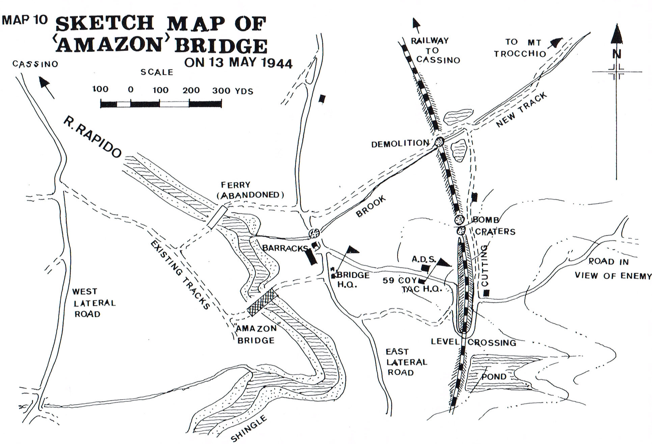
To be built sequentially by 225, 7 & 59 Fd Coys.
Notes:
The plan of his CRE Lt Col Nelson was that 225, 7 & 59 Fd Coys would work sequentially in that order to build the Amazon bridge. This they did with 578 Fd Coy taking over the completed bridge.

Slide 20
Timeline – Night of 12 – 13 May
There was almost continuous and sometimes extremely heavy enemy artillery, mortar and small arms fire throughout the night. Also, counter fire dropped short a number of times. Most omitted for clarity.
Time | Event
1700 | Works starts on track to bridge. 225 Coy bulldozing site. 7 & 59 Coys to harbour area.
1733 | Conditions most unfavourable, work has not started because lorries have not arrived.
1810 | Approaches 25% complete. D6 bulldozer working on bank.
1900 | 7 Coy moved to waiting area, the railway cutting.
1945 | 7 Coy unloading party to site.
1950 | D6 now a casualty – replaced by D4
2000 | 59 Coy moved to waiting area. D7 damaged. D4 OK. Maj Low (OC7) wounded.
Notes:
These are the key events of the build on the night of 12 & 13 May. The site was subject to almost continuous and sometimes very heavy enemy artillery, mortar and small arms fire. Counter battery fire also dropped short onto the bridge site a number of times. Just a reminder that due to the high flood banks the tail of the bridge was 7 feet from the ground. A demanding lift.

Slide 21
Time | Event
2025 | Lt Severn of 7 Coy reported bulldozing complete, nose started.
2030 | Track finished, launching rollers finished. Section of 7 Coy on site with 225 Coy.
2035 | Maj Low (OC 7) reported injured – both legs (time message received by CRE).
2130 | Bridging lorries on site. Getting dark. Lt Notley and CSM Tatton (59 Coy) took control of bridging lorries, which were unloaded … 225 Coy withdrew except bank seat party which left at 2145.
2135 | Require artillery concentration for at least one hour. Progress of bridge good but slow.
2200 | Launching nose complete. Lt Hobson (7 Coy) asked for 59 Coy support. Lt Bolton went with 2 Sect, tried to build ferry, failed.
2255 | Work 100% on near bank & 30% complete far bank. Unloading 90% done. Bridge 30% complete.
2320 | Still being shelled. Nose complete.
2359 | All stores unloaded. Bridge proper started. 59 Coy took over. ETC 02.00
0015 | 8 Fd Sqn to clear enemy minefield.
0100 | Sherman tanks heard; Daniell ran to turn them away. Enemy fire increased due to tanks. ETC 03.00
Notes:
The news that Major Low had been wounded at 20.00 hrs reached the CRE at 20.35hrs. At midnight Major Daniell reported the estimated time of completion as 02.00hrs and an hour later it was given as 03.00 hrs. From 23.59 hrs 59 Coy took the lead although men from 7 and 225 Coy remained on site to its completion

Slide 22
Time | Event
0130 | All lorries unloaded. Bridge 60% complete. Bridge open at 0300 hours. Still being shelled.
0200 | 8 Fd Sqn recce group cleared; bridge reached far bank but lead transom stuck. Second machine gun taken on by Sgt Parry with Spr Halliday who also rescue of 8 Fd Sqn recce group.
0230 | Bridge 75%. Some 7 Coy to bridge centre to deck down.
0330 | Enemy MG in position on far bank. Infantry are assisting.
0330 | Construction nose on rollers. Bridge proper still 20 feet short. D4 damaged, tank sent for.
0340 | Bridge launched [by tank] – open to infantry.
0345 | Tank pushes bridge. More artillery fire due to noise of tank.
0400 | Very heavy shelling. Bridge complete, pushed off home bank rollers.
0430 | Ramps started. All sappers building to finish [59 Coy & a few from 7 & 225]
0500 | Maj Daniell reports the bridge complete. Handed over by Lt Boston to 578 Fd Coy
Notes:
which Tony Daniell declared at 05.00hrs. The bulldozers and their gallant operators played a key role in preparing the approaches and launching the bridge. The D6 and D7 were knocked out in the early evening leaving ‘Weary Willie’ a D4 dozer to do all of the work. This was put out of action by enemy fire at 03.30hrs as it was launching the bridge. Lt Boston was detailed to get one of the 17/21 Lancers tanks to come up.

Slide 23
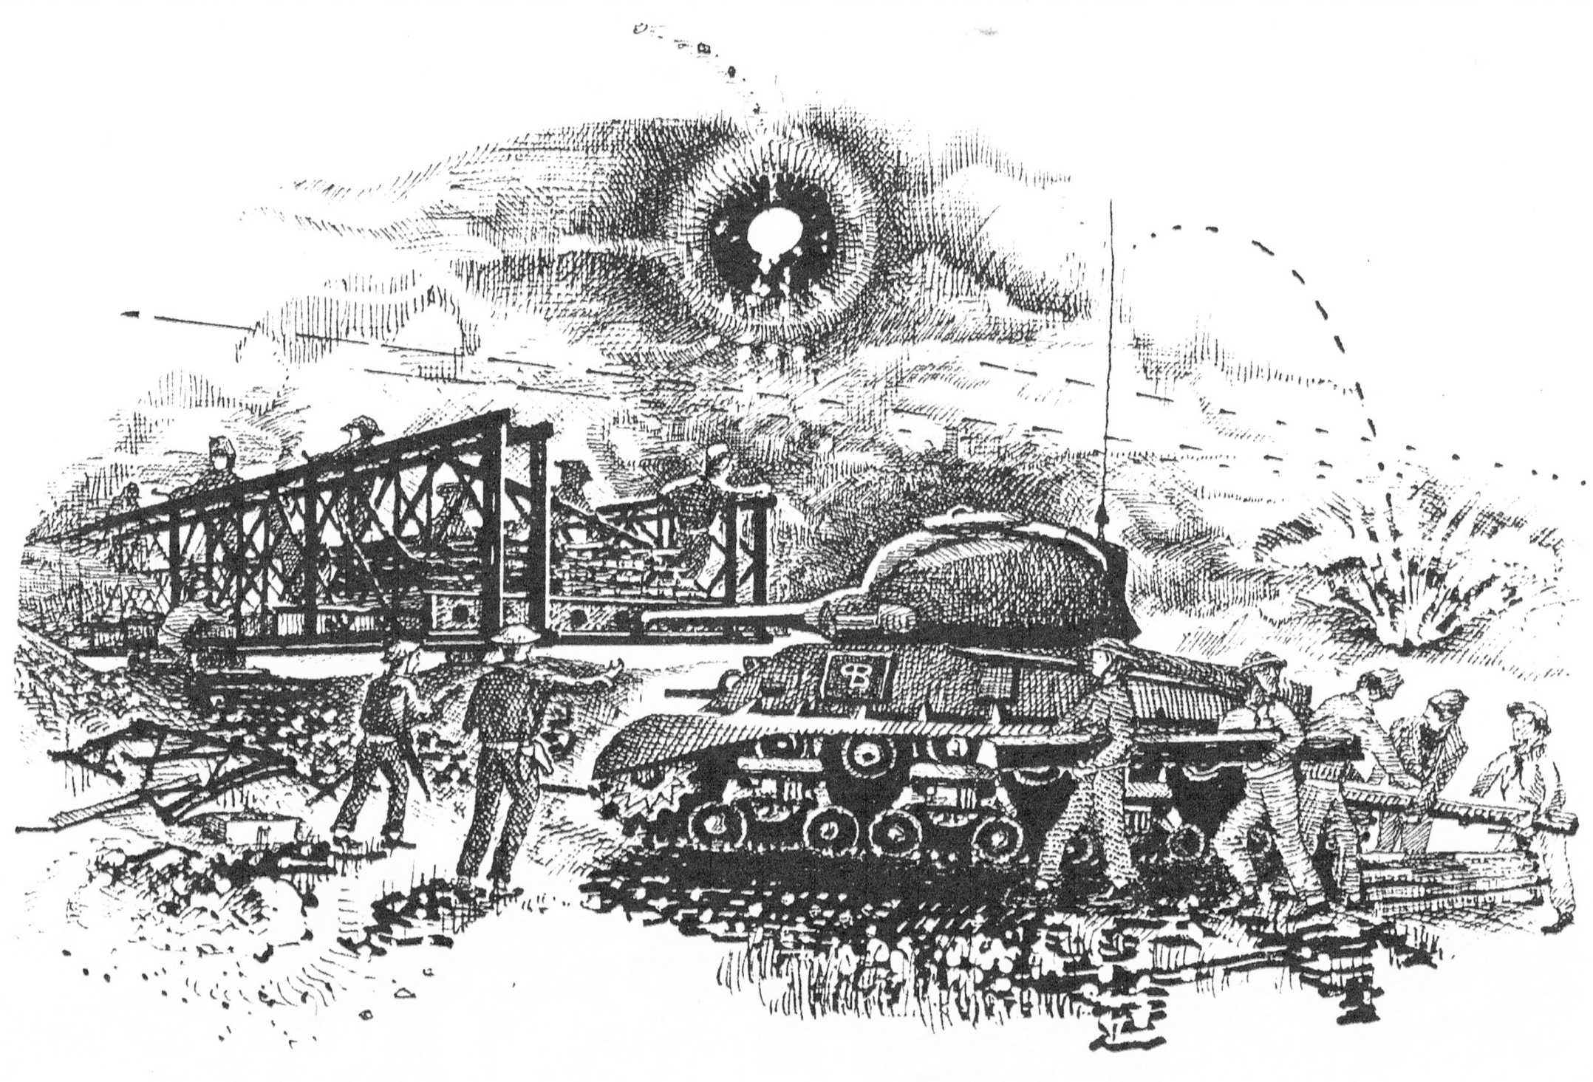
Notes:
This proved more challenging than expected as attracting their occupants attention was a problem. Peter Boston eventually resorted to hammering on the turret with his pistol butt. A tank came up, pulled the Dozer out and launched the bridge by pushing on the transom with its gun. Once across the bridge was pushed of its rollers. The sway bracing and transoms of the launching nose were then removed, leaving the panels to be removed later. The first tanks crossed at 05.30hrs.

Slide 24
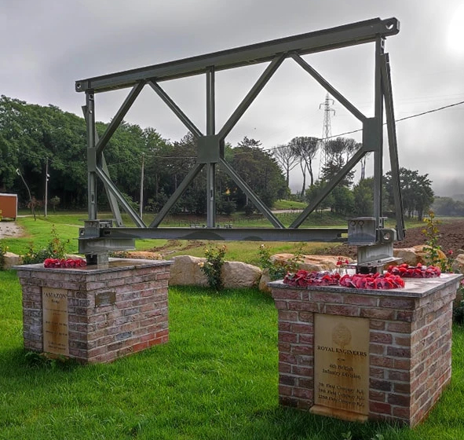

Casualties
‘AMAZON’
Bridge
The bridge that
Had to be built
“…at all costs.”
Built 1700 hrs
12th May
To
0500 hrs
13th May 1944
72 officers and men killed and wounded
ROYAL ENGINEERS
of the
4th British
Infantry Division
7th Fd Coy RE
59th Fd Coy RE
225th Fd Coy RE
Casualties 12 to 13 May | Killed in action (All ORs) (CWGC records) | Officers Wounded | ORs Wounded | Total
7 Fd Coy | 2 | 3 | 29 | 34
59 Fd Coy | 3 | 1 | 18 | 22
225 Fd Coy | 5 | - | 5 | 10
Total | 10 | 4 | 52 | 66
Notes:
As is well known, this all-out effort proved to be successful, although it did indeed require all three under manned field companies to complete the bridge and, even then, the bridge, normally a 3-hour task for a reinforced field platoon, took 12 hours to build. The CREs War Diary recorded that there was a total of 66 casualties of whom 10 were killed in action. I have not been able to reconcile this with the 72 stated on the memorial which is near the site of the bridge.
10 sappers were killed and 4 officers and 52 sappers wounded. [7 Fd Coy: 3 Offrs and 31 OR; 59 Fd Coy: 1 Offr and 21 OR; 225: 10 OR].

Slide 25
Status of Crossings on and after 14 May
Bridge | Field Company | When open
4th British Inf Div area
Amazon 80’ DS | 225, 7, 59 and 578 Fd Coys | Built 12/13 May
Blackwater 100’ DS | 7 and 59 Fd Coys | Built 14 May
Congo 100’ TS | 586 Army Fd Coy then 7 Fd Coy | Built 13/14 May
8th Indian Div area
Cardiff 90’ TS | 7 Fd Coy Indian Engrs | Built 14 May
London 90’ TS & 40’ DS on home approaches. | 577 Corps Fd Coy | Completed by Corps Tps on 14 May
Oxford 90’ DS | 66 Fd Coy Indian Engrs | Two rafts early on 12 May Bridge 12 May
Plymouth 100’ DS | 69 Fd Coy Indian Engrs Canadian Churchill tank launched | Open 12 May 40’ SS later added over boggy ground.
Quebec 80’ DS Cl. 40 | 1 Fd Coy RCE | Built 15 May
Tonbridge 110’ TS | 56 Fd Coy, XIII Corps Tps | Built 14 May
Edenbridge 90’ DS | 56 Fd Coy, XIII Corps Tps | Built 14 May
Swindon 80’ DS | 12 Fd Coy, Cdn Corps Tps | Built 14 May
Notes:
This is the status of the crossings on and after 14 May by which time all of the planned bridges and ferries were complete.

Slide 26
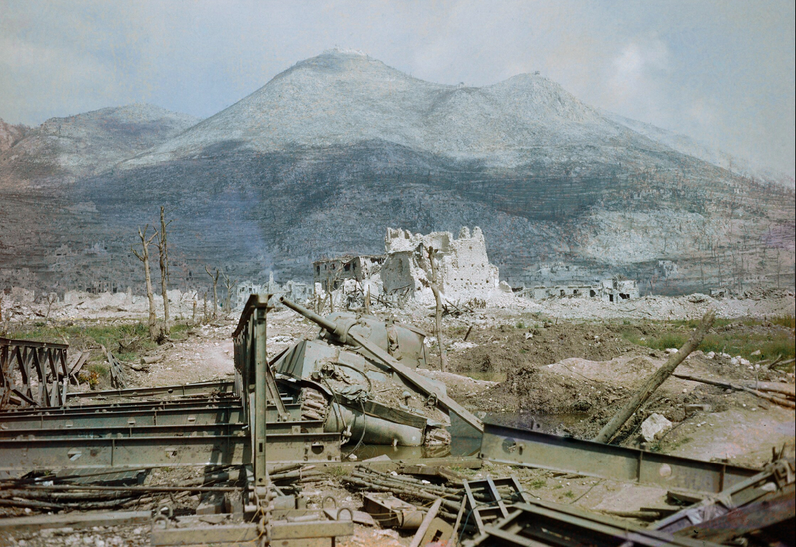
Notes:
As can be seen in the foreground of this image there was no rest for the Sappers. All of the bridges had to be repaired, maintained and improved. They were also, of course much in demand elsewhere. Whilst this talk is about the Amazon bridge it is only fair to mention the remarkable achievements of the Polish Sappers who amongst other things covertly made two almost collapsed paths up the mountainside wide enough to take tanks.

Slide 27
Medal Recipients
Rank | Surname | Forename | Award | Unit
Sergeant | Clark | Frank | DCM | 7 Fd Coy
Temp. Lt. Colonel | Nelson | John Edward Toole | DSO | CRE 4 Div
Lieutenant | Boston | Peter Shakerley | MC | 59 Fd Coy
Temp. Major | Daniell | Anthony Piers de Tabley | MC | 59 Fd Coy
Temp. Major | Gabbett MBE | Robert Edward | MC | 225 Fd Coy
Lieutenant | Hobson | Albert | MC | 7 Fd Coy
Lieutenant | Kraly | Henry Ivan Joseph | MC | 578 Fd Coy
Temp. Major | Low | Robert Carmichael Stuart | MC | 7 Fd Coy
Lieutenant | Severn | Kenneth | MC | 225 Fd Coy
Sapper | Cox | George | MM | 10 Mech Eqpt Sect
Corporal | Norton | Alfred Dennis | MM | 225 Fd Coy
Sergeant | Parry | Arthur | MM | 59 Fd Coy
Sergeant | Riordan | Thomas Mortimer John | MM | 7 Fd Coy
Sergeant Clark was killed in action on 9 Nov 1944
Sergeant Parry was killed in action on 9 Jun 1944
Corporal Norton died of wounds 25 May 1944
Notes:
The efforts of the engineers did not go unrewarded. This table shows the medals awarded to the officers and men of the three companies. Three were later killed in action in Italy. I’m conscious of the fact that some of you may not have seen a medal citation, this is for
Sergeant Clark DCM from Chippenham, Wiltshire was killed in action on 9 Nov 1944. Sergeant Parry MM from Rhymney, Monmouthshire was killed in action on 9 Jun 1944 and Corporal Norton MM from Newington, Kent died of wounds 25 May 1944

Slide 28
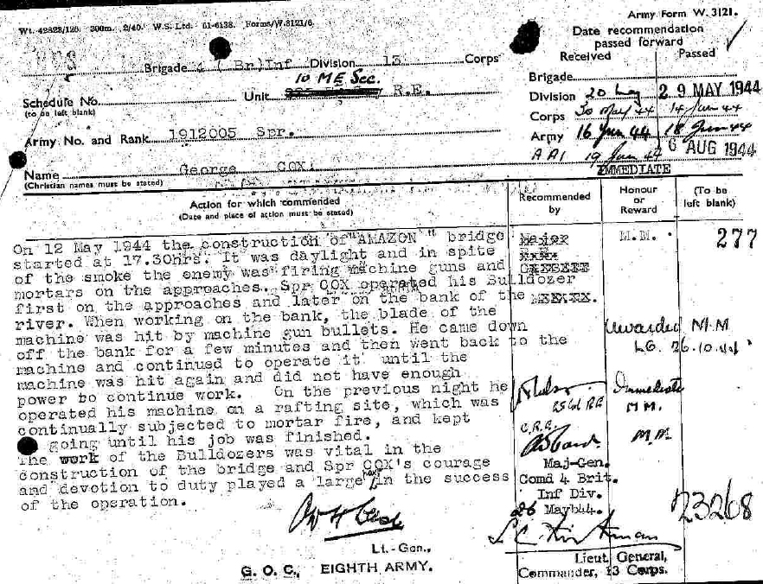
Notes:
Sapper George Cox the D4 operator, one of 25 dozer operators to be awarded the MM in Italy. The campaign on the Italian mainland was a Sappers war with a continuum of clearing mines, repairing tracks, building mainly Bailey bridges, clearing mines, taking down Bailey bridges, building Bailey bridges and so on. It is, therefore not surprising that in 1970

Slide 29
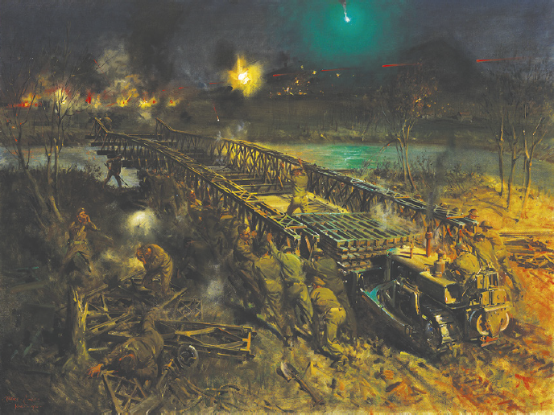
Notes:
the officers of the Corps commissioned Terence Cuneo to portray the Amazon bridge in recognition of this. Terence Cuneo was a war service Sapper who had incidentally been stationed at the SME Ripon as the Bailey bridge was being introduced into service. The story of how the Corps supported Cuneo in the creation of the painting can be found in the April issue of the REJ. Standing on the bridge is Lt Peter Boston and on the nose, although in reality lying down is Sgt Arthur Parry. It’s highly probable that the D4 operator is Sapper George Cox. Thank you all for your attention.

